Slide 1
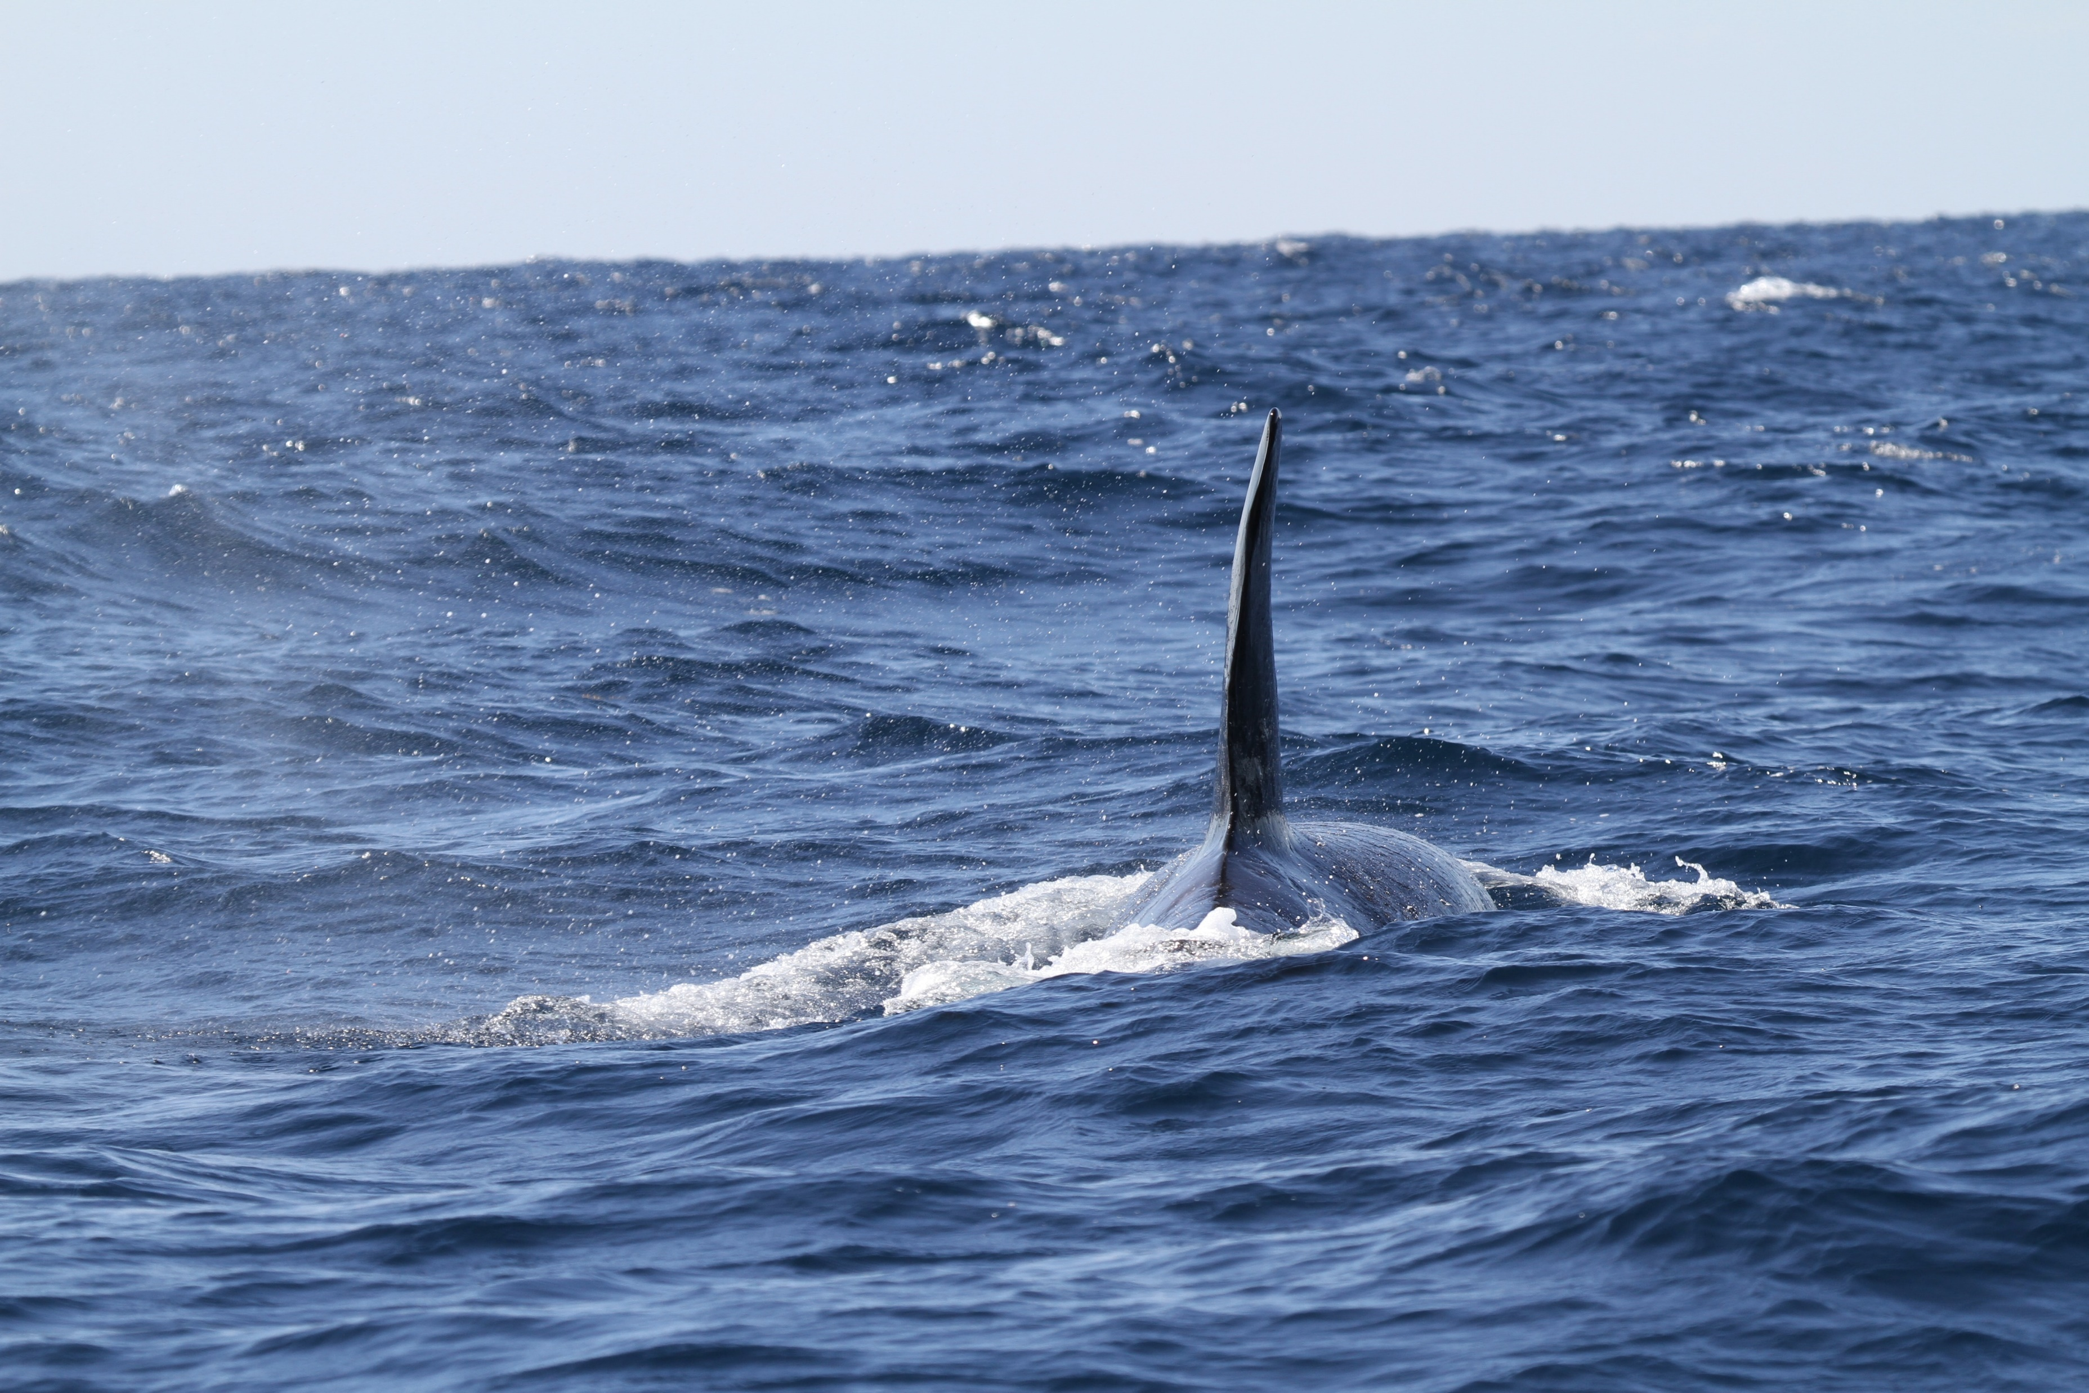
Conservation Status pledges
Preliminary analysis – Atlantic and Macaronesian regions Paul Goriup
NatureBureau
Natura 2000 Biogeographical Process in the Marine Regions

Slide 2
Natura 2000 Biogeographical Process in the Marine Regions
Preliminary analysis
Pledges received
Analysis methods
Summary of results

Slide 3
Natura 2000 Biogeographical Process in the Marine Regions
Member states and marine regions
Member State | Atlantic | Macaronesian | Baltic | Mediterranean
Belgium | X
Denmark | X |  | X
France | X |  |  | X
Germany | X |  | X
Ireland | X
Netherlands | X
Portugal | X | X
Spain | X | X |  | X
Sweden | X |  | X

Slide 4
Natura 2000 Biogeographical Process in the Marine Regions
Member states – conservation status pledges received*
Member State | Atlantic |  | Macaronesian
 | HD | BD | HD | BD
Denmark |  | ✓
Germany | ✓ | ✓
Spain | ✓ | ✓ | ✓ | ✓
Sweden |  | ✓
*Member States are still updating their pledges

Slide 5
Natura 2000 Biogeographical Process in the Marine Regions
Analysis – habitats and species
Only preliminary results as Member States are still updating their pledges
Compare pledges and targets with current conservation status

Slide 6
Natura 2000 Biogeographical Process in the Marine Regions
Analysis – habitats and species
Determine relevant marine habitats and species
for member state…
…by biogeographical region

Slide 7
Natura 2000 Biogeographical Process in the Marine Regions
Analysis – habitats and species
Determine current conservation status* of each feature
FV – favourable
XX – unknown
U1 – unfavourable, inadequate
U2 – unfavourable, bad
*Overall assessment status

Slide 8
Natura 2000 Biogeographical Process in the Marine Regions
Analysis – habitats and species
Pledges and targets for each feature
30% – status improvement target
non-det – non-detriment target
UNKN – target to address unknowns
Unlikely – non-detriment target unlikely to be achieved
N – no target specified
See Annex 2 of background document for full tables

Slide 9
Natura 2000 Biogeographical Process in the Marine Regions
Analysis – birds
Only preliminary results as Member States are still updating their pledges
As for habitats and species
additional step to assess bird species that are largely marine
pledges and status assessments not made by biogeographical region

Slide 10
Natura 2000 Biogeographical Process in the Marine Regions
Analysis – birds
Determine bird species
for Member States
identify which are largely marine in nature

Slide 11
Natura 2000 Biogeographical Process in the Marine Regions
Analysis – birds
Determine current conservation status* of each species
D – Decreasing I – Increasing
S – Stable U – Uncertain
Unk – Unknown F – Fluctuating
Note: there may be more than one assessment for any bird species (e.g. if there are different breeding and wintering populations). Each assessment is counted as a separate datapoint
*Population trend

Slide 12
Natura 2000 Biogeographical Process in the Marine Regions
Analysis – birds
Pledges and targets for each feature
30% – status improvement target
non-det – non-detriment target
UNKN – target to address unknowns
Unlikely – non-detriment target unlikely to be achieved
N – no target specified
See Annex 2 of background document for full tables

Slide 13
Natura 2000 Biogeographical Process in the Marine Regions
Analysis – summary in Sankey charts
Habitats and species
Germany (MATL)
Spain (MATL and MMAC)

Slide 14
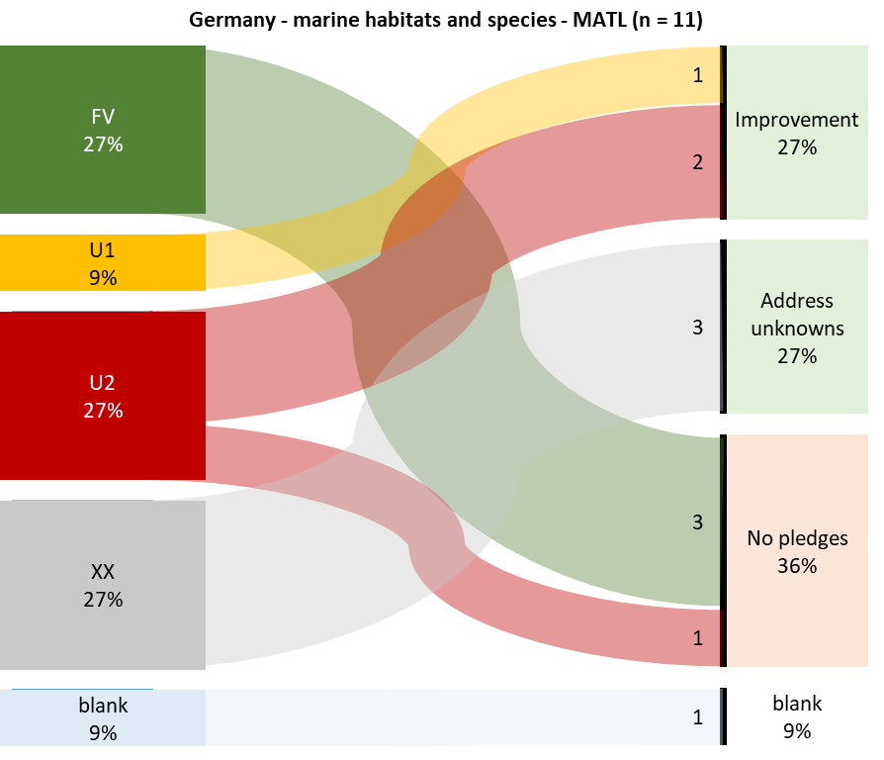
Natura 2000 Biogeographical Process in the Marine Regions
Germany (MATL) – marine habitats and species

Slide 15
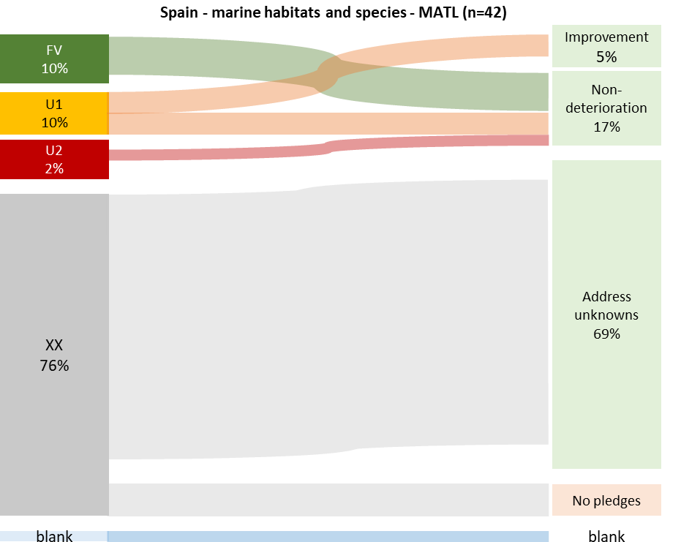
Natura 2000 Biogeographical Process in the Marine Regions
Spain (MATL) – marine habitats and species

Slide 16
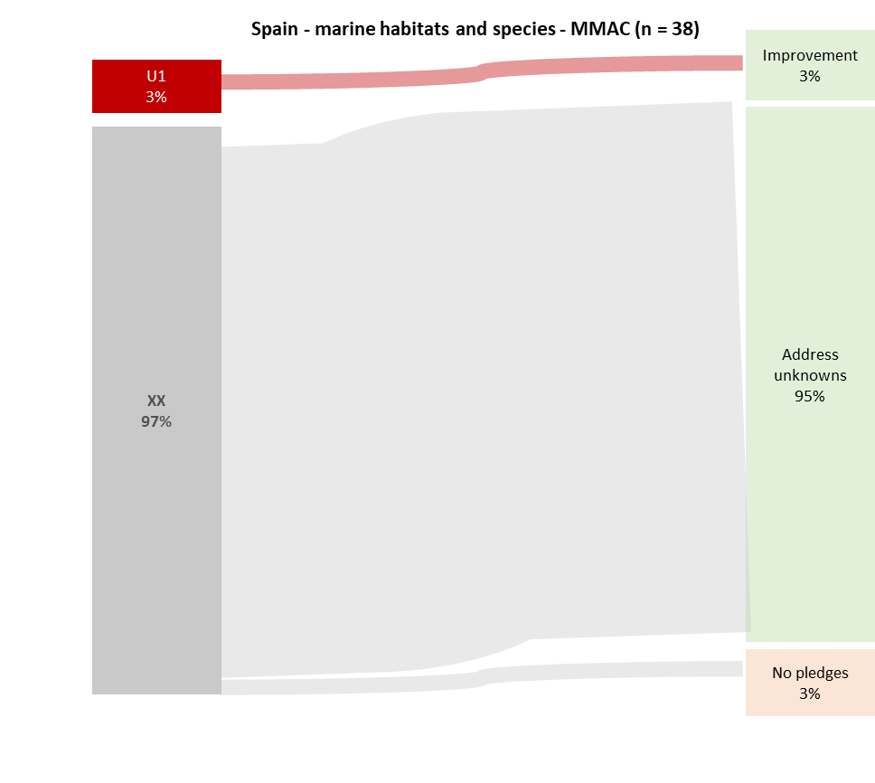
Natura 2000 Biogeographical Process in the Marine Regions
Spain (MMAC) – marine habitats and species

Slide 17
Natura 2000 Biogeographical Process in the Marine Regions
Analysis – summary charts
Birds
Denmark
Sweden
Germany
Spain (MATL and MMAC)

Slide 18
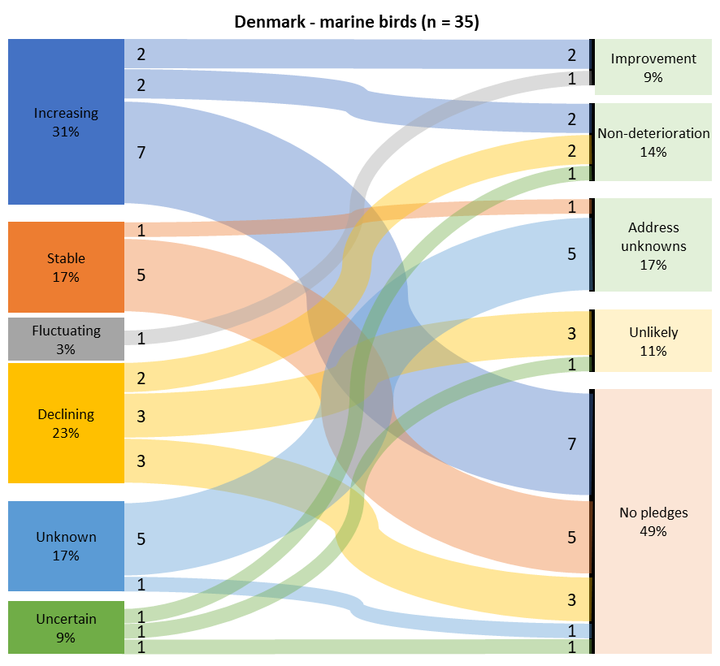
Natura 2000 Biogeographical Process in the Marine Regions
Denmark – marine birds

Slide 19
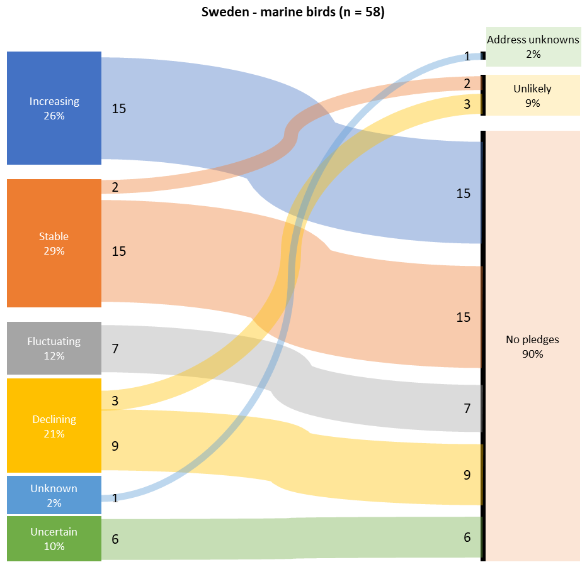
Natura 2000 Biogeographical Process in the Marine Regions
Sweden – marine birds

Slide 20
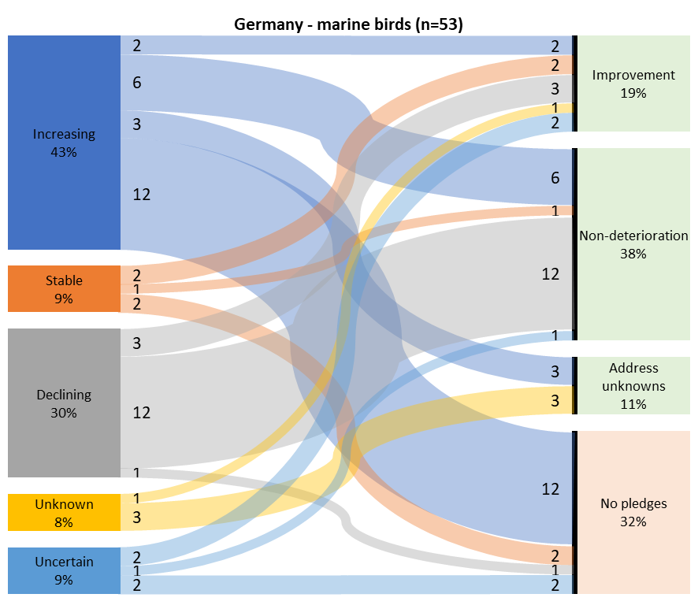
Natura 2000 Biogeographical Process in the Marine Regions
Germany – marine birds

Slide 21
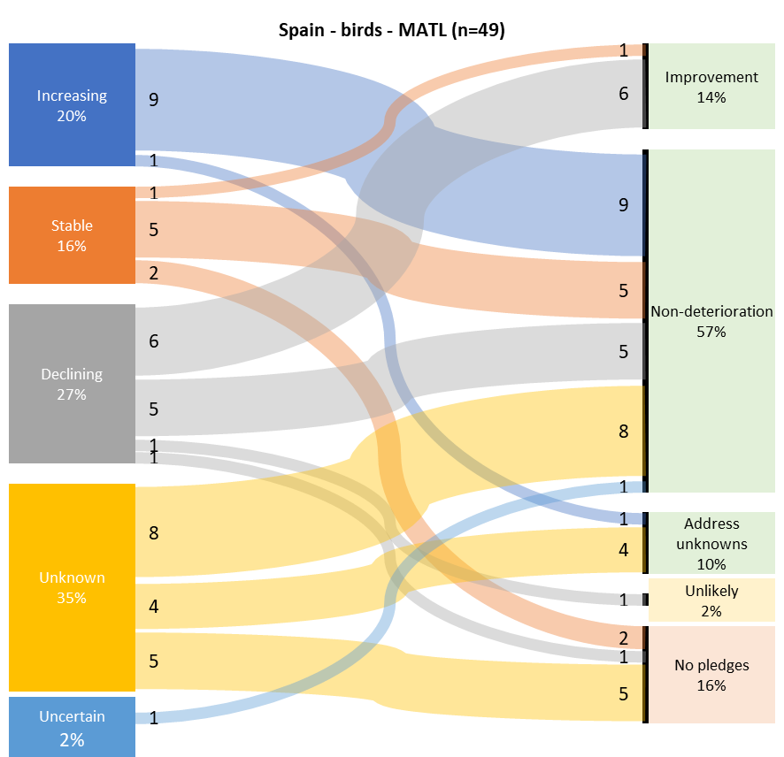
Natura 2000 Biogeographical Process in the Marine Regions
Spain (MATL) – marine birds

Slide 22
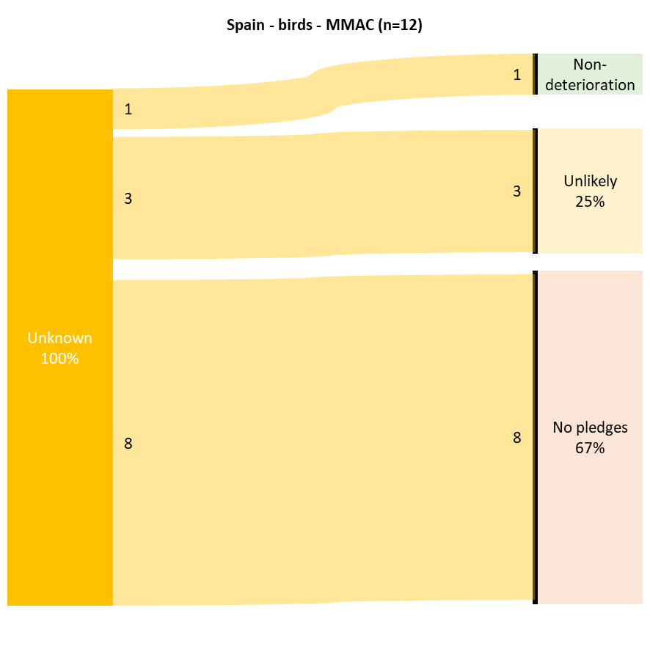
Natura 2000 Biogeographical Process in the Marine Regions
Spain (MMAC) – marine birds

Slide 23
Natura 2000 Biogeographical Process in the Marine Regions
Overview
Analysis only preliminary as MS continue to develop pledges
Aspects of CS targets (e.g. 30% improvement) must include terrestrial…
…can’t work out distance to target on marine alone
Analysis methods will develop as more pledges received…
…including biogeographical summary

Slide 24
Thank you! .
https://biogeoprocess.net/
https://twitter.com/MarineAreasBGP
Natura 2000 Biogeographical Process in the Marine Regions

