Slide 1
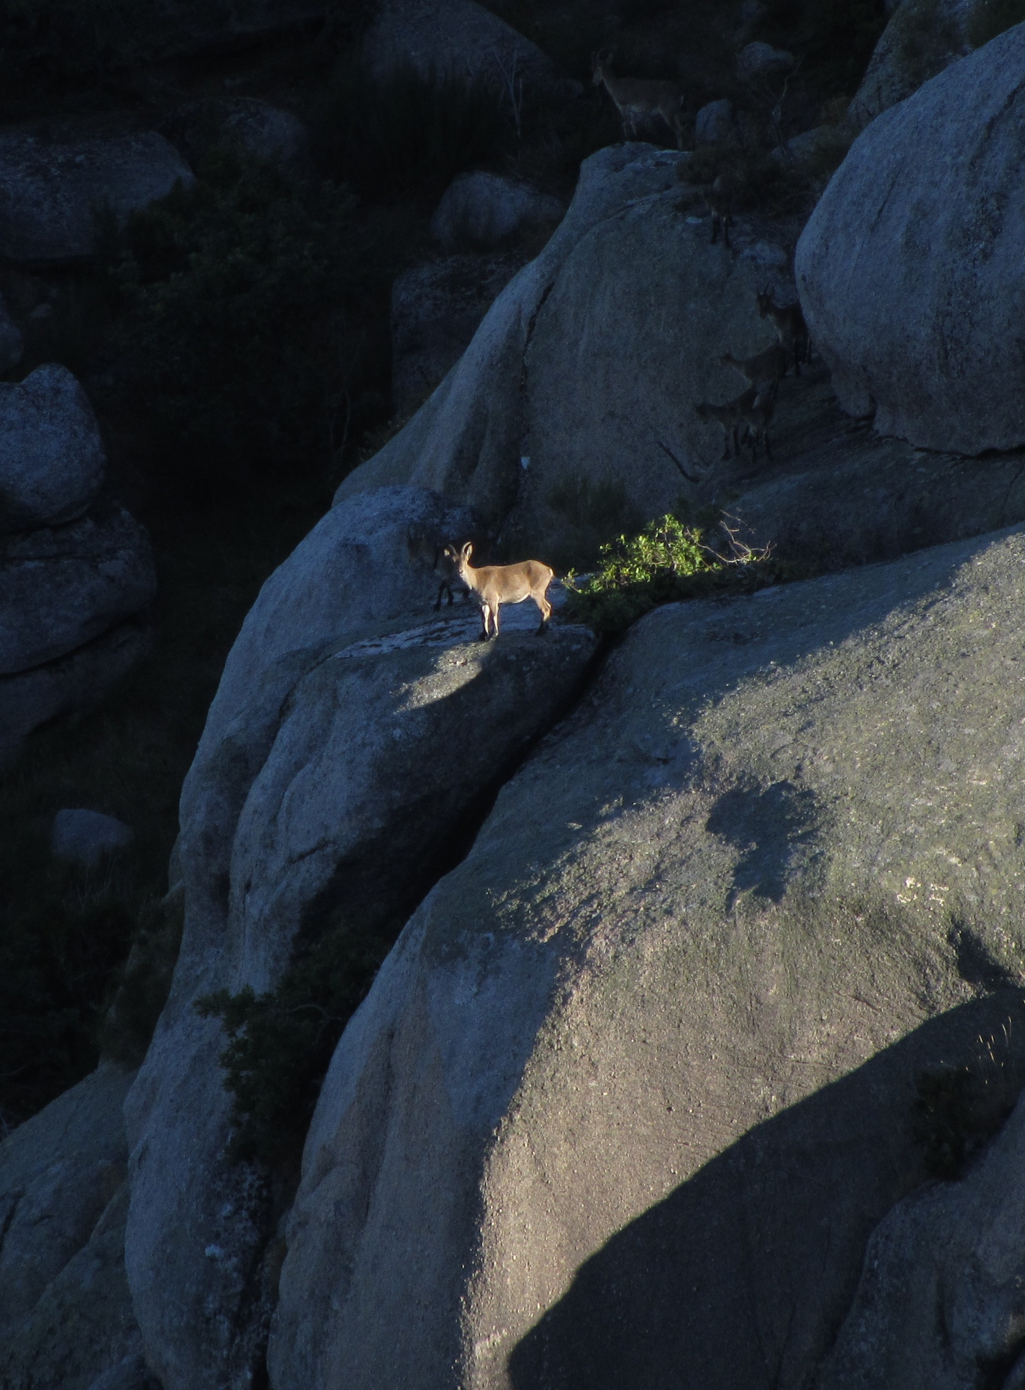
Strict protection: the new tool in EU biodiversity policies
Henrique M. Pereira
Nestor Fernandéz
iDiv / Martin Luther University Halle-Wittenberg, Germany
CIBIO-InBio, Biopolis / University of Porto, Portugal

Slide 2
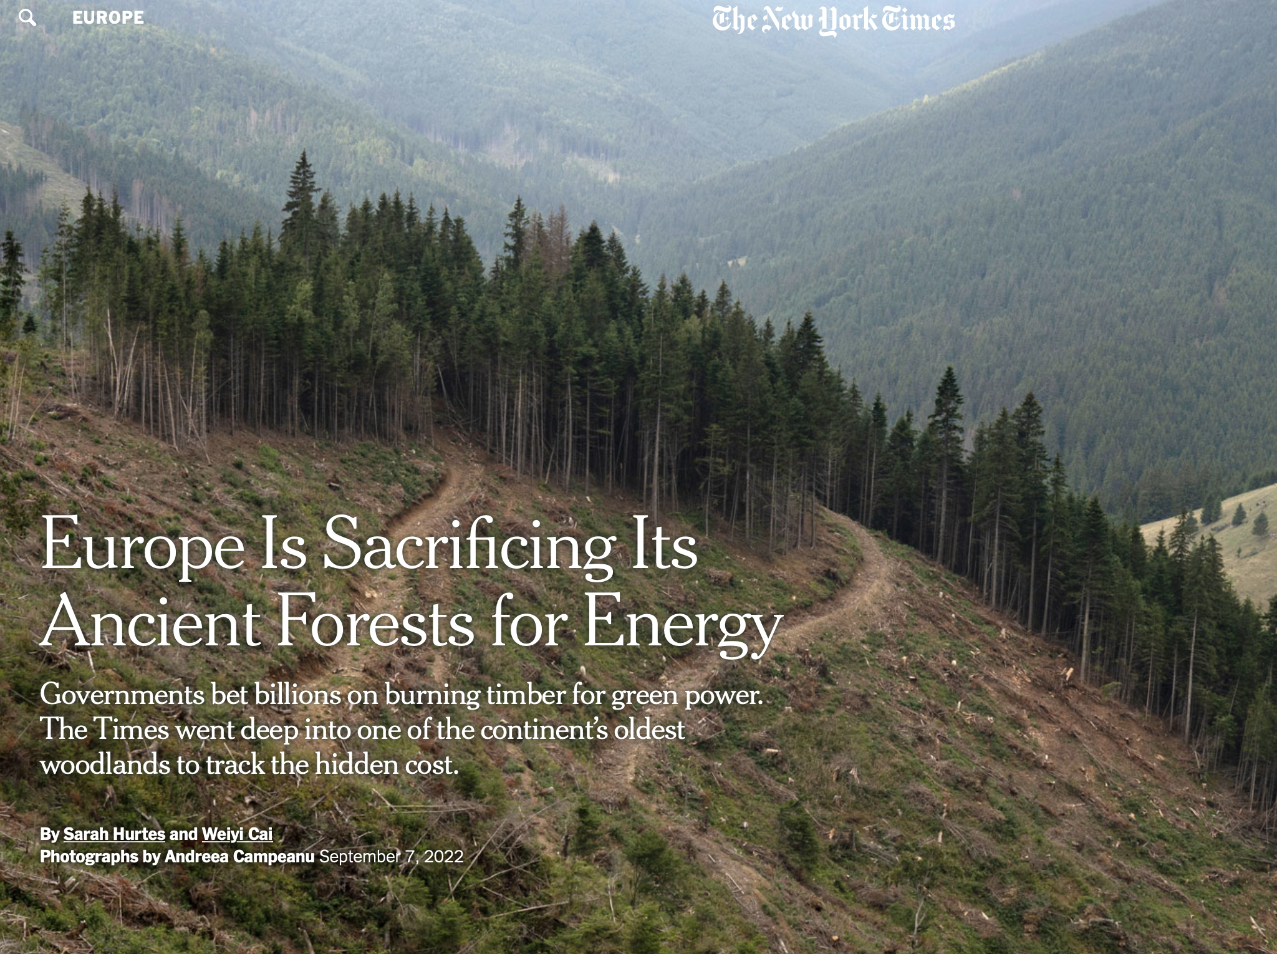
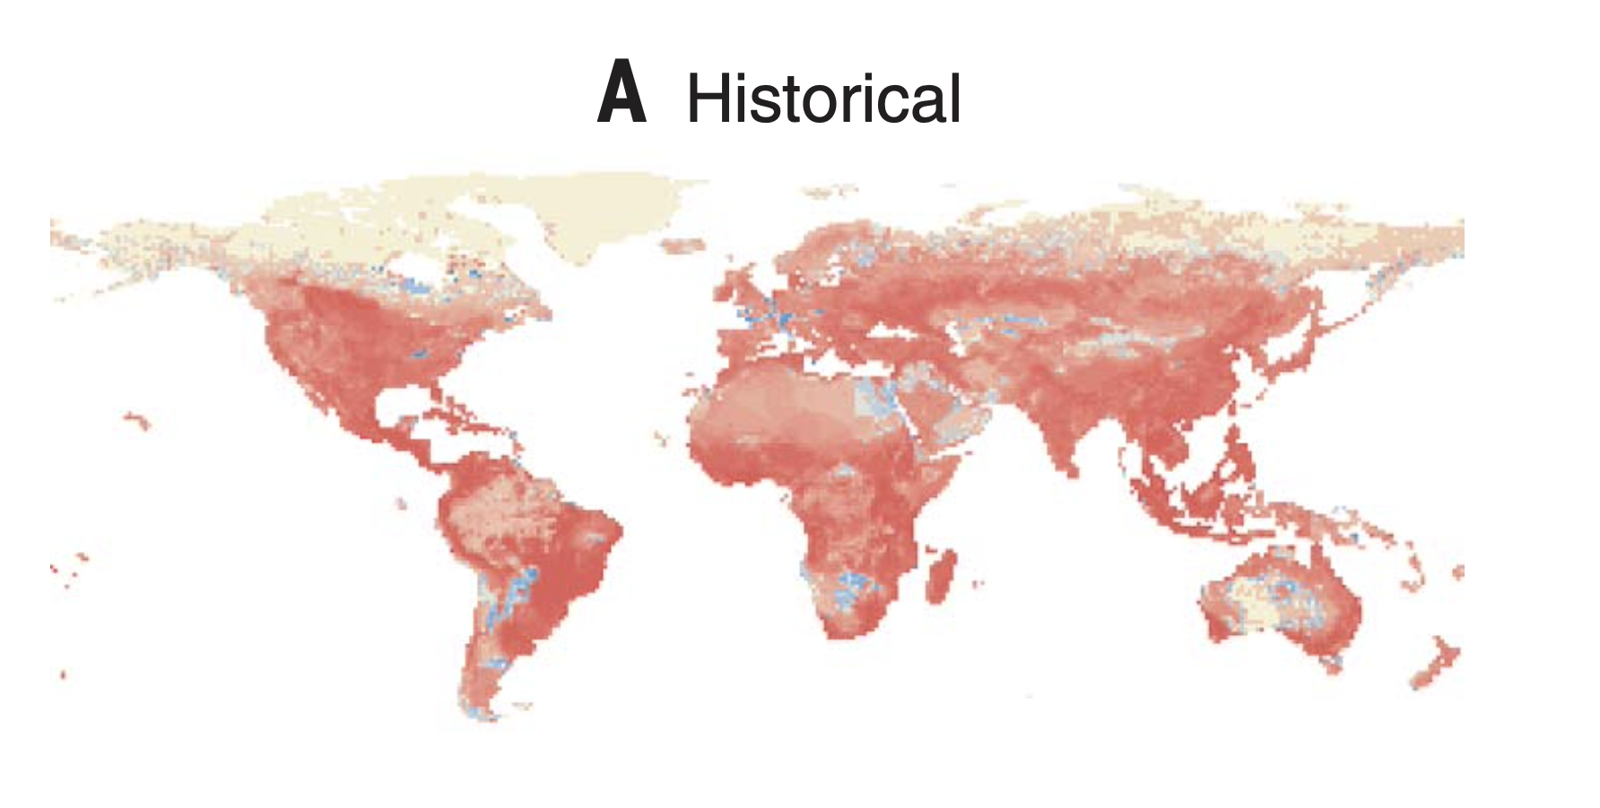
What is happening to biodiversity?
1900-2015
Pereira, H.M. et al (2024) Science

Slide 3
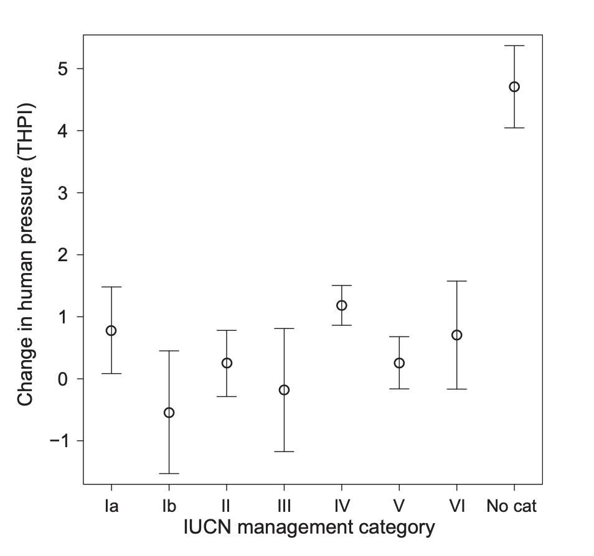
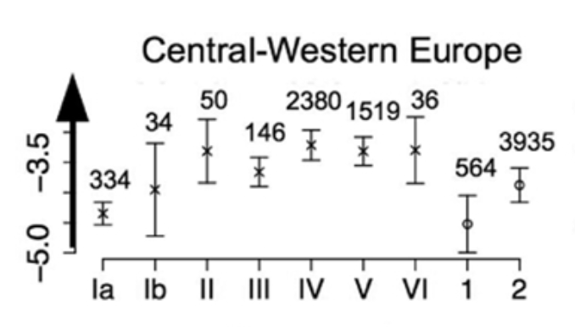
Strict protection is more effective
High forest loss
Low forest loss
Leberger et al (2020) Biol Con
Geldmann et al (2014) Con Bio

Slide 4
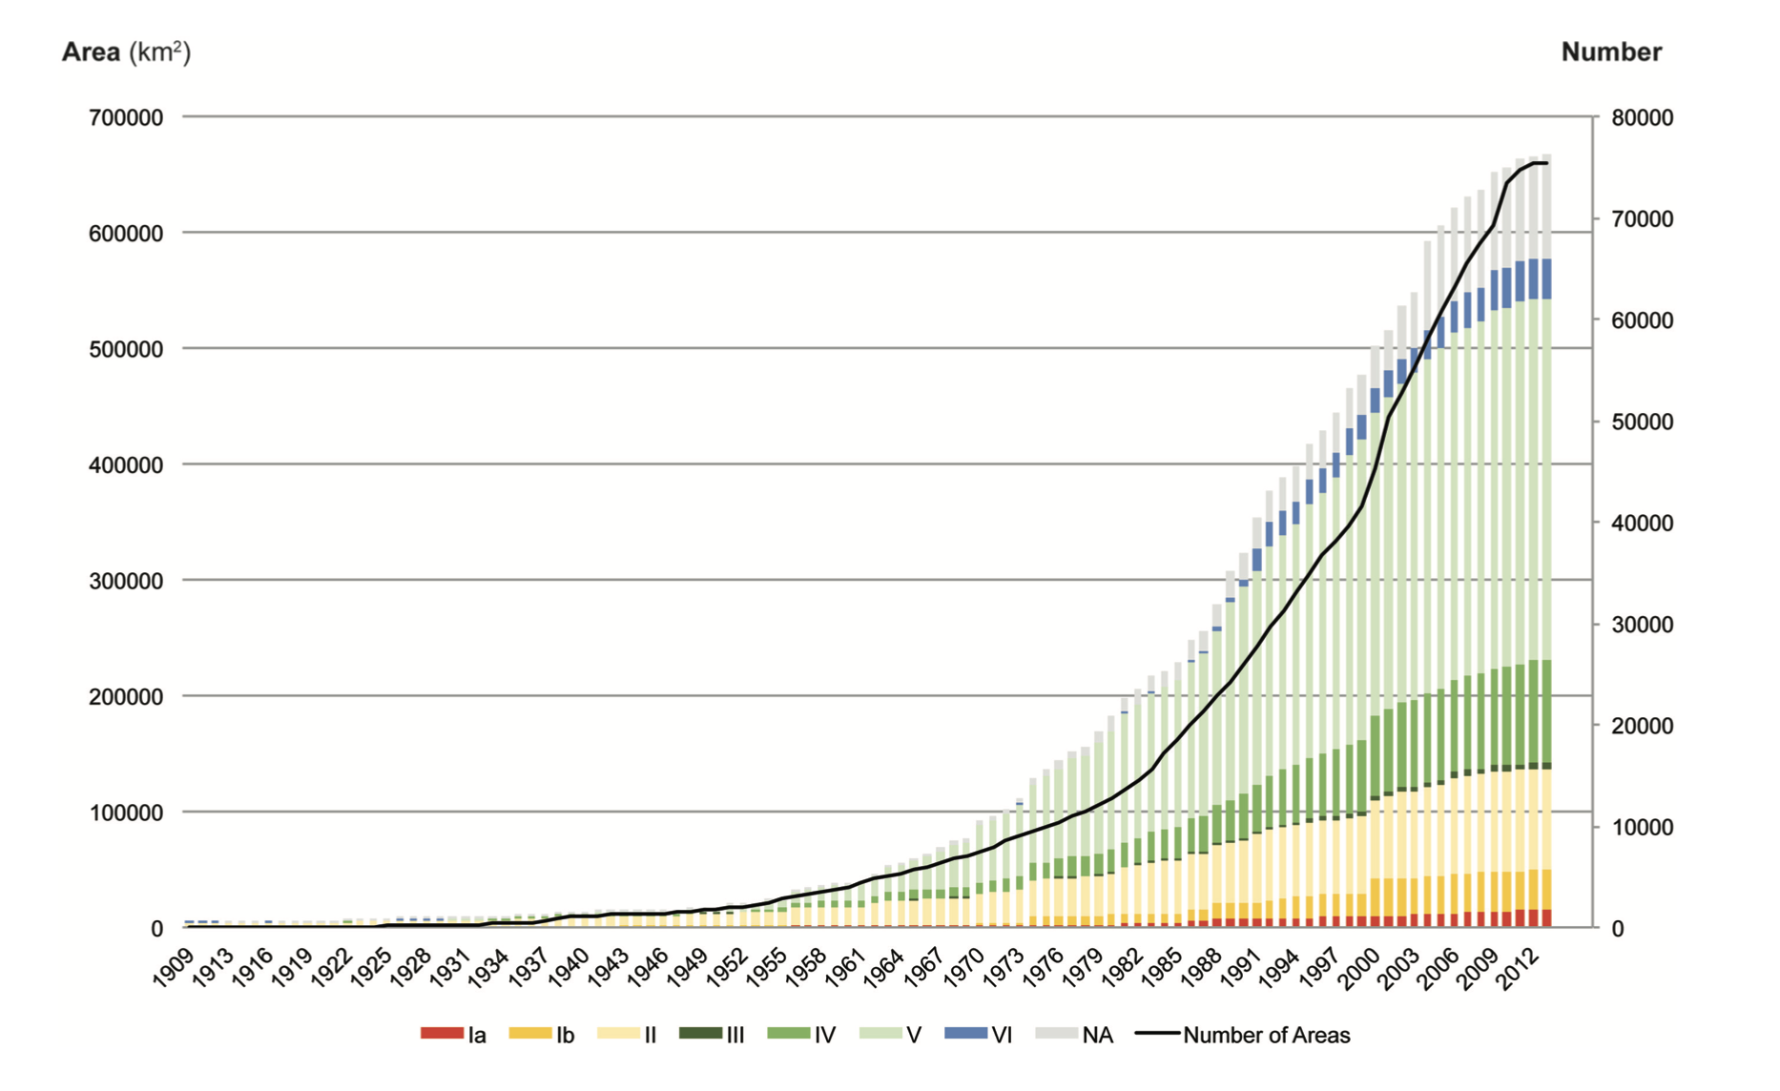
Strict protection has a long tradition in Europe, but was not a key concept in Natura 2000
Pereira et al (2024) Curr Bio
Pereira and Navarro (2015) Rewilding European Landscapes

Slide 5
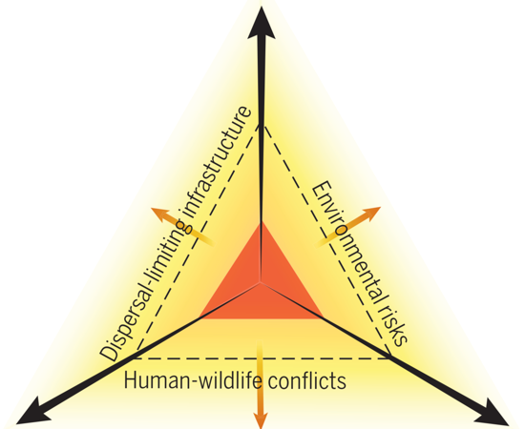
Ecological integrity and wildness as key concepts for strict protection
Dispersal
Wildness
Spatial redistribution processes
Trophic complexity
Stochastic disturbances
Torres, Fernández, … Pereira (2018) Phil Tran Royal Soc. B
Top-down / bottom-up interactions
Eco-evolutionary drivers
Perino, Pereira, et al (2019 Science
Notes:
How these maps are used

Slide 6
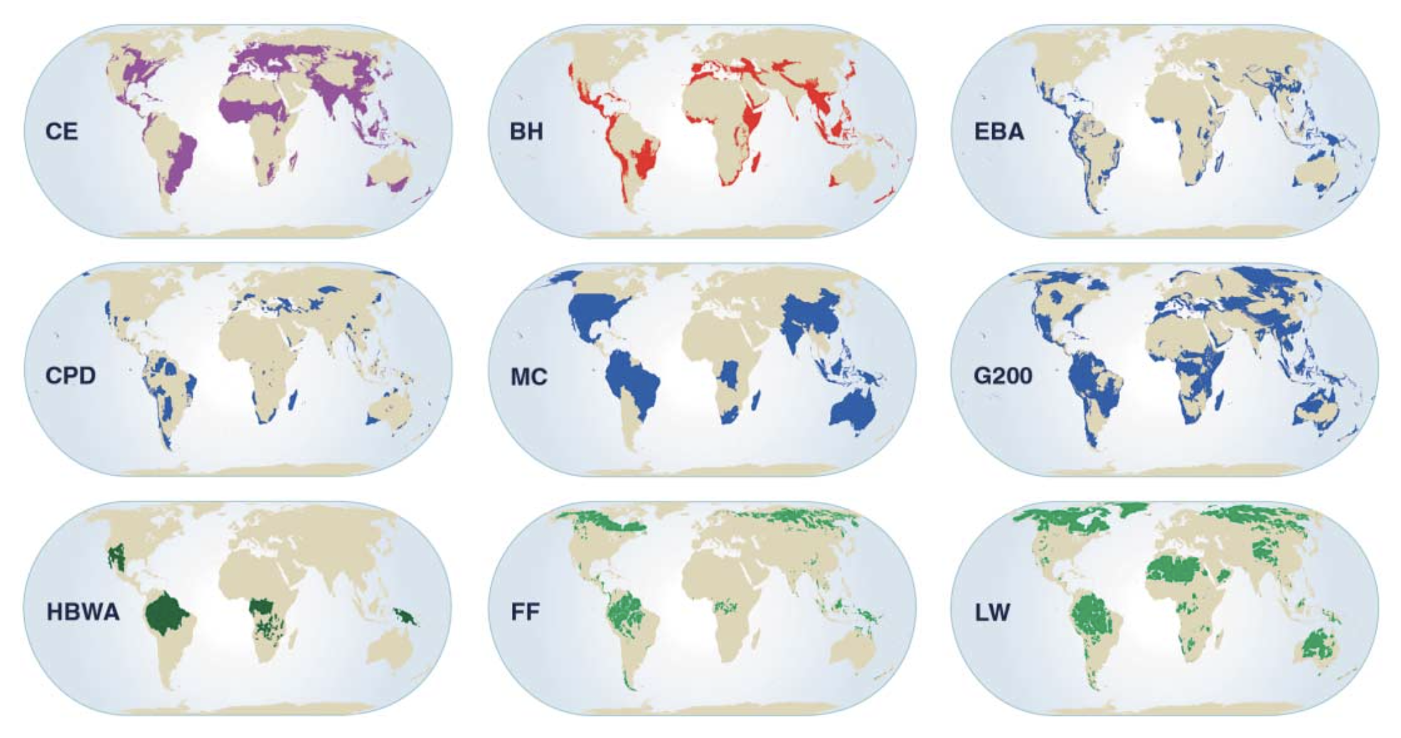
Protecting for ecological integrity may lead to different conservation priorities
Brooks et al (2006) Science

Slide 7
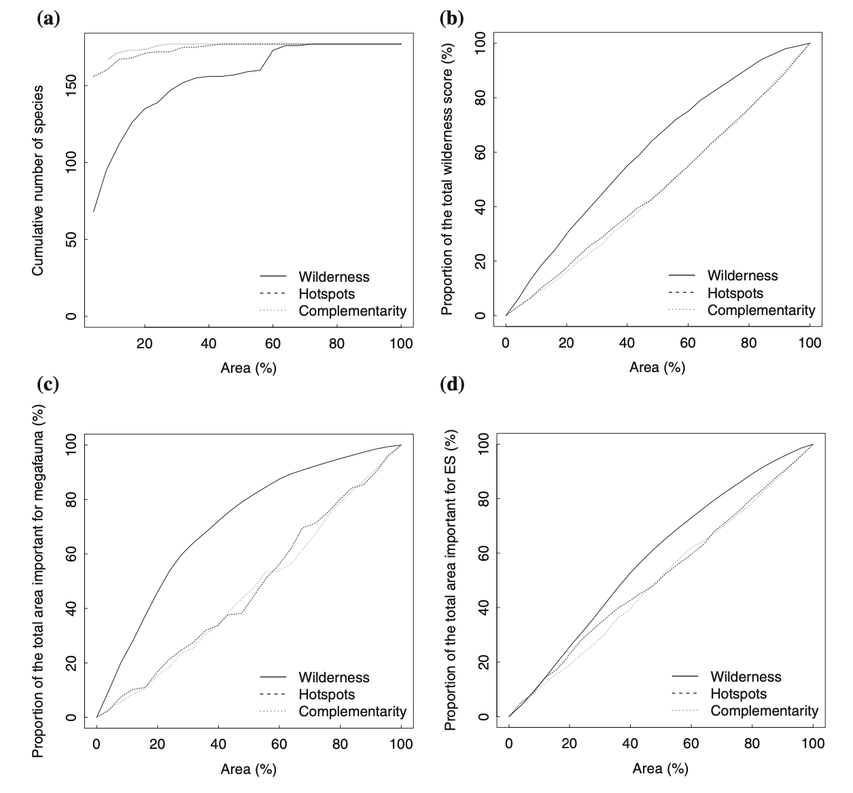
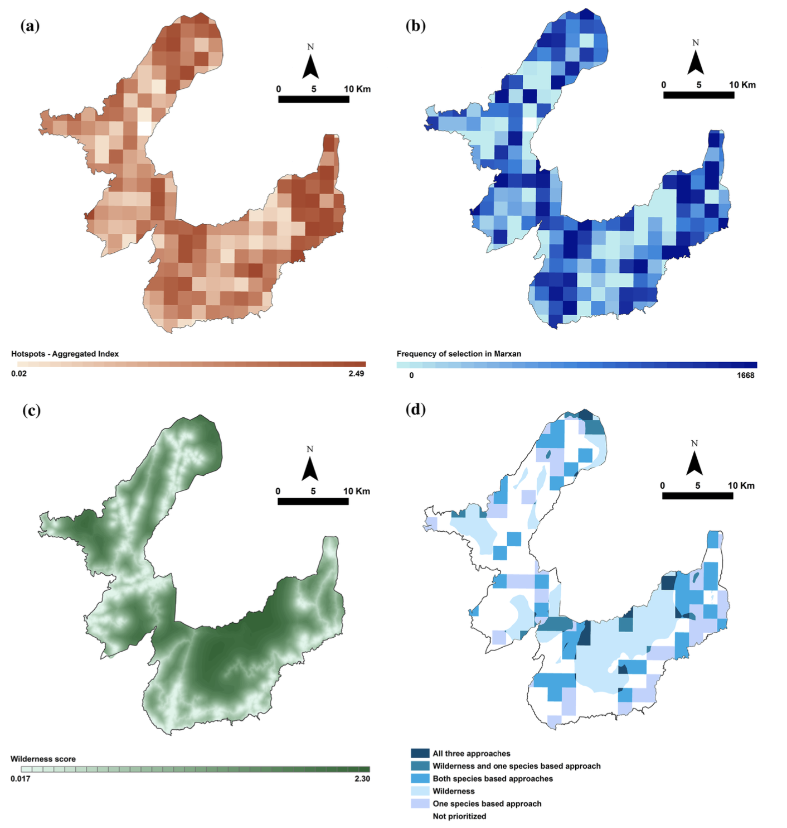
Protecting for high wildness can delivery multiple biodiversity and ecosystem service benefits
Ceausu et al (2015) Env Man

Slide 8
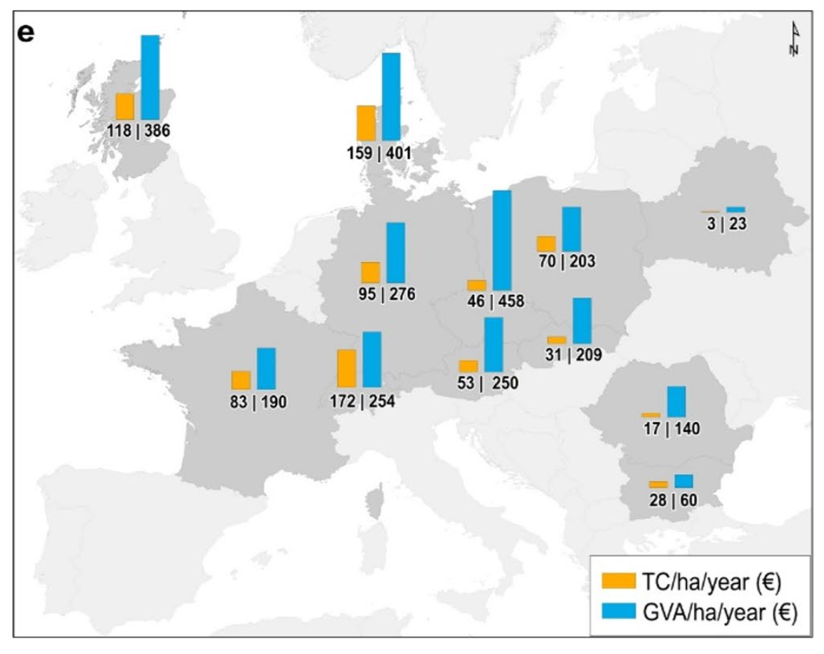
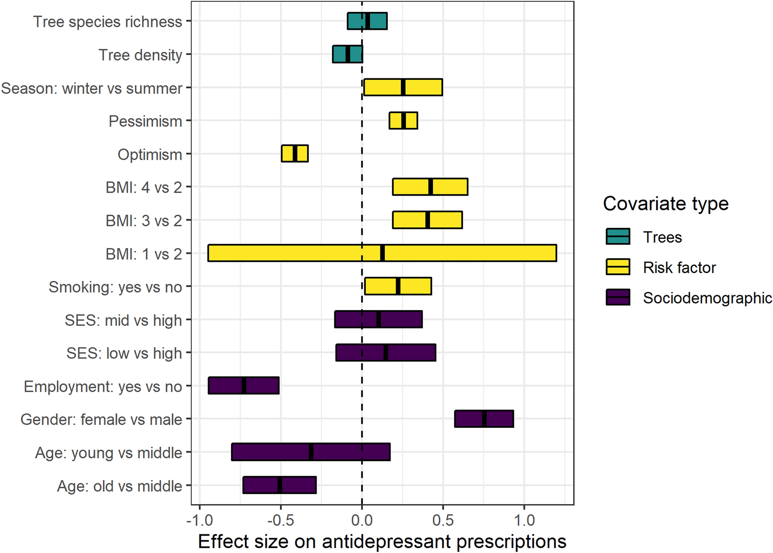
Strict protection brings mental health and recreation benefits
Recreation
Logging
Marselle et al (2020) Sci Rep
Giergiczny et al (in review)

Slide 9
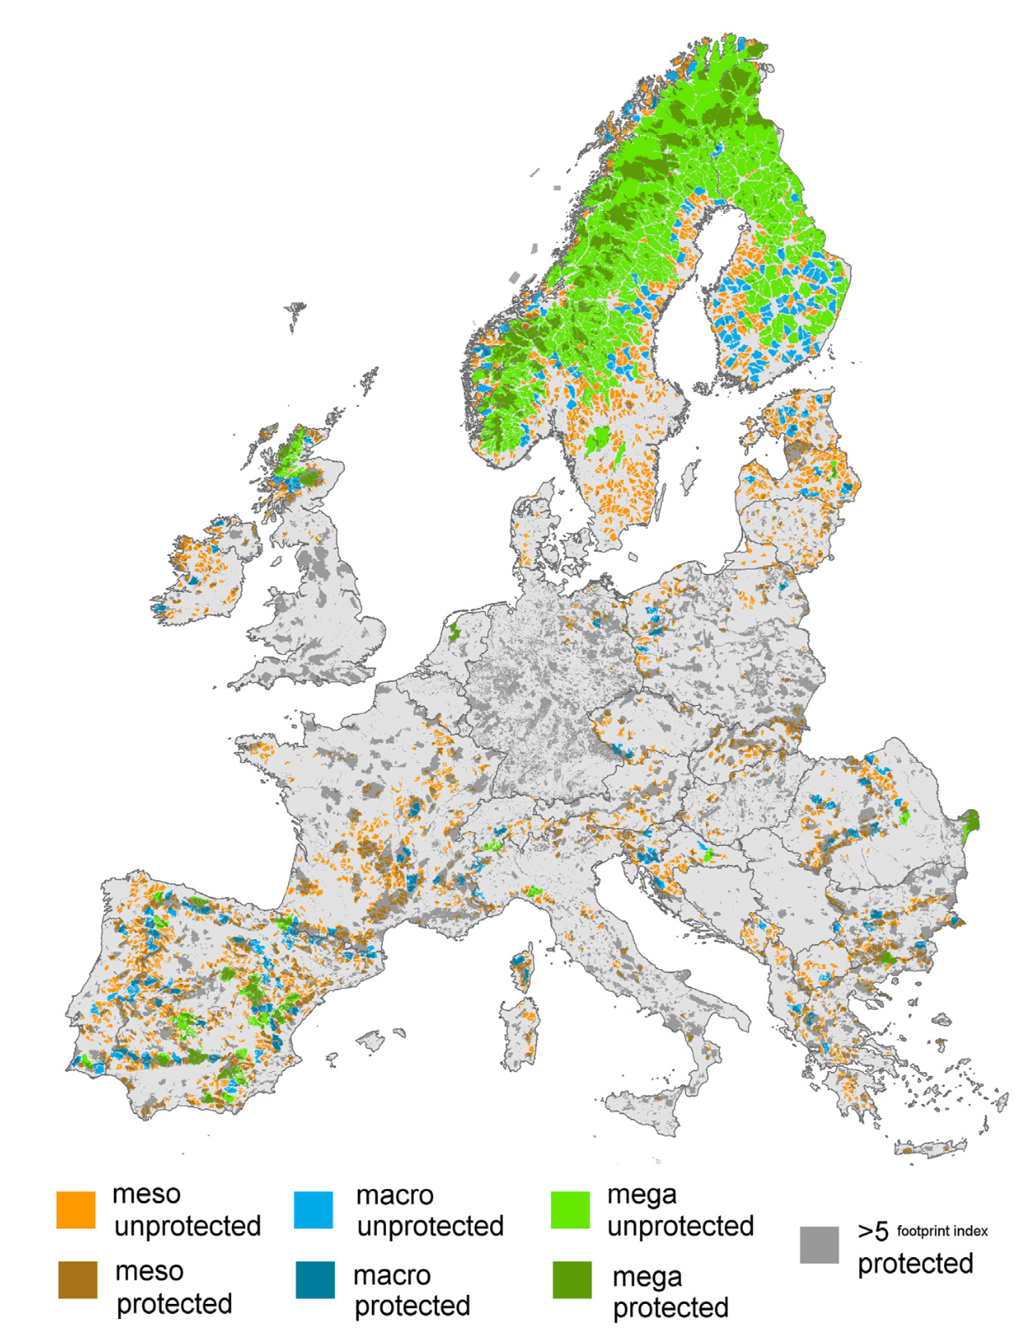
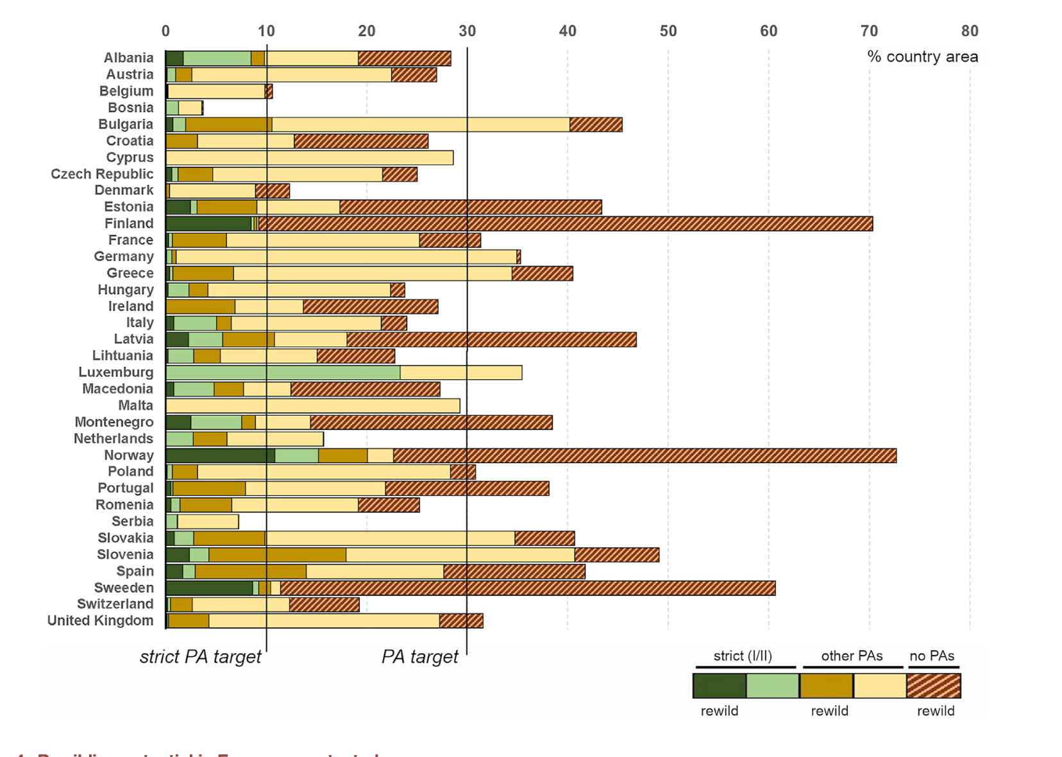
Rewilding can be an effective strategy to meet the strict protected area target
Araujo and Alagador (2024) Curr Bio

Slide 10
Opportunities for rewilding in farmland abandonment areas
Dissimilarity from
potential vegetation
Night light pollution
Road Access
Human harvest
Ceausu et al (2015) Con Bio

Slide 11
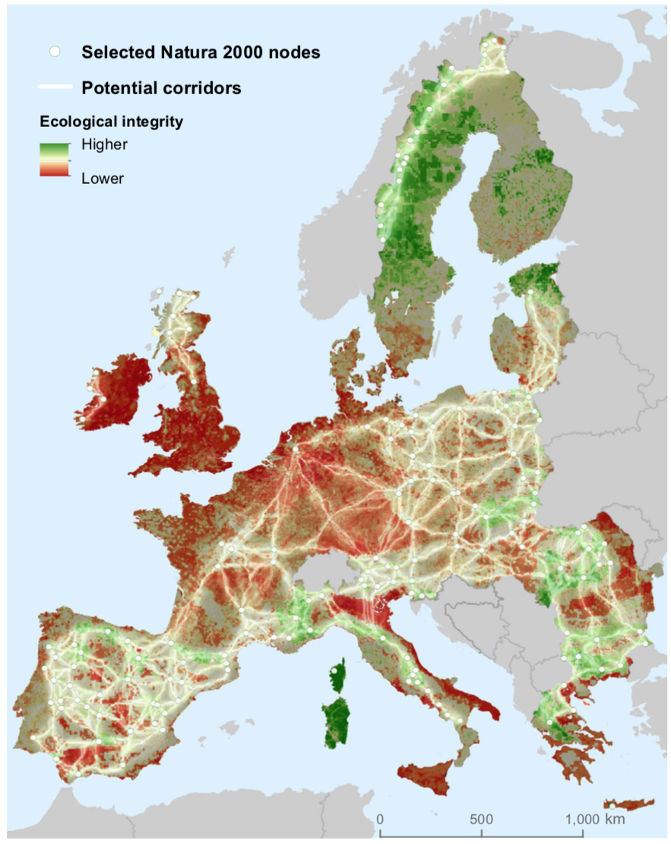
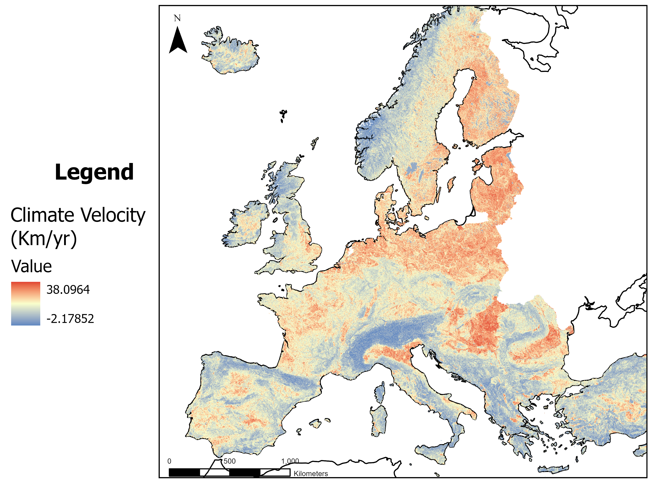
Connectivity of high ecological integrity areas for climate change adaptation
Fernandez et al (2019) Boosting Ecological Restoration for a Wilder Europe
Stark et al (in prep)

Slide 12
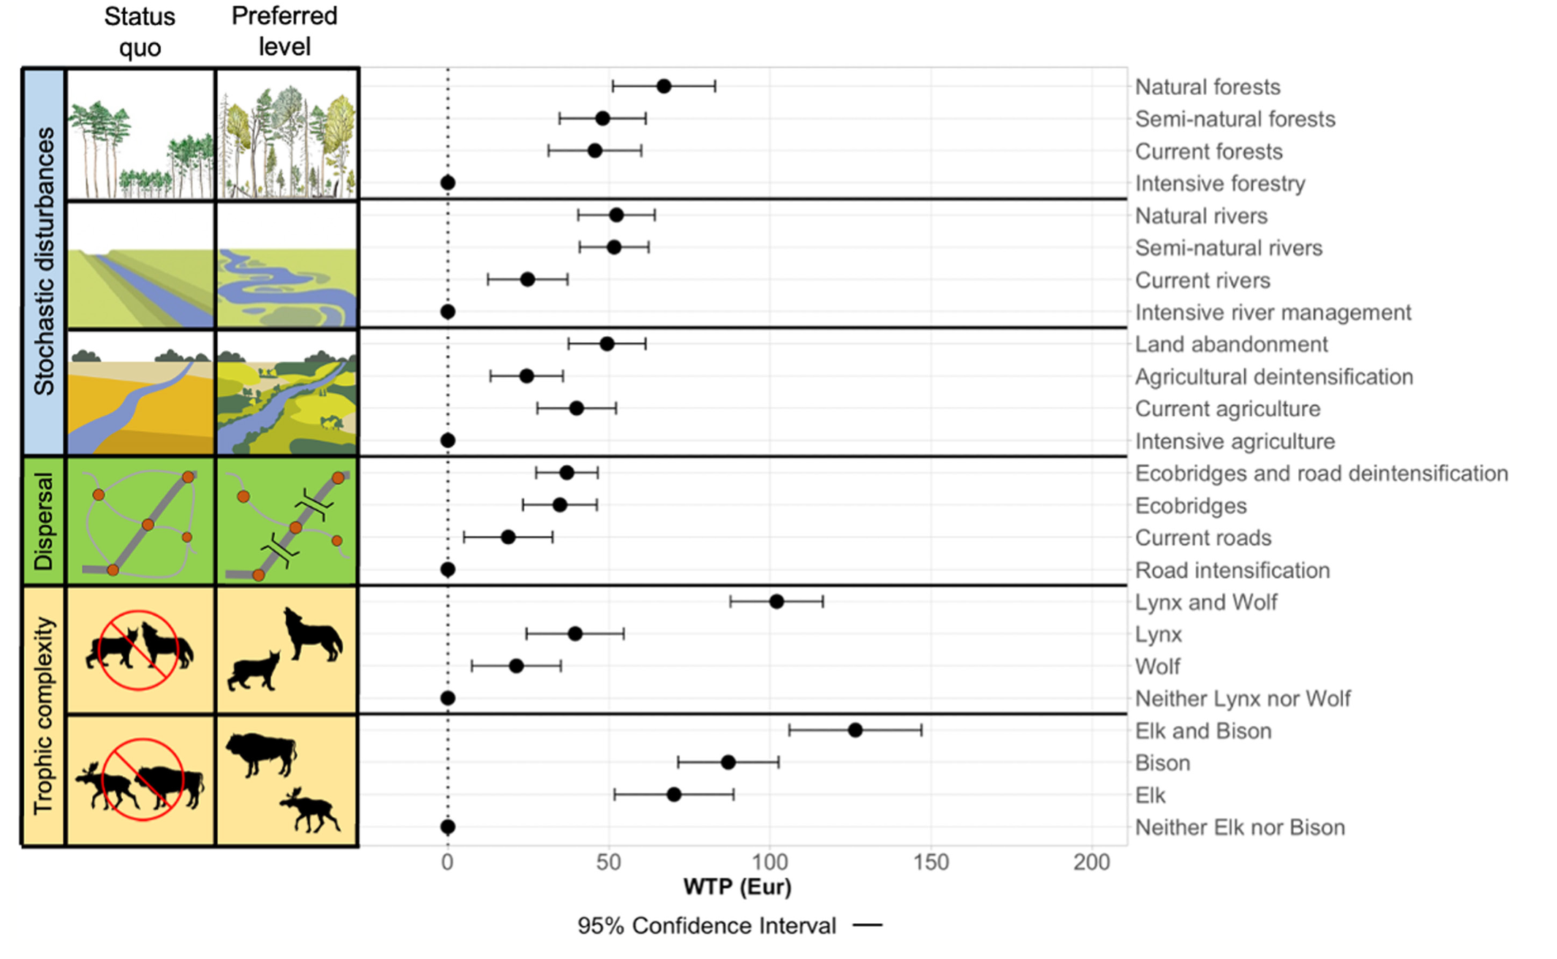
Public support for rewilding
Dunn-Capper… Pereira (2024) People and Nature

Slide 13
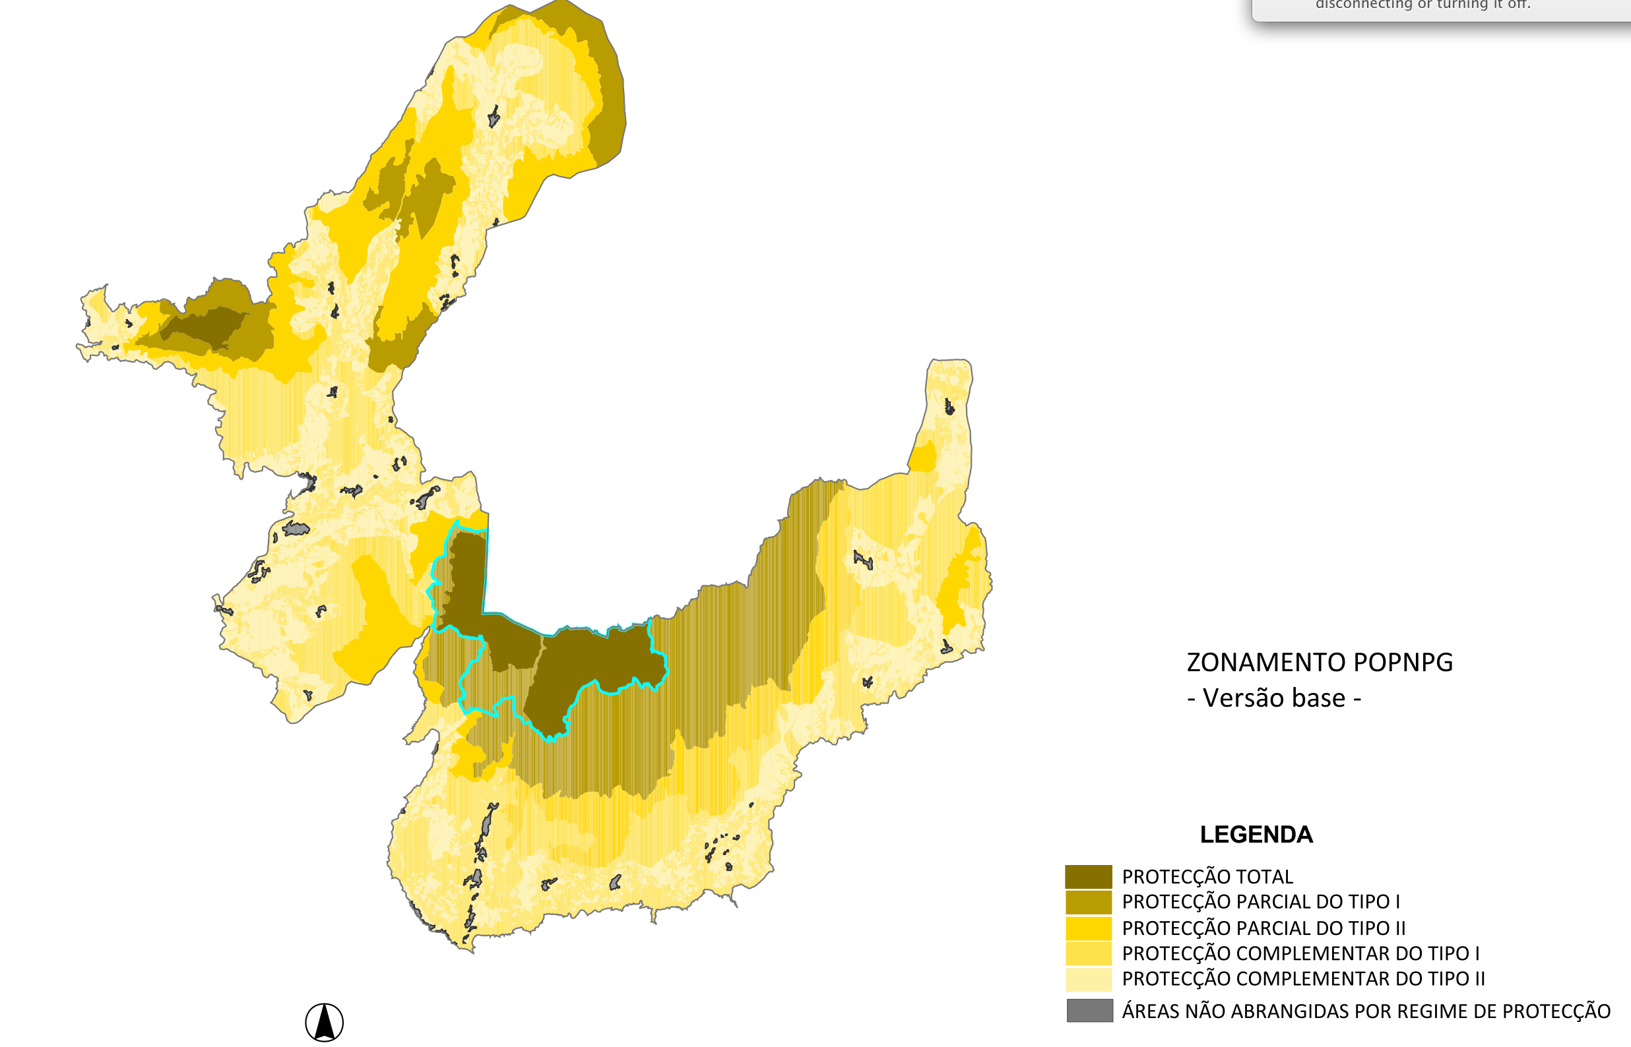
Not allowed
Requires permit
Allowed
Zoning is a key tool in protected area management:
typology activities + spatial planning + land tenure
 | Grazing | Motor vehicles | Hiking | Hunting | Timber harvest | Infra-structure | Agriculture | Building
ZPT
ZPP1
ZPP2
ZPC1
ZPC2
Strict
protection
Buffer area
ICNF (2009) Proposta de plano de ordenamento do PNPG.

