Slide 1
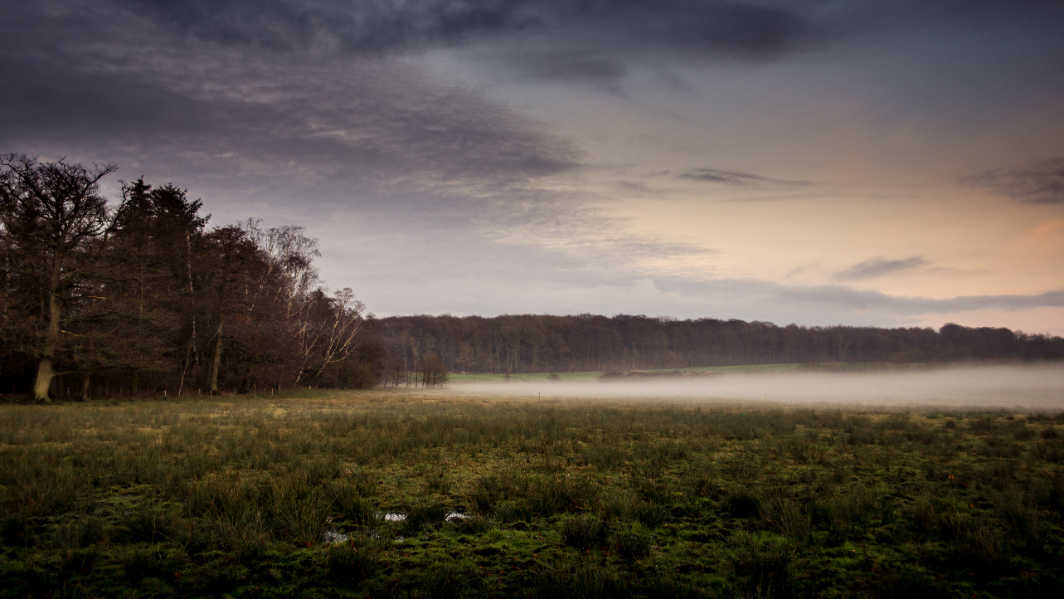
MINISTRY OF GREEN TRANSITION MINISTRY OF ENVIRONMENT AND GENDER EQUALITY
Danish reflections on strictly protected nature on land

Slide 2
Green agreement between the government and organisations
Green agreement from 24 June 2024 between
Danish Government (the Social Democratic Party, the Liberal Party, and the Moderates)
Danish Agriculture and Food Council
The Danish Society for Nature Conservation
The Danish Food and Allied Workers’ Union ( NNF)
The Danish Metal Workers Union,
Confederation of Danish Industry
KL - Local Government Denmark.
Political negotiations between the government and the Danish Parliament
The agreement presents:
Model for a greenhouse gas tax on agricultural production, and efforts to improve nature, biodiversity and water.
The initiatives must contribute to:
Achieving climate targets (reducing Co2)
Implementing the water framework directive
Contribute to the EU target of 30 % protected area

Slide 3
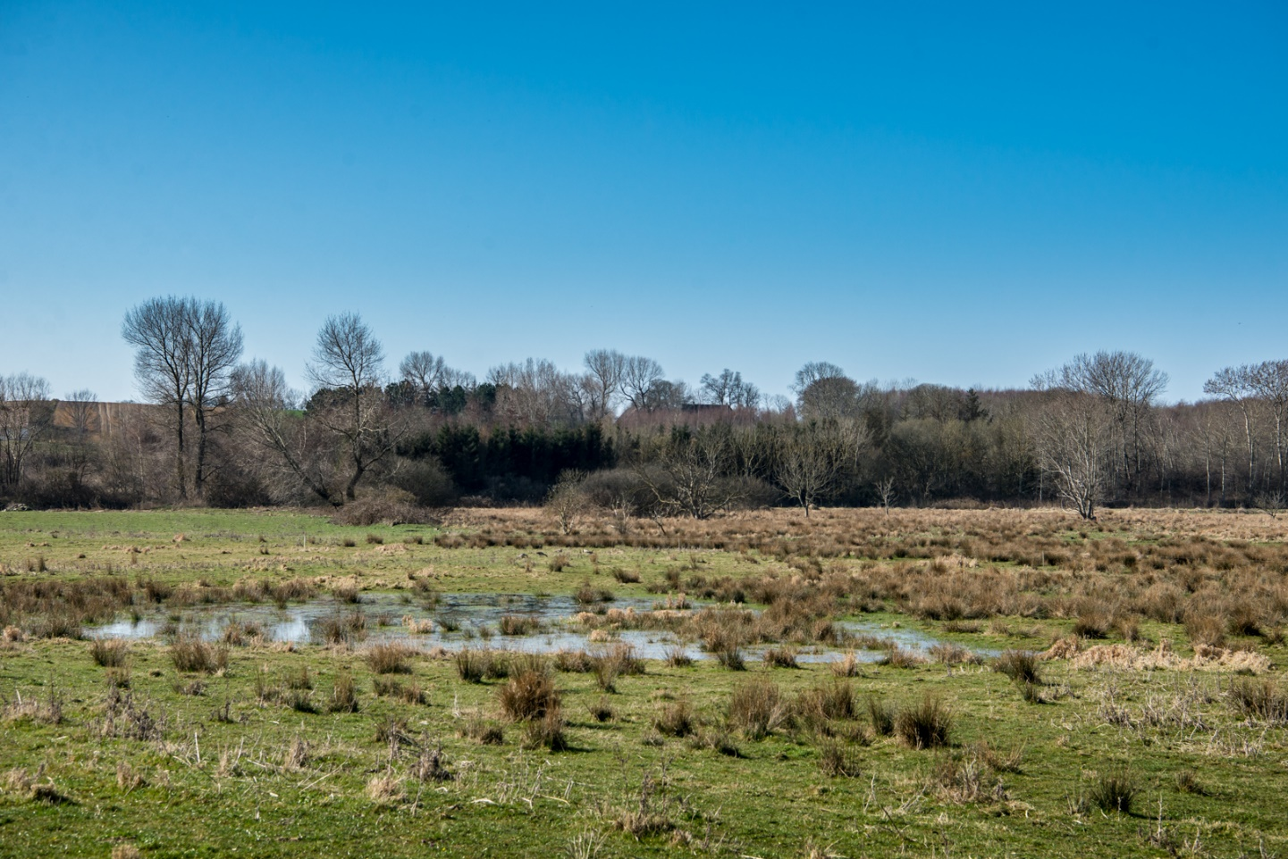
The agreement will set-aside agricultural areas into forest and nature
The agreement contains:
A Green Area Fund, which will set-aside 15 % of existing agricultural areas (approx. 400.000 hectares) to forest and nature:
250.000 ha afforestation (an expansion of forest area by 40 %)Of these 100.000 ha must become set-aside forests
140.000 hectares drained peatlands in agricultural use and their buffer zones must be rewetted
Furthermore the government will work on permanent extensification also on agricultural land
Ministry of Green Transition and Ministry of Environment and Gender Equality

Slide 4
The agreement will contribute to improvement of nature and biodiversity
A new law that will contribute to the biodiversity strategy's goals for protected areas
The government must present a law on nature and biodiversity.
The law will define different types of areal protection and set targets on at least 20 % protected areas on land. (DK has today 14,8 %).
Denmark will have 31.7 protected and 10 per cent strictly protected areas at sea by 2030
Improvement in the conditions of nature
In Denmark, the main obstacles in achieving a good state of nature are nitrogen emissions and too small and fragmented nature areas.
The agreement also helps here:
Nitrogen management
More and larger areas of nature

Slide 5
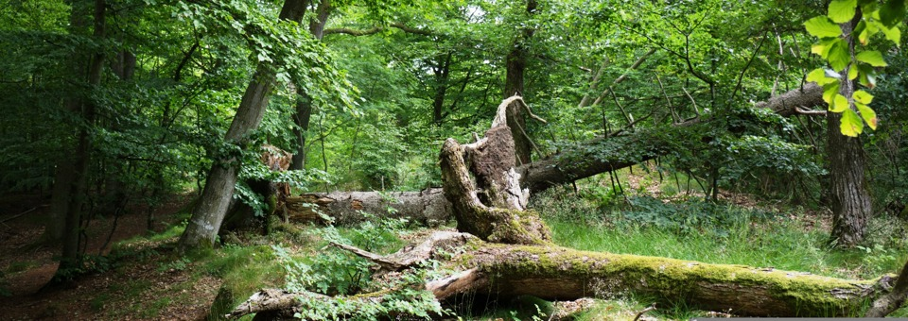
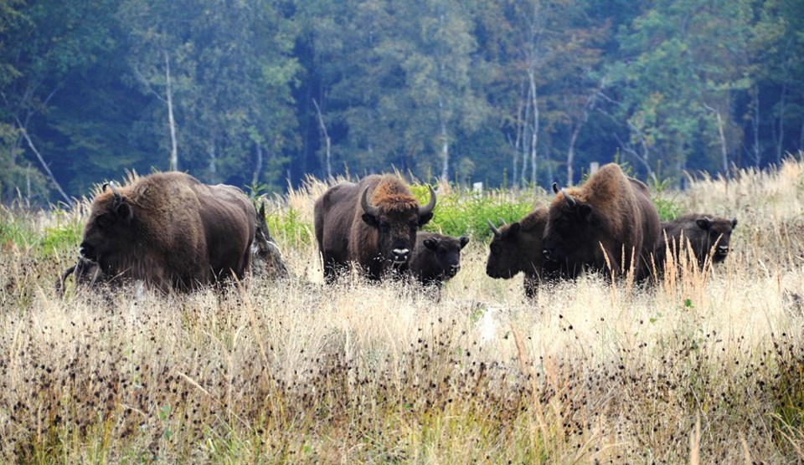
New areas which can be protected
Some of the new forest and nature areas may become protected areas:
100.000 hectares private and public owned set-aside forests
The rewetted drained peatlands
Five additional nature national parks with the main purpose of protecting and restoring biodiversity
And new projects on other set-aside areas.

Slide 6
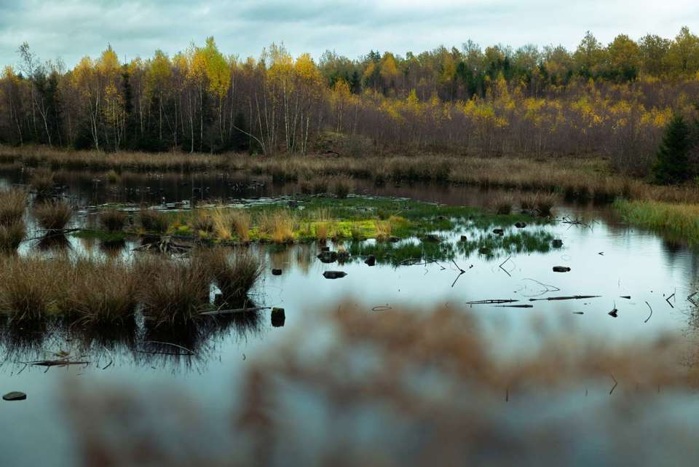
Considerations for strict protection
There is great interest in designating areas for strict protection and contribute to the EU strategy
And
Strict protection must be defined in the upcoming law on Nature and Biodiversity
That is why we are discussing the requirements to be categorized as strictly protected.
Photo: Lars Ostenfeld

Slide 7
Protected areas in Denmark
14.8 per cent of the Danish land area is subject to an areal protection in danish law
Denmark does not yet have a legal definition of strictly protected areas
Protected areas consist of
Nature 2000 areas
Nationally protected areas with nature types such as moors, dunes, streams, lakes. etc. The areas must not be changed and must not be fertilized
Designated areas that are protected for the sake of nature
The areas can be small. It is possible to do extensive forestry, release game and hunt, in some of the Nature 2000 areas there may be conventional agriculture.

Slide 8
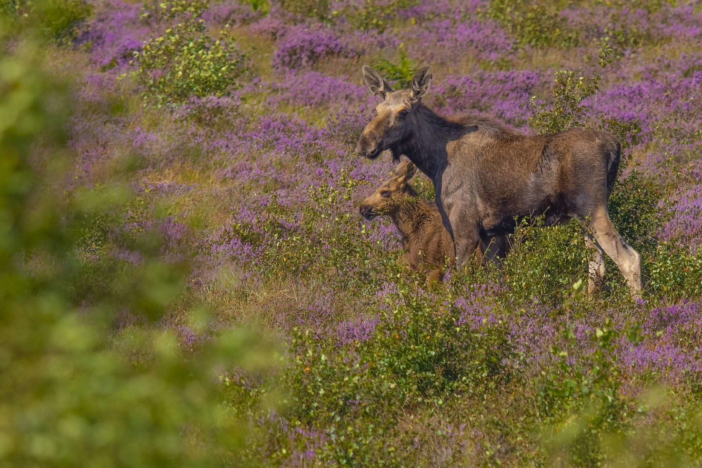
Requirements for strict protection
We work with a framework of:
Areas rich in or with potentiel for rich biodiversity
A minimum size of the area (the entire area is not necessarily strictly protected)
Long-term and legally protected
Management plans in place
The objective is to help and secure natural ecological processes (e.g. natural hydrology and if possible large herbivorous animals)
Aage V Jensens naturfond

Slide 9
Requirements for strict protection
Thoughts on possible activities within the areas:
Opportunity to discover and experience nature
Walking, running, biking
Camping in shelters, tents, etc. at permitted sites
Also kindergartens and scouts in the forest
Defence activities - with the exception of activities with an expected significant impact on nature and biodiversity

Slide 10
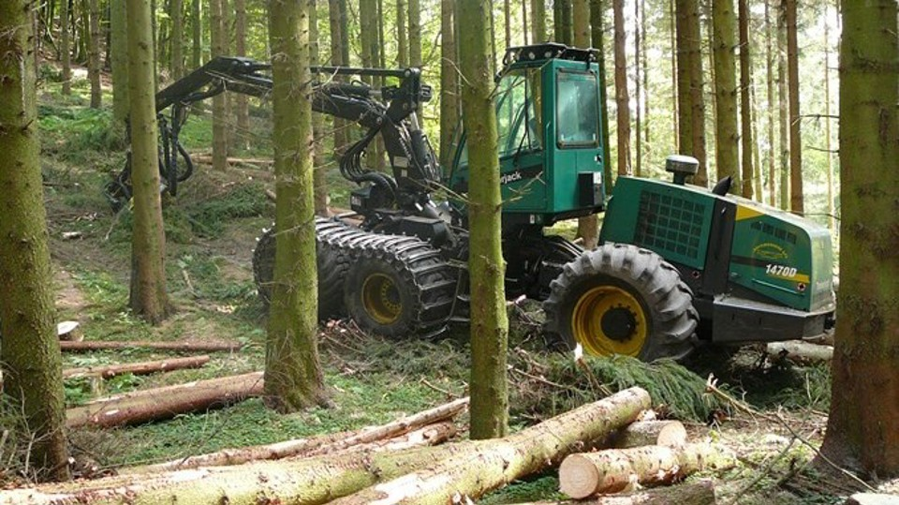
Not to happen in strictly protected areas
Potential restrictions in strictly protected areas:
Commercial agriculture or forestry activities
Construction plants, eg. renewable energy plants etc.
Hunting – only regulation to ensure adequate populationsize and removal of invasive species is allowed
Organized outdoor events etc. only after specific assessment on a case-by-case basis to ensure no significant harm to biodiversity
TV 2 Kosmopol

Slide 11
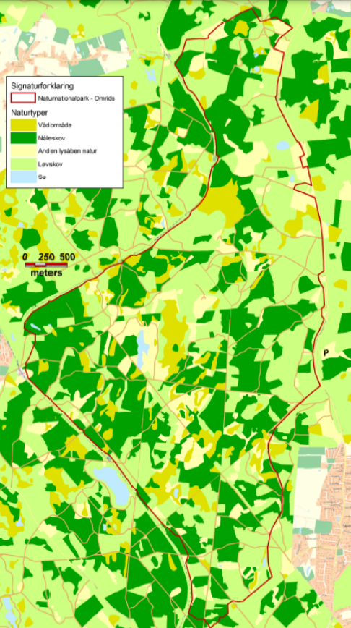
Example of possible strictly protected area: Nature National Park Gribskov
The goal is to support an ecosystem with natural processes and dynamics and minimal use of management interventions
Nature National Park Gribskov covers 1,300 hectares
Located in the central part of Gribskov , which is one of Denmark's oldest and largest forests
The nature national park covers approximately ¼ of Gribskov's total area.
The area is part of a Natura 2000 area with lakes, bogs and forests, breeding birds and birds of prey
Notes:
For several hundred years, Gribskov has been a production forest, where the trees have been felled and used as timber. The traces of forestry with high-stemmed, uniform stands will mark the area for many years to come.

Slide 12
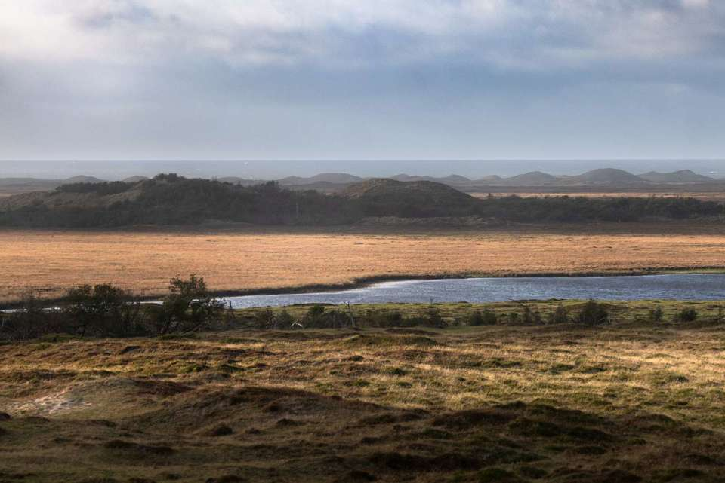
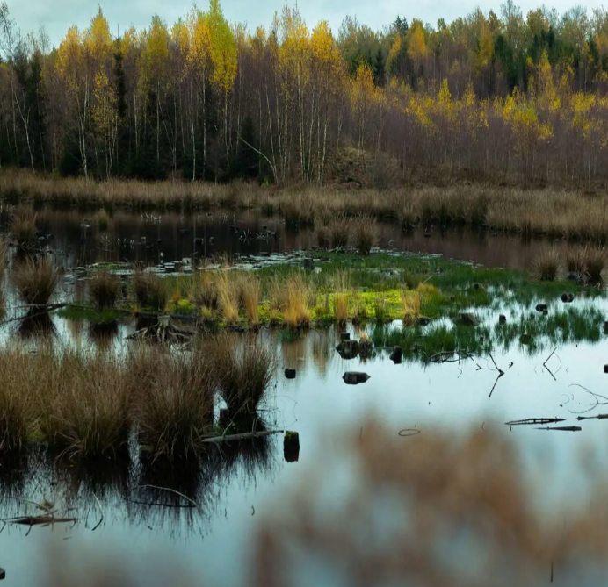
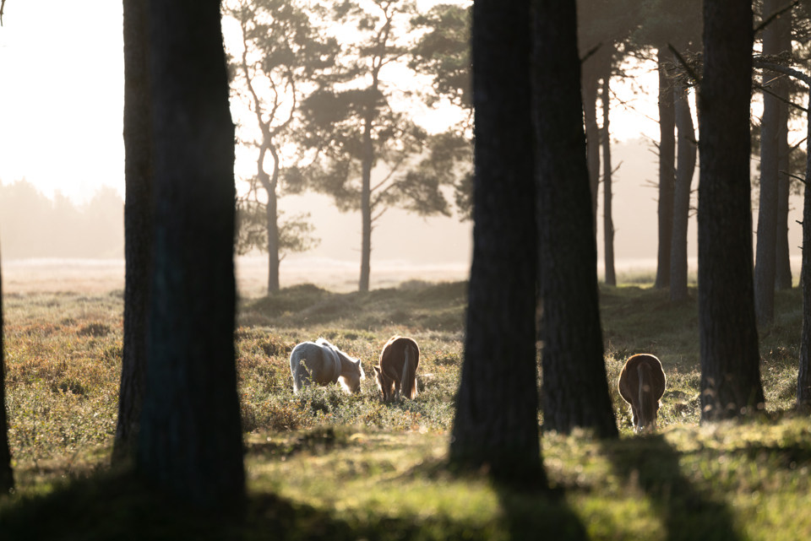
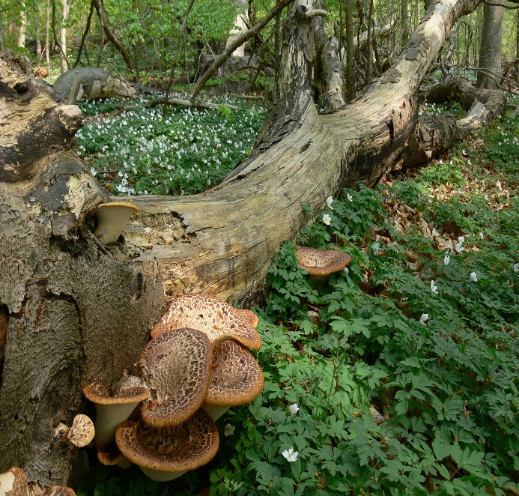
Initiatives in the national nature park
Establishing a large self-managing nature area
Restoring Natural Hydrology and destruction of drainage
Set-aside forest with dead wood and felling of non-native species
Large herbivores such as moose, cattle and deer, which can create habitats for many different plants, animals and fungi.
Photos: Lars Ostenfeld

Slide 13
Thank you !
Photo: Lars Ostenfeld
We are working with definitions and criteria,
We will be glad for any experience, point of view
and any input you can give us
during these days or in the coming weeks

