Slide 1
Setting the scene: Strictly protected areas in the EU Biodiversity Strategy for 2030
Networking event on Strictly protected areas in the EU Biodiversity Strategy for 2030
Brussels, 12-13 November 2024
Iva Obretenova, European Commission, DG Environment, Unit D.3 - Nature conservation

Slide 2
Strictly protected areas in the EU BDS 2030
A larger and coherent EU-wide network of protected areas (PA):
Legal protection for at least
All protected areas:
Have clearly defined conservation objectives and measures
Are effectively managed
Are appropriately monitored
30% of EU land area
30% of EU sea area
10% of EU land area
10% of EU sea area
Strict protection for at least

Slide 3
Strictly protected areas - definition
“Strictly protected areas are fully and legally protected areas designated to conserve and/or restore the integrity of biodiversity-rich natural areas with their underlying ecological structure and supporting natural environmental processes. Natural processes are therefore left essentially undisturbed from human pressures and threats to the area’s overall ecological structure and functioning, independently of whether those pressures and threats are located inside or outside the strictly protected area”
in Criteria and guidance for protected areas designations: https://ec.europa.eu/environment/publications/criteria-and-guidance-protected-areas-designations-staff-working-document_en

Slide 4
Strictly protected areas - What does it mean?
strictly protected areas need to be legally protected (just like other protected areas)
should incorporate
natural processes are left essentially undisturbed → not necessarily incompatible with some human activities
the compatible activities, strictly regulated, controlled and enforced, will depend on site conservation objectives and will need to be reviewed regularly
functionally meaningful areas → sufficient size on their own or together with buffer zones
all old-growth and primary forests
areas of very high biodiversity value or potential
significant areas of carbon-rich ecosystems, such as wetlands, mangroves and seagrass meadows
important fish spawning and nursery areas

Slide 5
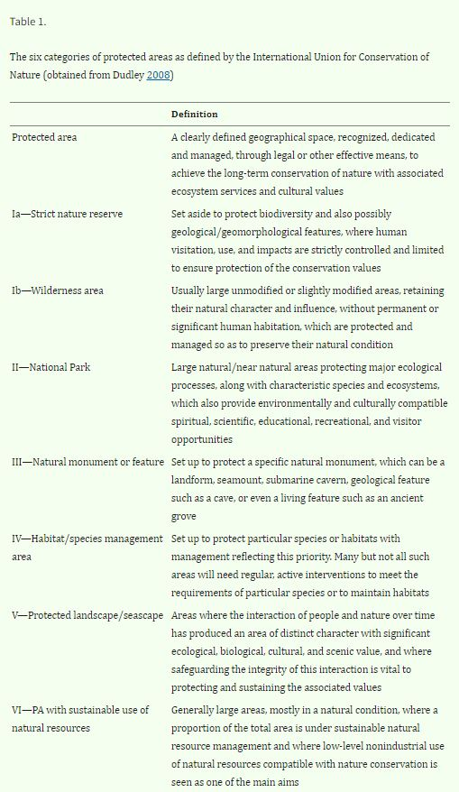
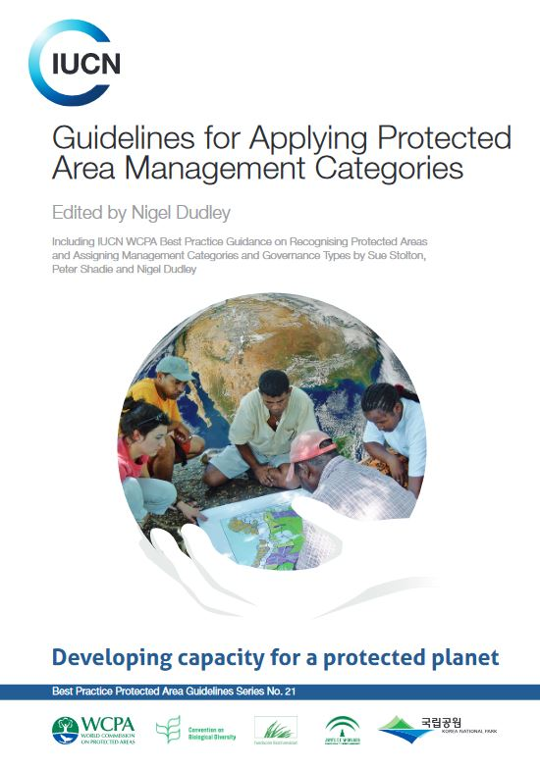
Strictly protected areas and IUCN PAs categories
IUCN PAs categories primarily defined by the applicable management practice
Categories Ia (strict nature reserve) and Ib (wilderness area)
Category II (National park) - as part of the zoning
Categories IV – VI

Slide 6
Objectives of the event
Operationalize the overarching definition by:
Better understanding of the diversity of definitions and circumstances across MS
Clarifying application of the concept of “active management sustaining or enhancing natural processes”
Support case-by-case assessment by MS
Ensuring a level playing field among MS
Facilitate designation and effective management

