Slide 1
Strict protection vs biodiversity conservation
Delphine Dupeux, Director-European Affairs
European Landowners Organisation (ELO)
Delphine.dupeux@elo.org

Slide 2
EU Biodiversity 2030 Are we missing the target ?

Slide 3
EU Biodiversity 2030
Some challenges…
Fragmented policies and regulations
Lack of coordination among Member States
Insufficient stakeholder engagement
Limited funding and resources

Slide 4
Thinking out of box !!

Slide 5
TRADITIONAL CONSERVATION METHODS
Protected area coverage is a measure easy to apply and to understand for policy-makers but does not account for biodiversity, ecosystem services and social equity within and around protected areas, nor for the connectivity between them.
Hoffmann, S. Challenges and opportunities of area-based conservation in reaching biodiversity and sustainability goals. Biodivers Conserv 31, 325–352 (2022)

Slide 6
Going beyond protected areas How OECMs can help ?
Protected areas have a primary conservation objective. Their core function is to promote the in situ conservation of biodiversity
PROTECTED AREAS
Other effective area-based conservation measures OECMs should deliver the effective in-situ conservation of biodiversity, regardless of their primary management objective
OECMs
Managed areas that deliver effective conservation of biodiversity

Slide 7
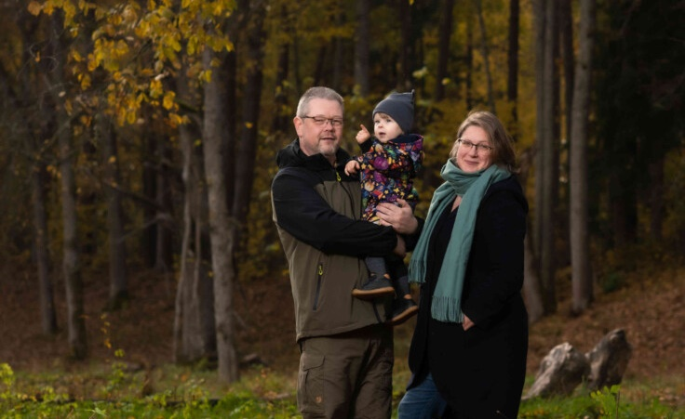
Private Land Conservation
in the EU Biodiversity Strategy is not a "nice to have", but essential to ensure our survival and wellbeing
What it is
Beneficial for all parties (empowerment instead of opposition, new alliances, popular across party lines,...)
Widening of the toolbox
What it is not
a substitute for regulation
not to replace hammers with screwdrivers - complementary
Viestrus and Inese combine farming and nature on their land in Latvia. The largest part of the farm’s territory lies within the nature reserve and nature park zones. They host 11 different types of meadow and water habitats on the farm, which are specially protected in accordance with the EU Habitats Directive. The Bekas farm is hosting more than 50 protected and endangered species of plants, animals and fungi
Notes:
Private land is complementary to public land conservation
Focus: private land owned by individuals
Understanding might differ per country (legal understanding)
Private land conservation can be defined as a voluntary activity carried out by individuals, groups of individuals, corporations or non-governmental organisations with the aim to protect or to restore habitats or species on a property under their governance. The opposite of private land conservation is mandatory land conservation through regulatory tools, such as public designation of protected areas or other administrative acts of public authorities.

Slide 8
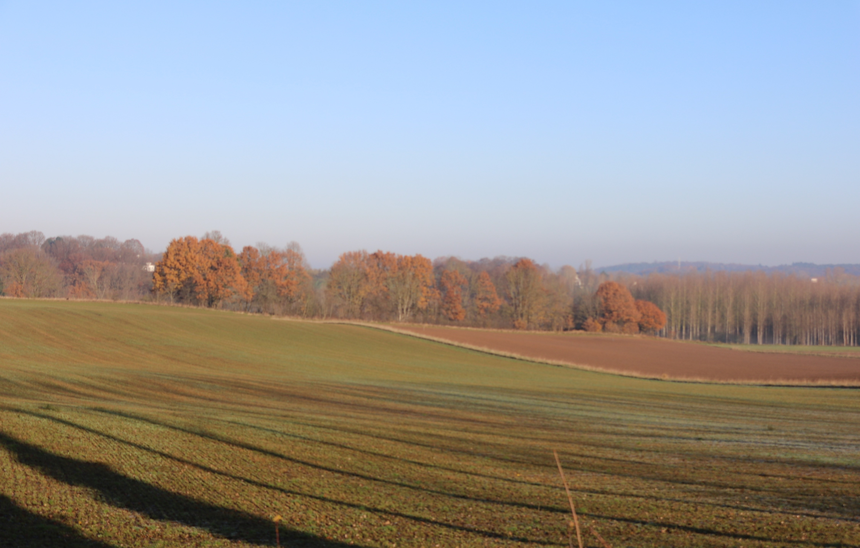
Main messages on strict protection
Should be applicable to public land only
Long term but flexible
No need for new guidelines but legal certainty is critical
Nature is not static. The EU landscape as we know it today as been shape by humans: Active management is prerequisite
Do not respond to climate change and IAS Challenges = Risk management schemes are essential

Slide 9
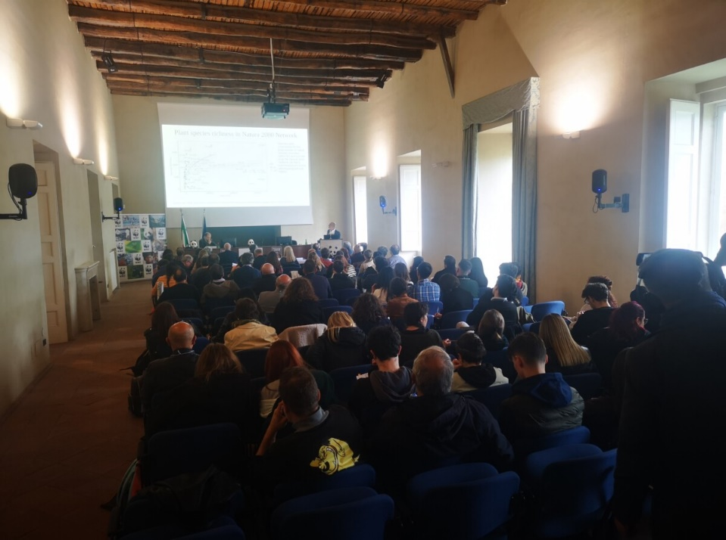
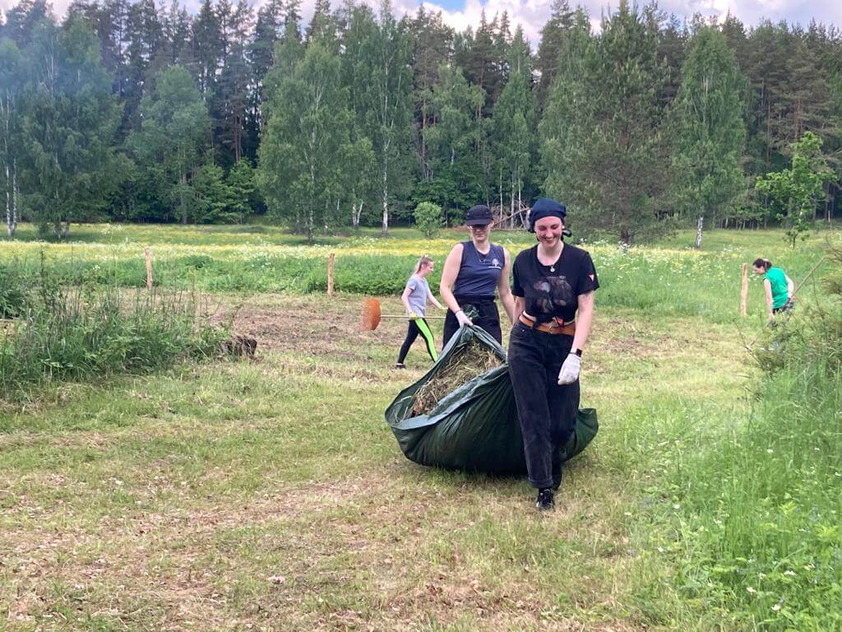
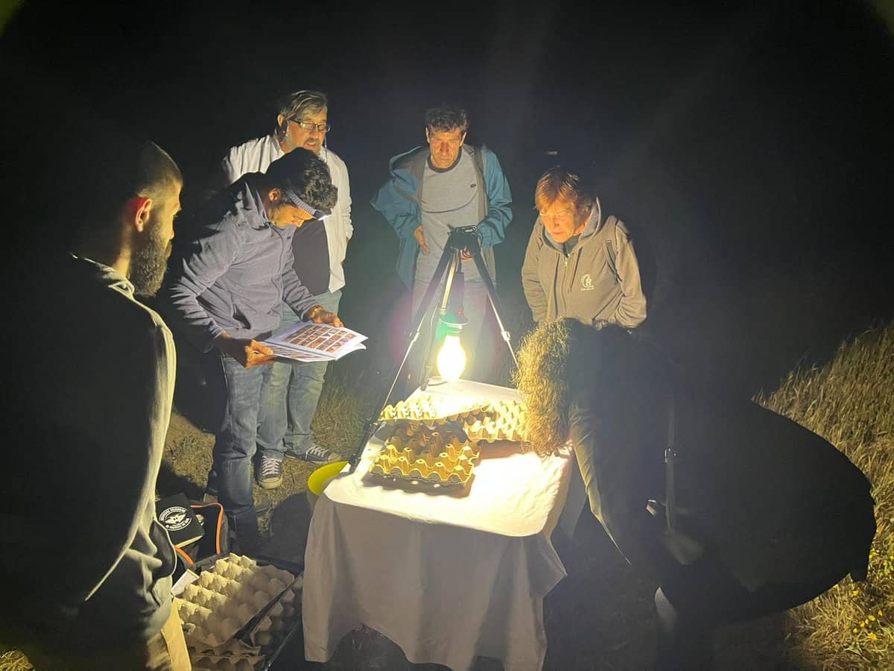
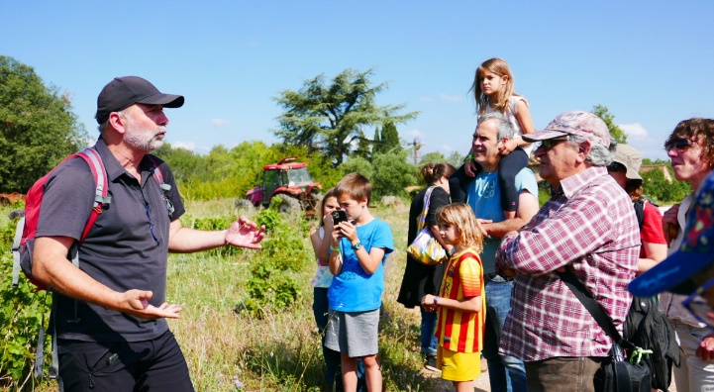
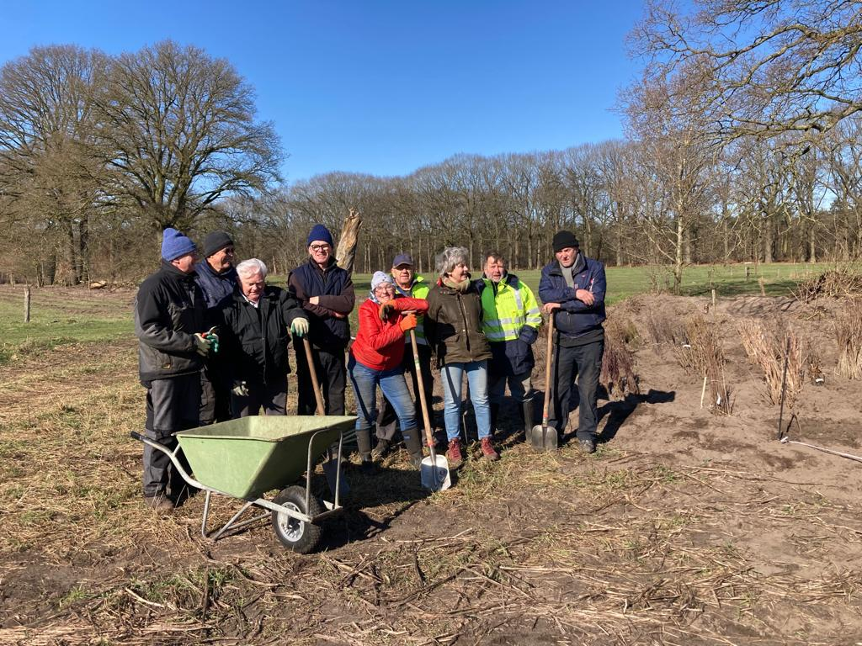
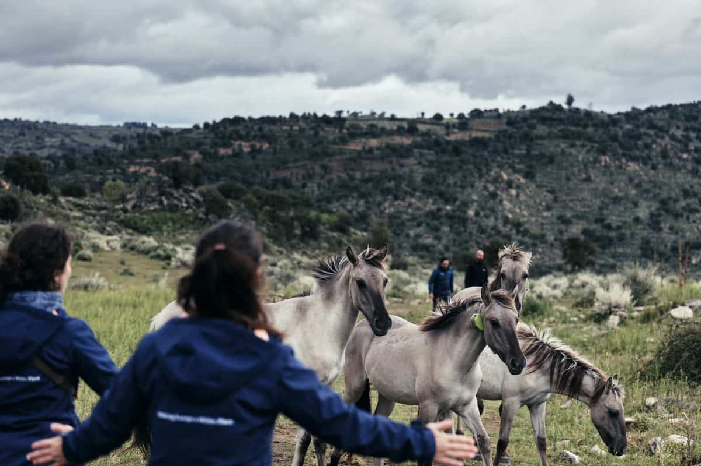
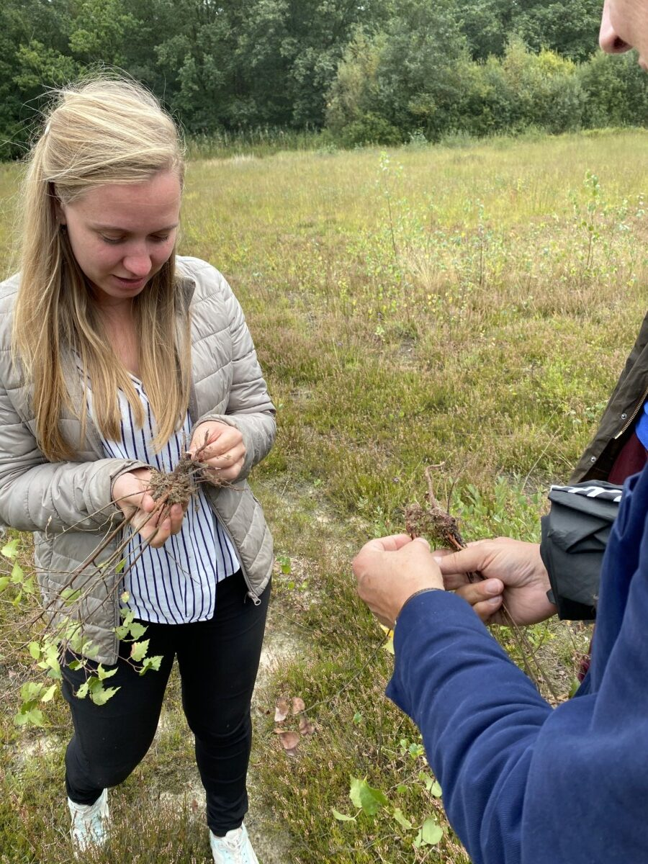
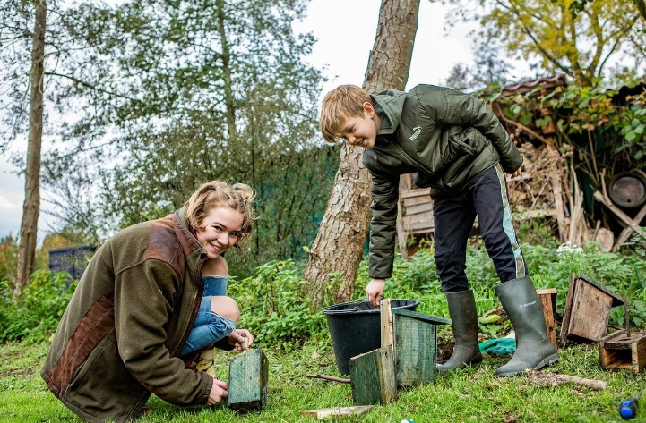
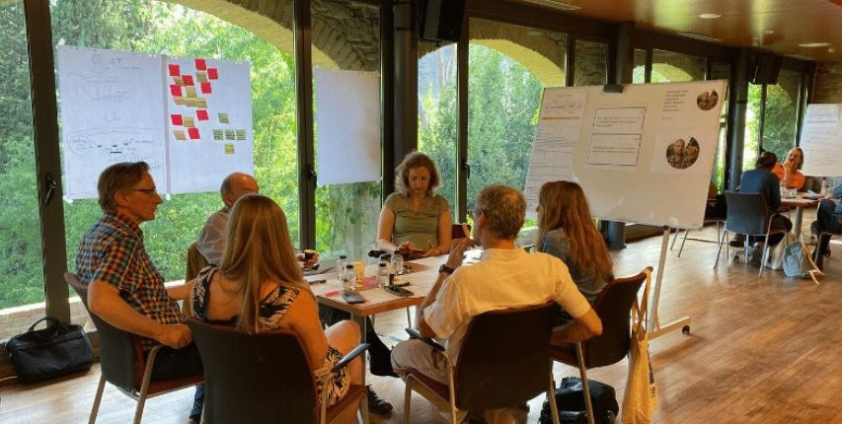
Notes:
Trainings, workshops, bioblitzes, workcamps, etc…

