Slide 1
EUROPARC Federation
date
Strictly Protected Areas
View of PAs Managers
Michael Hošek
Brussels, November 13th 2024

Slide 2
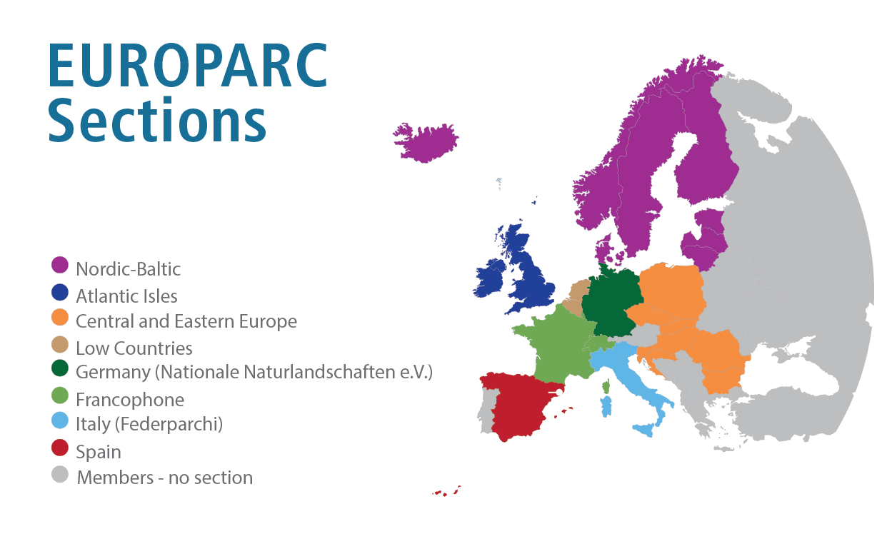
EUROPARC Federation was founded in 1973 with the aim of supporting Protected Areas to fulfill their role as preservers of Europe’s natural beauty.
Our vision:
Sustainable Nature; Valued by People.
+/- 400 members
in around 40 countries
Get to know them!
www.europarc.org/about-us/network/members/
www.europarc.org
Notes:
Short introduction of the EF – more than 60% PAs managers, but also national and regional agencies, universities.
I will try o balance various views as I represent the entire network here.

Slide 3
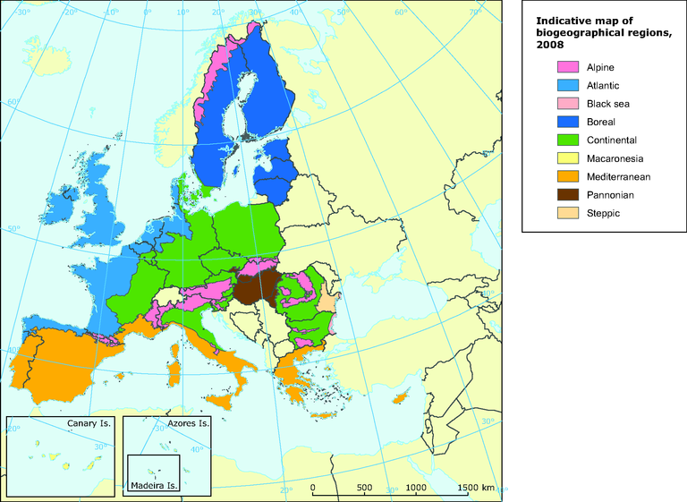
European (Bio)Diversity
Credits: EEA
Notes:
A significant part of biodiversity in Europe is "introduced" by human activities and the development of agriculture and other activities. Many species now commonly found in Europe and important for conservation are native to other areas, such as the Middle East, and others.
While in northern Europe the conservation of natural processes may prevail as the appropriate approach, southwards this gradient is changing into a need for active management.

Slide 4
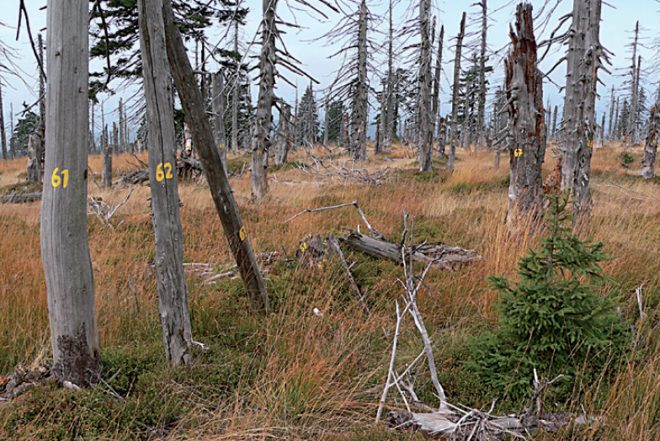
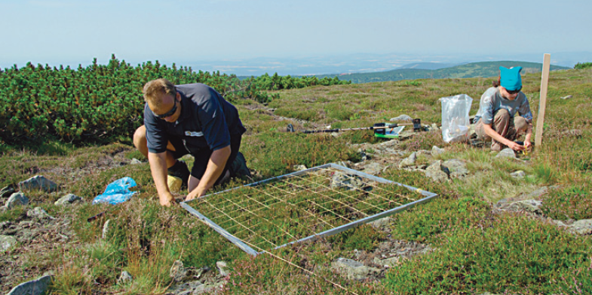
Practice Versus Research?
Photo Credits: Jiří Flousek, Kamila Antošová
Notes:
Oppose the common perception that research and practice are separate groups of people and activities. On the contrary - much research is done at the request of PAs managers and with their participation.

Slide 5
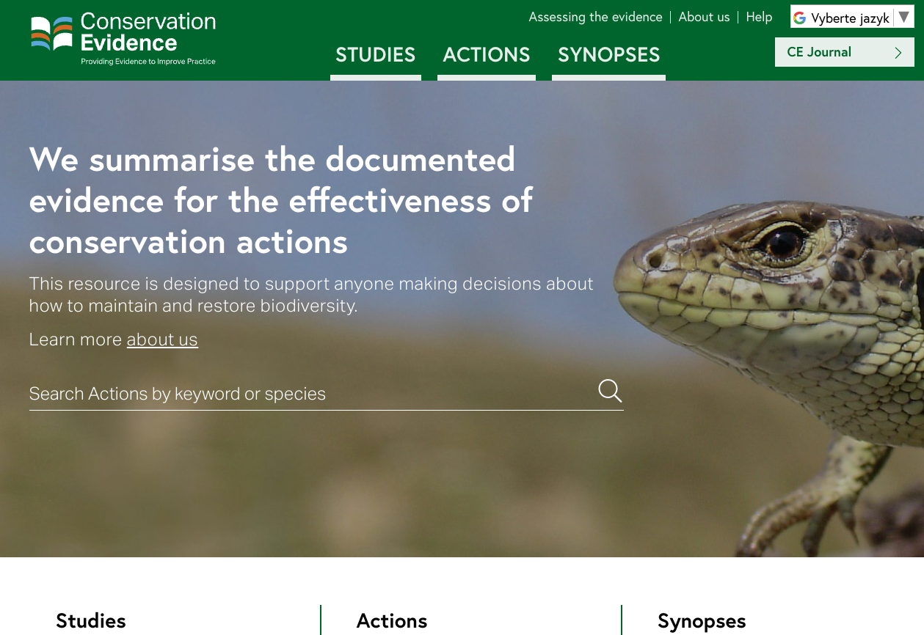
Evidence and Guides Mainly Available
Notes:
Example of one of many resources.

Slide 6
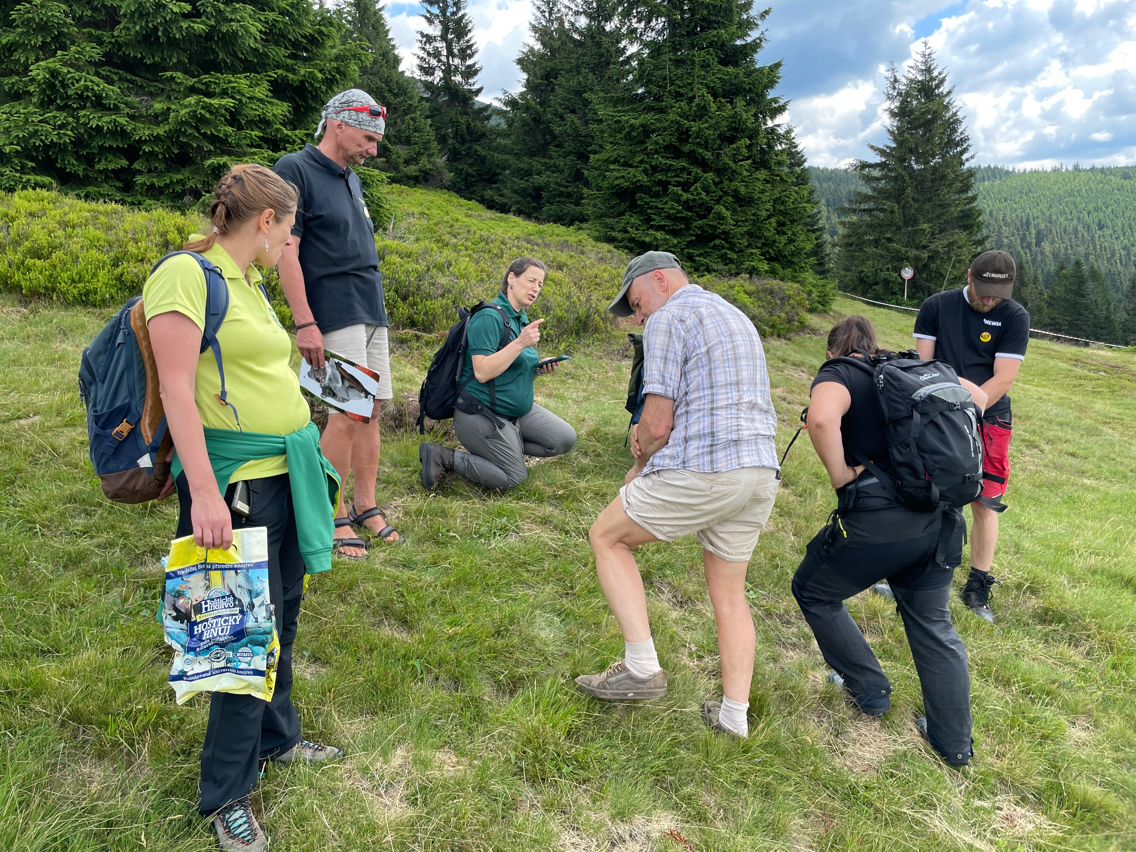
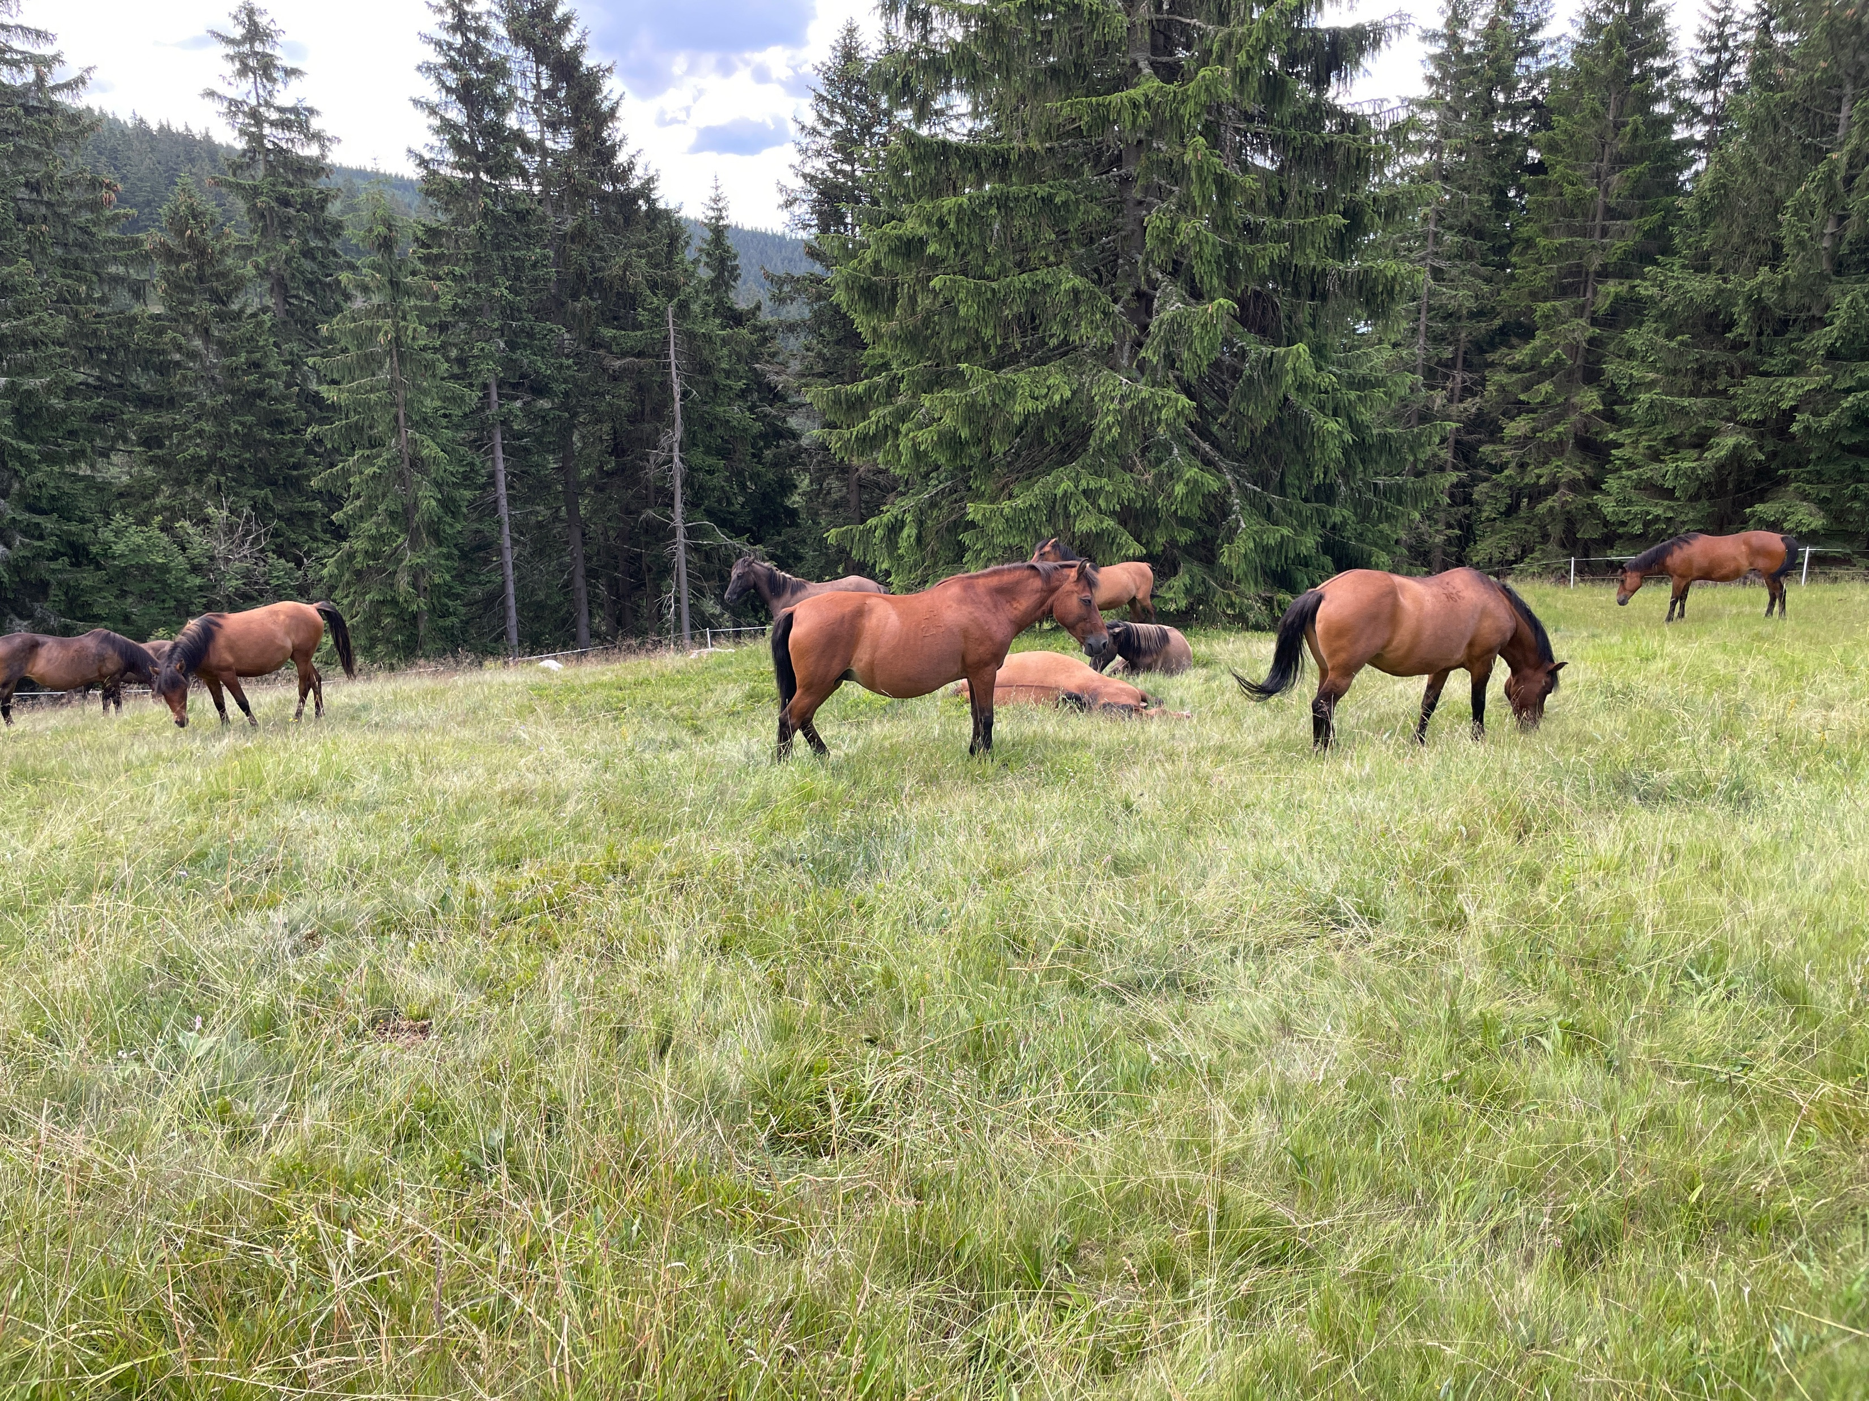
Practice + Research + Local Knowledge
Notes:
Not only research, but also local knowledge and cooperation with stakeholders and users is inevitable.
Mountain meadows – Natura 2000 conservation objective in Krkonoše NP.

Slide 7
Practice + Research + Local Knowledge
Notes:
And we also need to celebrate successes with partners! They need to understand what we want to achieve and they can know better than us hot to achieve it effectively.

Slide 8
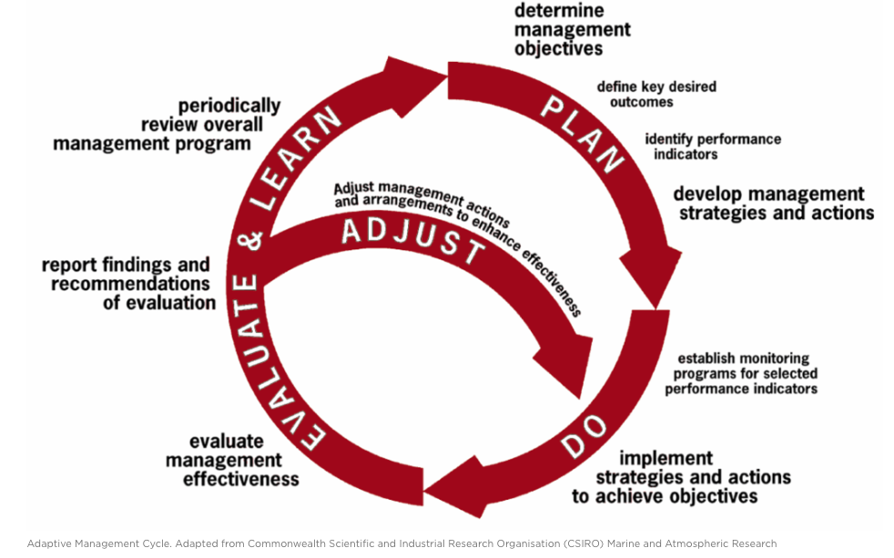
Adaptive Management Approach
Notes:
A fundamental success of nature conservation today is the recognition that we need to diversify management approaches according to needs. We have gone through a period of "protection", i.e. non-intervention, as well as over-protection in the past. However, the current adaptive approach should fully meet our needs, as it incorporates all management approaches from non-intervention to active regular care, according to the needs in specific sites.

Slide 9
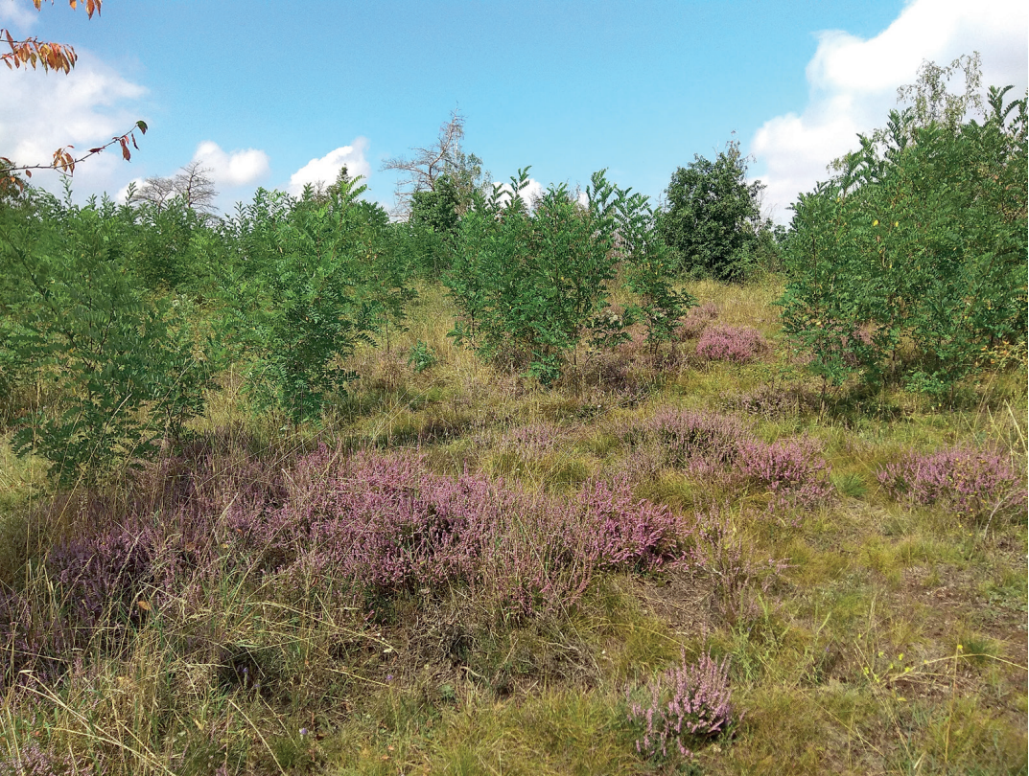
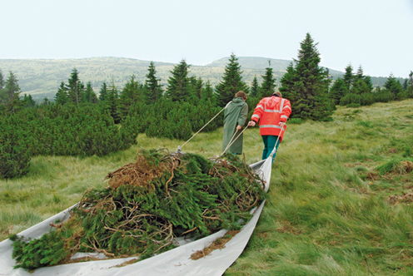
Why Adaptive Approach?
Photo Credits: Robert Stejskal, Kamila Antošová
Notes:
Significant impact - invasive species (example of Acacia thorn tree) and Scots pine overgrowing the mountain tops due to climate change... Both require an adaptive and reactive approach.

Slide 10
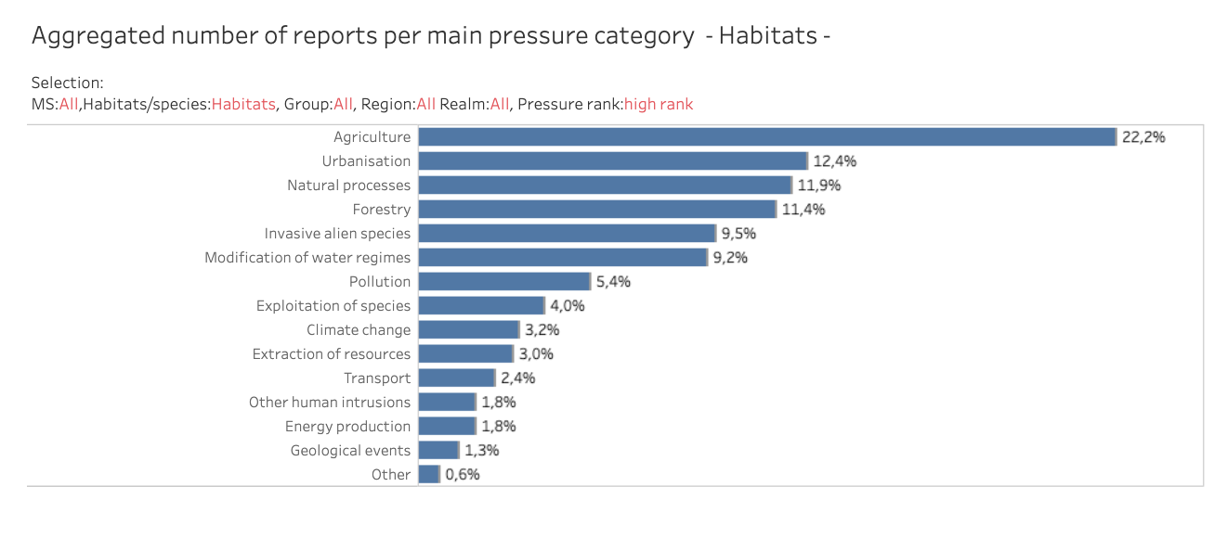
Main Challenges
Source: EEA
Notes:
Reports under Art 17. of HabDir and Art. 12 of BirDir clearly shows that main pressures are not caused by too intense management, opposite is true – the third most important pressure are natural processes for habitats.

Slide 11
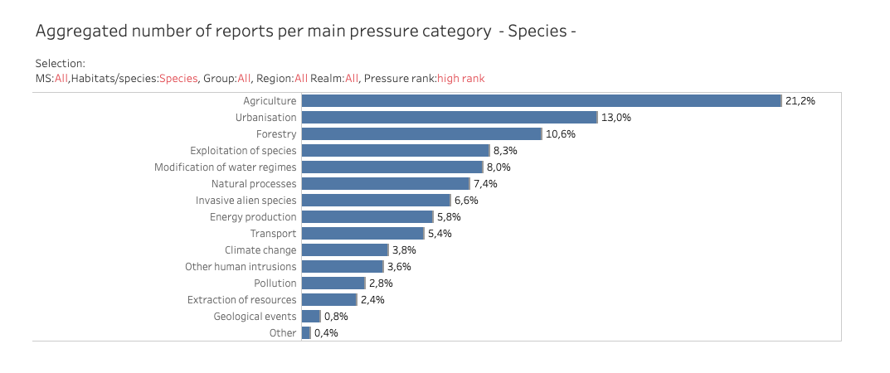
Main Challenges
Source: EEA
Notes:
Reports under Art 17. of HabDir and Art. 12 of BirDir clearly shows that main pressures are not caused by too intense management, opposite is true – the sixth most important pressure are natural processes.

Slide 12
Strategic Challenges
Nature Restoration Law – a need for active restoration approach
Already designated PAs with clear objectives and managed – can we afford to stop doing it just because strategic target with no clear justification based on the needs?
Notes:
NRL is clearly designed as tool for mainly active restoration approach, and it might be in contradiction with Strict Protection.
In already designated PAs abandonment of management might cause a loss of biodiversity (conservation objectives) and thus it might be considered as wasting of all capacities used for management there so far.

Slide 13
To Conclude
Protection of natural processes as well as conservation measures are both needed (and their combinations)
Decision about appropriate measures and their scale should be based on national conditions and state of nature there
Notes:
I do not question the protection of natural processes. On the contrary, they have an indispensable place in our approaches. It is also important to remember that each country has completely different conditions: while in Finland, for example, the protection of natural processes may be a priority, in the Czech Republic it is certainly active management.

Slide 14
To Propose
Strict protection concept can help:
Limit / stop harmful activities in PAs and allow only those measures that have positive impact and are needed
Consider well effectiveness of measures taken in PAs
It is not recommended to develop a list of allowed / forbidden activities as arbitrary list – inflexible approach
Notes:
Member state can use strict protection concept to identify sites that need either protection or natural processes or better identify and eliminate pressures negatively affecting them. I do not recommend creating a list of activities, as it will never be perfect and will not correspond to the reality of the time and situation in the different European countries. What is important is to achieve the objectives for which the areas have been designated and to measure this.

Slide 15
EUROPARC
November 13th 2024
Thank you!
michael.hosek@integracons.com
www.europarc.org

Slide 16
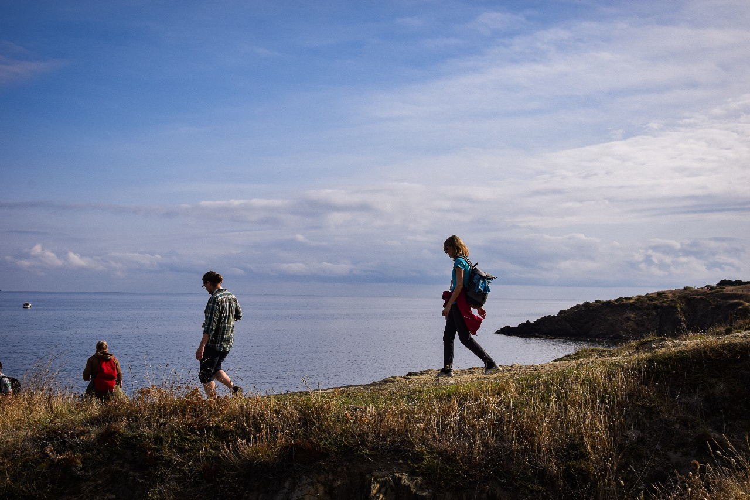
The EUROPARC Federation
Connecting People & Parks since 1973
facebook.com/EUROPARC
twitter.com/europarc
www.linkedin.com/company/437477
instagram.com/europarc_federation
www.europarc.org
www.europarc.org

