Slide 1
Strictly protected areas in Romania - state of play -
MINISTRY OF ENVIRONMENT, WATERS AND FORESTS
GENERAL BIODIVERSITY DIRECTORATE - NATURAL PROTECTED SERVICE

Slide 2
Context
Romanian Government Programme: 10% strictly protection (SP)
National Forest Strategy: 10% of forest area strictly protected
On going NPRR project (Aug. 2023 - Dec.2025)
Study on „Identification of potential non intervention/ strictly protected areas in terrestrial and marine natural habitats for the implementation of the European Biodiversity Strategy 2021-2030”

Slide 3
Main activities of the project
Analyzing of the existing data (studies, spatial database, projects, legislative acts, management plans for PAs, forest/pastoral/river management plans)
Elaboration the methodology and criteria for identification of SP areas
Field research, mapping of the potential SP areas
Consulting of the stakeholders, landowners for the identified SP areas
Completing a designation form and spatial data attributes
Designating the SP areas by legislative act

Slide 4
Definition of SP areas and criteria
Definition under Biodiversity Strategy 2030 | Definition under National legislation
Many strictly protected areas will be non intervention areas (with limited and well-controlled activities that either do not interfere with natural processes or enhance them Areas in which active management sustains or enhances natural processes (ex: limited mowing/grazing of grasslands Activities that are necessary for the restoration of the natural values | SP areas with Non-intervention regime in the national/natural parks and in Danube Delta Biosphere Reserve Virgine and quasi-virgine forests UNESCO World Heritage Site Ancient and Primeval Beech Forests of the Carpathians More restrictive regime: no human activities (just researching, ecological education, limited ecotourism)

Slide 5
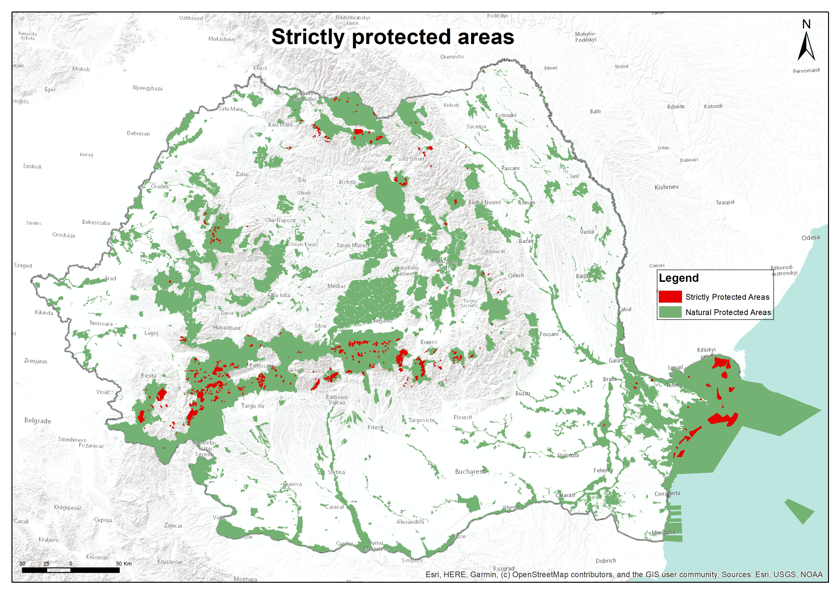
Strictly protected areas

Slide 6
Identification and designation the SP areas - key principles
Representativeness: based on the representative biodiversity values (ecosystems, habitats, species of high conservation value, rare, threatened or endangered species)
Functionality: areas to ensure the functionality of the protected ecosystems and thus the size of the proposed areas is sufficient;
Redundancy of criteria elements for SP areas designation. Important biodiversity features should be found in several protected areas to ensure their long-term maintenance;
Connectivity: by proposing areas to act as ecological corridors;
Participation: the designation of areas to be done in a participatory way, with the involvement of stakeholders/landowners;
Compatibility between the location/spatial extent of the areas and the objectives of major infrastructure national interest or development in general.

Slide 7
Identification Methodology for SP areas (1)
Forest areas:
Strictly protected stands in nature protected areas (in scientific reserves, areas from natural/national parks)
Virgine and quasi virgine forests (primary and OGFs);
Priority forest habitats, rare, vulnerable, endangered ecosystems: 91E0*, 91H0*
Forest habitats with high conservation (91AA ,91X0 the habitat is a relict needs active management)
High Conservation Value Forests (Forest Stewardship Council standard).
Forests with special protection functions: protection of springs, reservoirs and sources of mineral and drinking water, forest belts around alpine grasslands
Some of them need active management (low-interventions for conservation purposes)

Slide 8
Identification Methodology for SP areas (2)
Non-forest SP areas (grasslands, meadows, wetlands, aquatic)
Natura 2000 priority habitats, well conserved
presence of endemic, rare, vulnerable, endangered species based on Red lists
ecosystems with good preservation structures and functions
areas ensuring linkages between populations of species through ecological corridors (to ensure the functionality of their metapopulations)

Slide 9
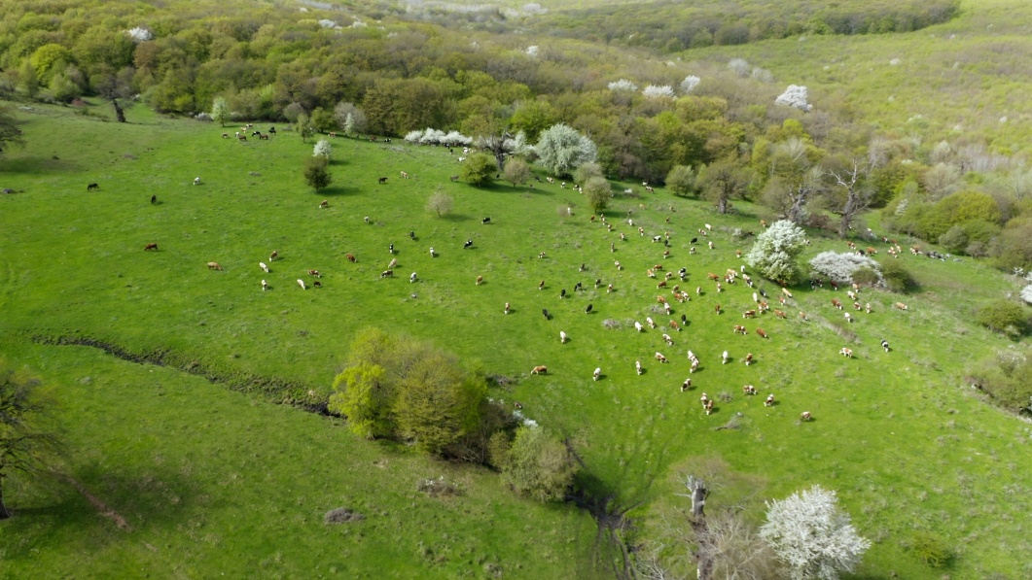
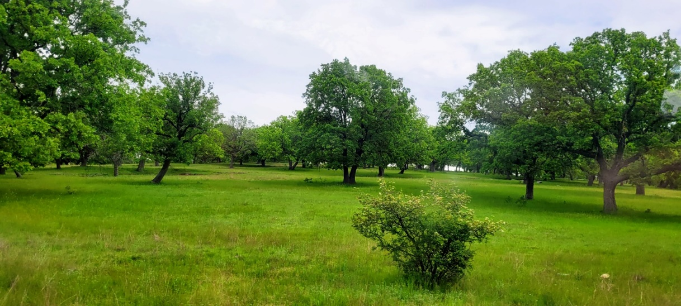
Identification Methodology for SP areas (3)
Examples:
grasslands with trees (especially Quercus species)
extensive use meadows and grasslands with a good conservation status, especially those under traditional management

Slide 10
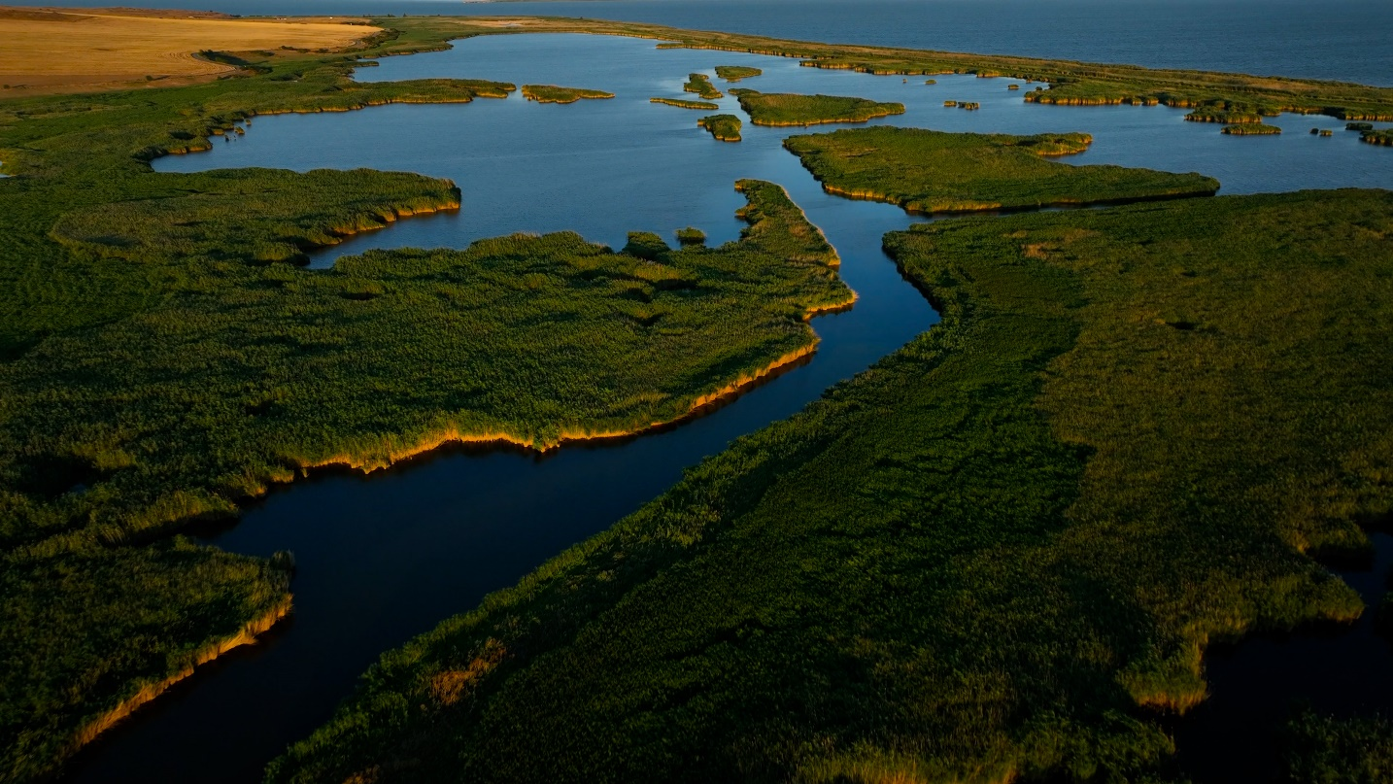
Identification Methodology for SP areas (4)
Examples:
Wetlands of international importance (20 Ramsar sites):
with complex ecological functions;
a refuge for many species of fauna and flora and breeding, feeding and wintering sites for aquatic and semi-aquatic fauna species.
all priority peat bogs habitats
the freshwaters ecosystems in good ecological status

Slide 11
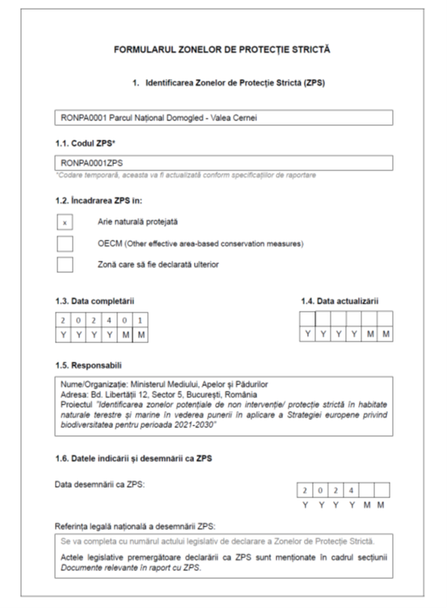
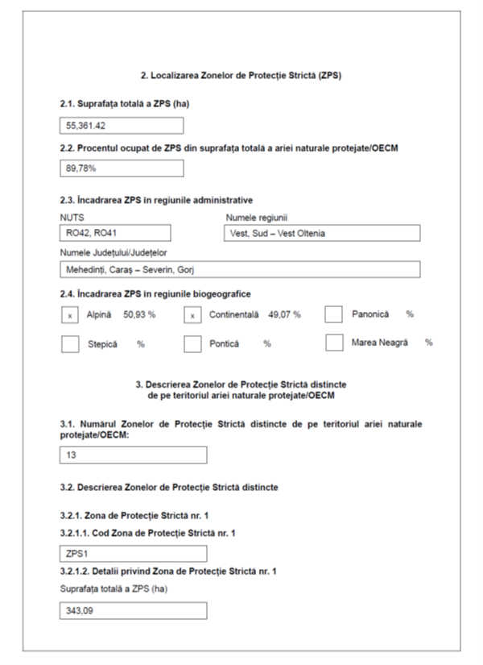
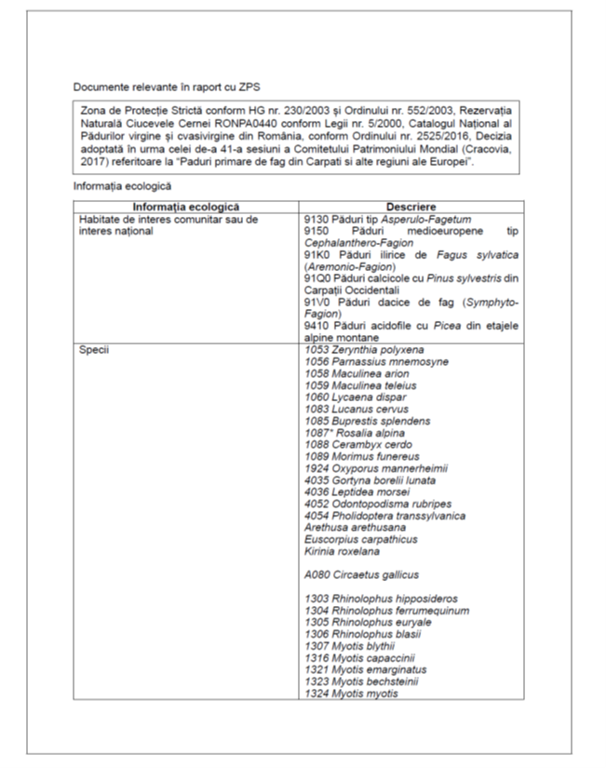
Data form for SP areas

Slide 12
Possible activities in strictly protected areas
Restoration of degraded land
Invasive alien species control
Natural disaster prevention
Minimum interventions (special conservation works) - in the forest ecosystems
Grazing/ mowing with limited measures in grassland to keep the integrity of the ecosystems
Scientific research
Recreation/ecotourism (without infrastructure development)

Slide 13
SWOT analysis (1)
Strengths | Weaknesses
Reach biodiversity Strictly protection in natural and national parks Virgine and quasi - virgine forests | Target will not be reach only with the non intervention regime 5 biogeographical regions: Target could not be reached in some regions (e.g. steppic) Diverse land ownership

Slide 14
SWOT analysis (2)
Opportunities | Threats
5 biogeographical regions: Target could be reached in some regions (e.g. alpine) Possibility to designate SP areas with minimum intervention for the conservation purpose SP (the restoration areas) could contribute to the 20% Target restoration (Restoration Plan) | Disagreement of landowners Lack of understanding of the purpose or necessity for strictly protected areas Lack of compensations for landowners affected by the restrictive regime Lack of political will

Slide 15
Questions pending
1. Would EU support some financial compensations for landowners if their land will become strictly protected area ?
2. Could some specific OECM areas be included as strictly protected areas, especially in non-forest areas ?
3. Land enrolled in Agro/silvo environmental existing voluntary and time limited schemes might be declared as strictly protected areas?

Slide 16
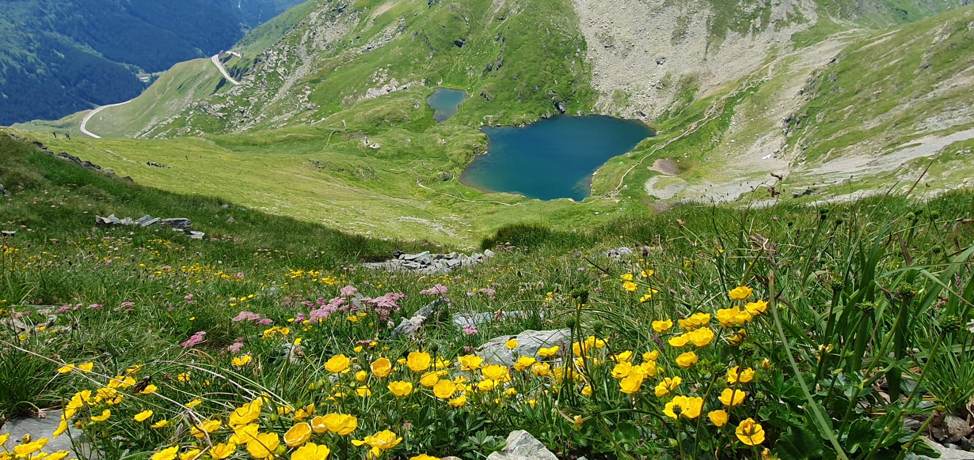
Thank you for your attention !
Ramona Zotta- Cherăscu
Anca Căciunaș
John Smaranda
E-mail: biodiversitate@mmediu.ro

