Slide 1
Strictly protected areas: Swedish (terrestrial) approach
Maano Aunapuu
Head of Nature Conservation Unit
Swedish Environmental Protection Agency
Networking event on Strict Protected Areas in the EU biodiversity Strategy for 2030
12th November 2024

Slide 2
Country specific legislation framework
Sweden has four fundamental laws which make up the Constitution.
The Environmental Code constitutes a framework legislation that consists the general provisions regarding environmental protection. There is an additional ordinance which regulates legislation in detail.
Protected areas are decided by the Government (national parks, Natura 2000 areas), regional or local authorities (nature reserves, biotope protection areas) and by Forestry Agency (forest biotope protection areas), based on the Environmental Code and related ordinances.

Slide 3
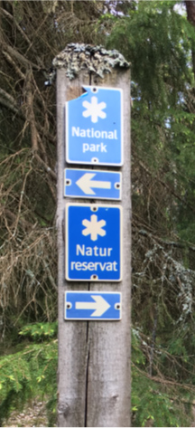
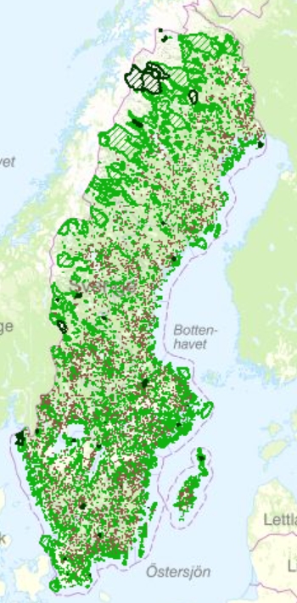
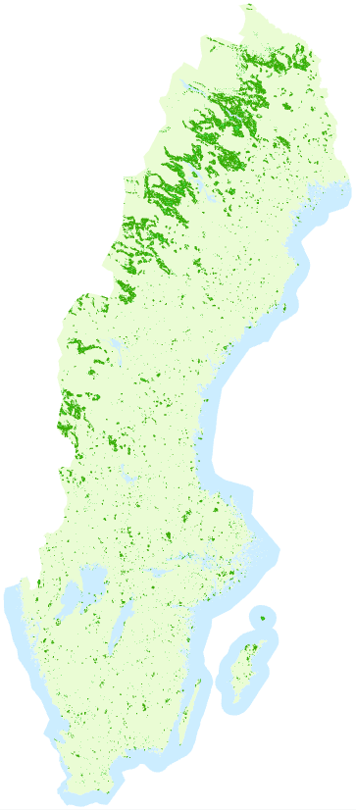
Protected areas & strictly protected forest
Potential
Strict protection of forest nature types
© Maano Aunapuu
Notes:
Left:
Map of national parks, nature reserves and biotop protection areas in forest. These are potential areas to be qualified as strictly protected areas
To say which protected areas qualifies as strictly protected, we have to look at the specific area and regulations there.
Right:
In these areas nature values connected to the forest nature types/species are protected, corresponding to criteria for strict protection.

Slide 4
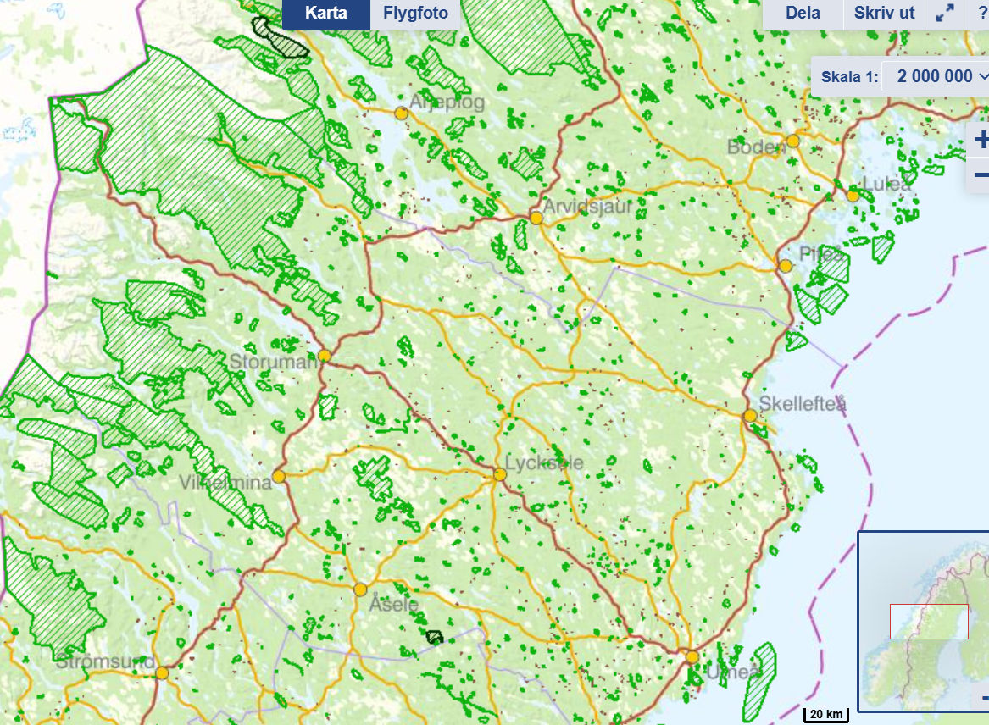
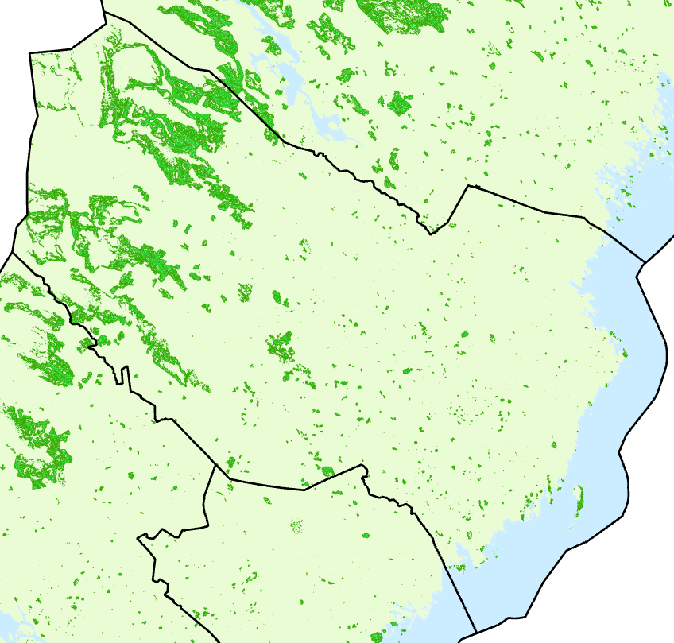
Strict protection of forest nature types
Potential

Slide 5
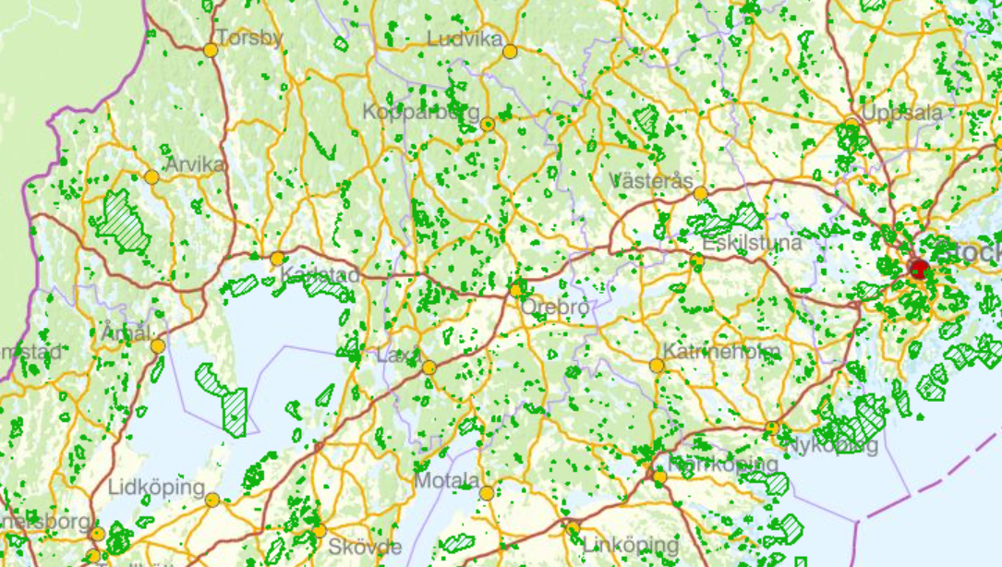
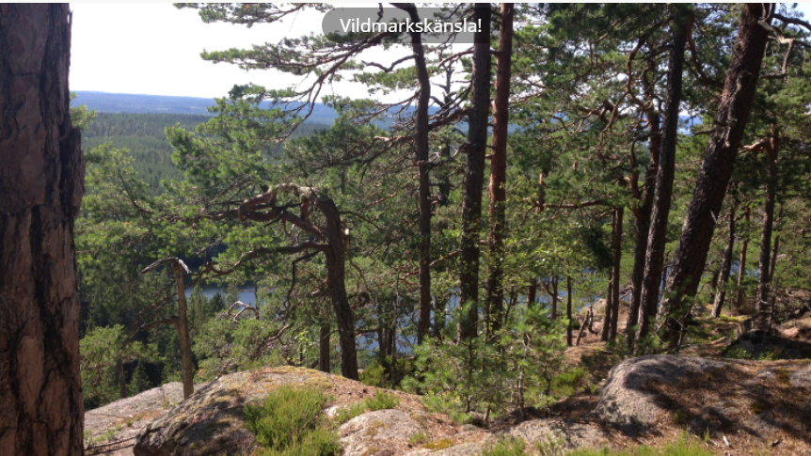
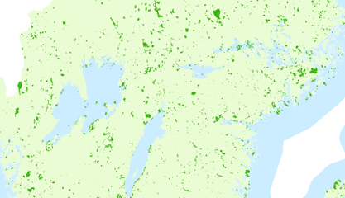
© CAB Värmland
Strict protection of forest nature types
Potential
Glaskogen nature reserve
Area: 22 530,2 ha

Slide 6
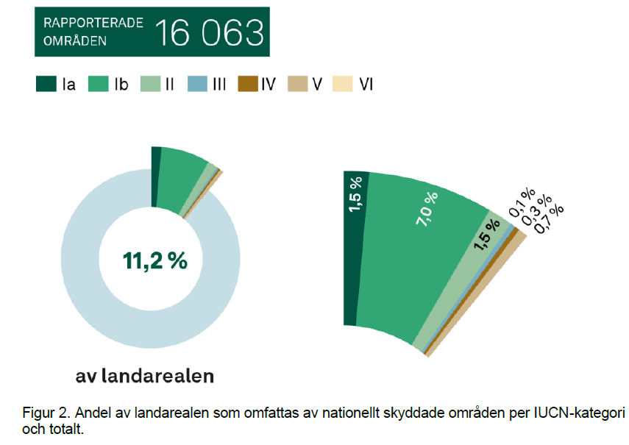
Strict protection in Sweden (per 2020-12-31)
11,2 % of land area is protected by
16 063 sites.
Ca 7.0% is strict protected areas (IUCN category I - IV together with legal protection for nature values).
In Sweden, we can’t currently use relation between IUCN categories and strict protection for aquatic environment in protected areas. This is due that the regulations for aquatic values often are less specific than for terrestrial values.

Slide 7
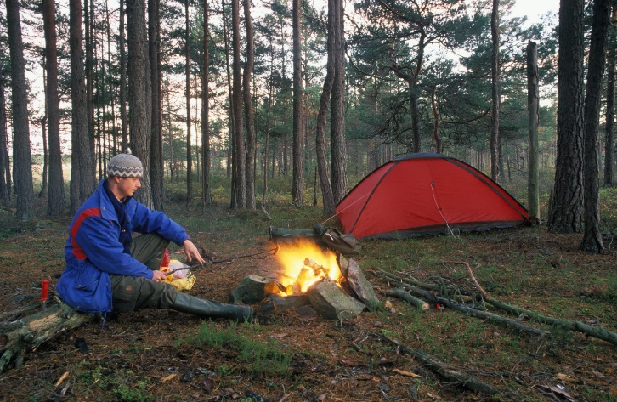
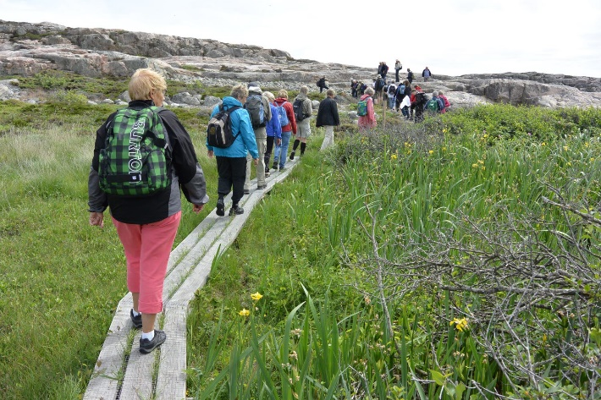
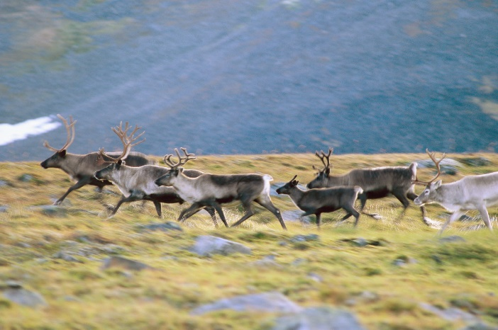
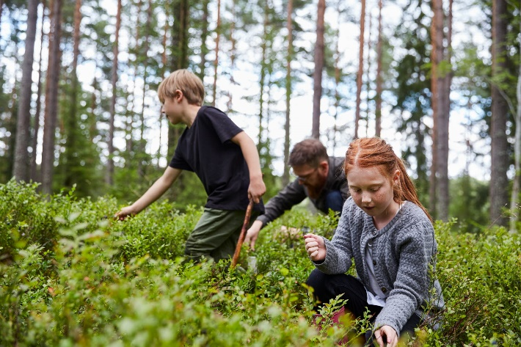
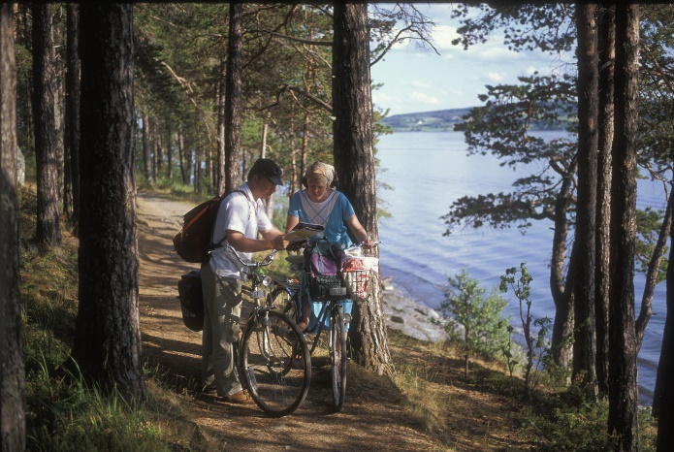
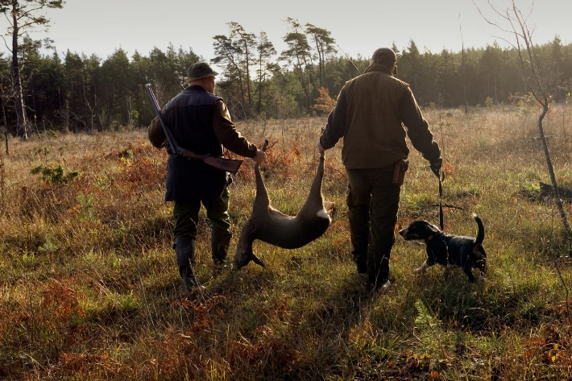
In strict protected areas you can:
© Jonas Forsberg
© Jerker Norlander
© Hans Geijer
© Göran Ekström
© Lina Arvidsson
© Per Klaesson
Notes:
Vi have strong public right of access, we don’t consider visitors as a threat. We have strong law enforcment.

Slide 8
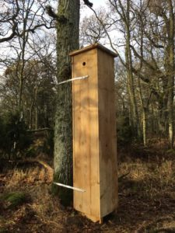
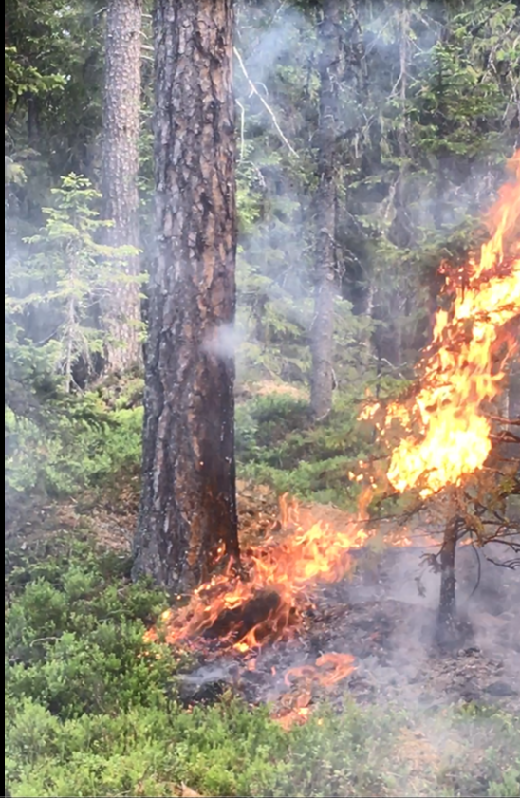
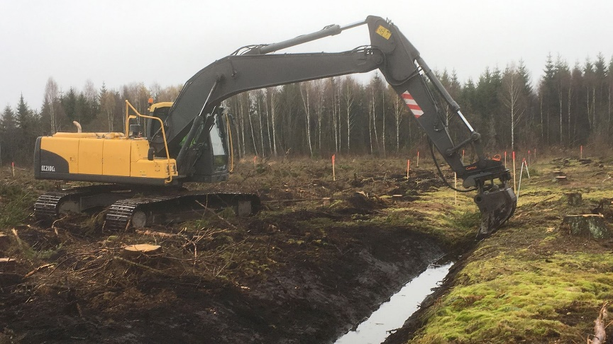
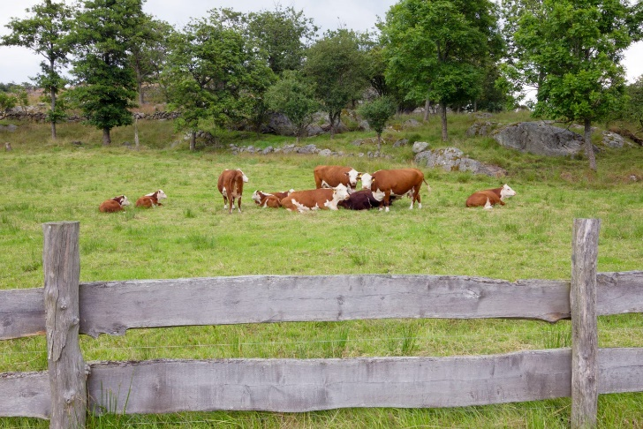
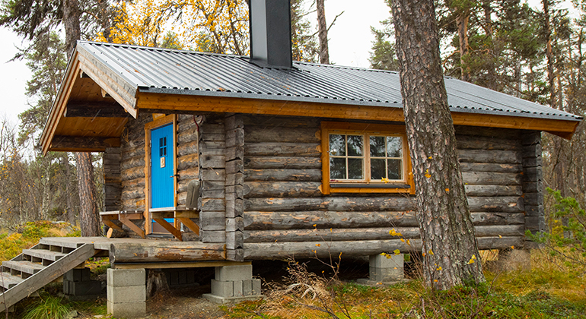
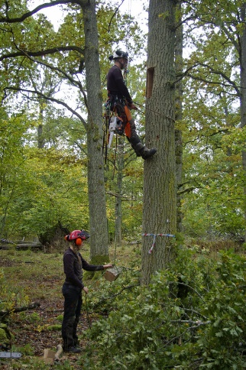
In strict protected areas it may be necessary to:
© Maano Aunapuu
© Annika Lydänge
© Ulf Sikström
© André Maslennikov
© CAB Västerbotten
© Frida Nilsson

Slide 9
Swedish pledges to 2030
From 15,5 % to 17,7 %
Notes:
Sweden has made pledge within strategy for EU KOM strategy for biological diversity.
The pledge is about increase area of protected areas. In land we can’t make promise concerning strict protection, while in marine environment Sweden has done it.

Slide 10
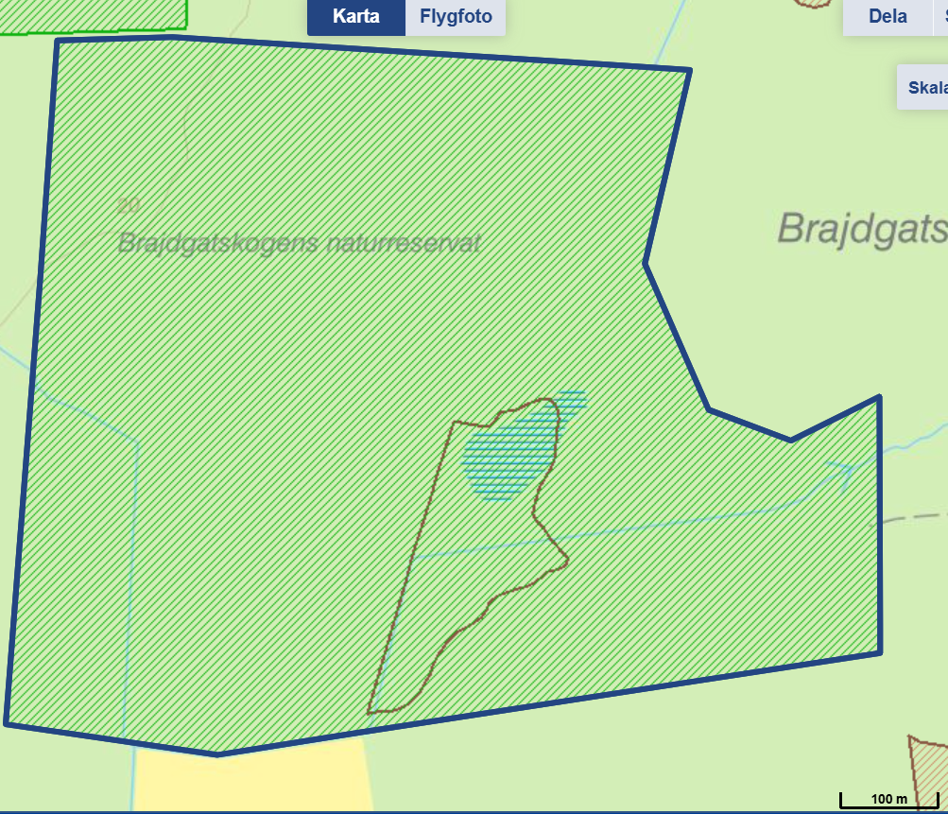
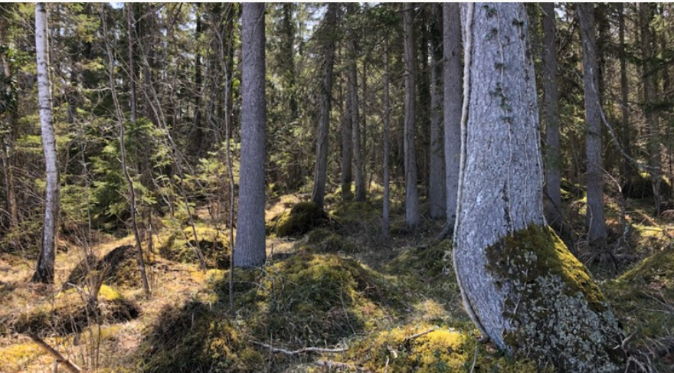
Applying legislation to an object
Brajdgatskogen nature reserve, Gotland
Area: 47,6 ha
© Elina Ambjörnsson

Slide 11
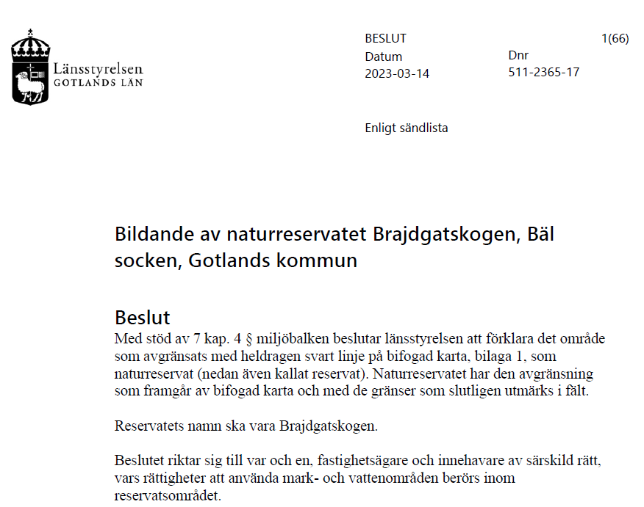
Decision

Slide 12
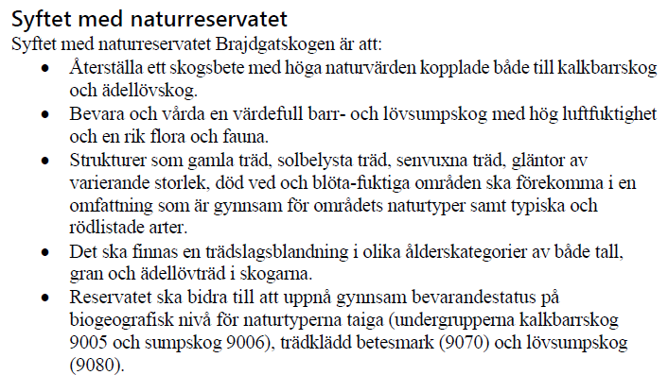
The purpose of the nature reserve
List of nature types,
structures, species

Slide 13
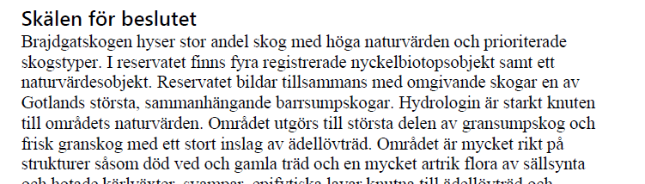
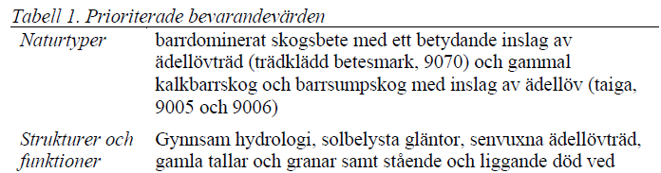
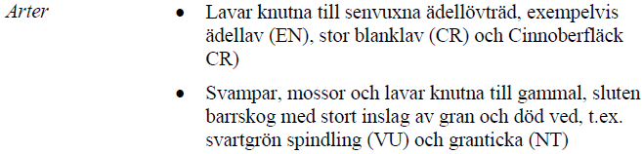
The reasons for the decision
The prioritized conservation values
Nature types
Structures & functions
Species

Slide 14
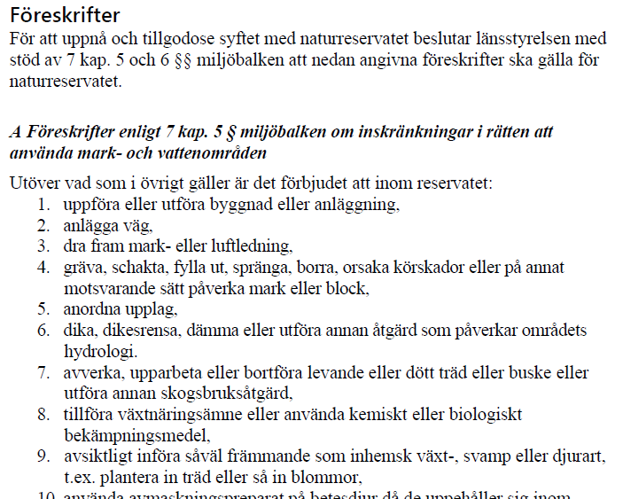
Regulations
Restrictions on the right to use land and water areas
Ban on forestry

Slide 15
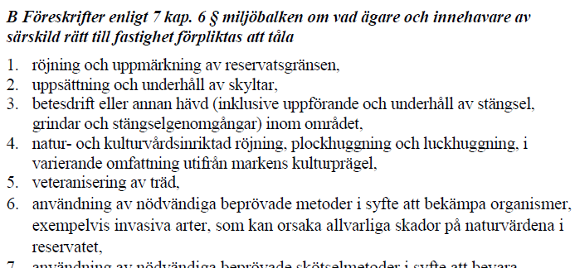
Mandate for the manager of nature reserve

Slide 16
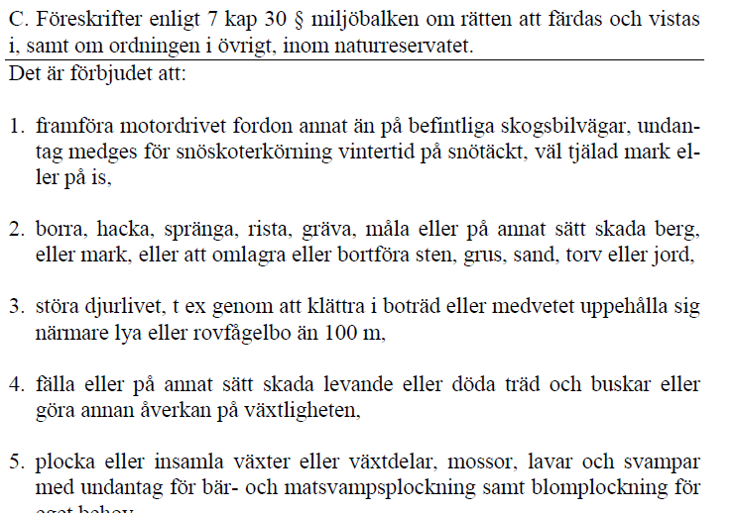
The right to travel and stay in, as well as about the order in general, within the nature reserve.
Not in all nature reserves. This example is from Stöttingfjället nature reserve, Västerbotten county

