Slide 1
Walloon contribution to the Belgian pledge on the EU BS 2030 Target 1 (PA) state of play
Terrestrial biogeographical seminars
Strictly Protected Areas, Brussels, 12-13 November 2024
Tomy Tchatchou & Stéphanie Zaros

Slide 2
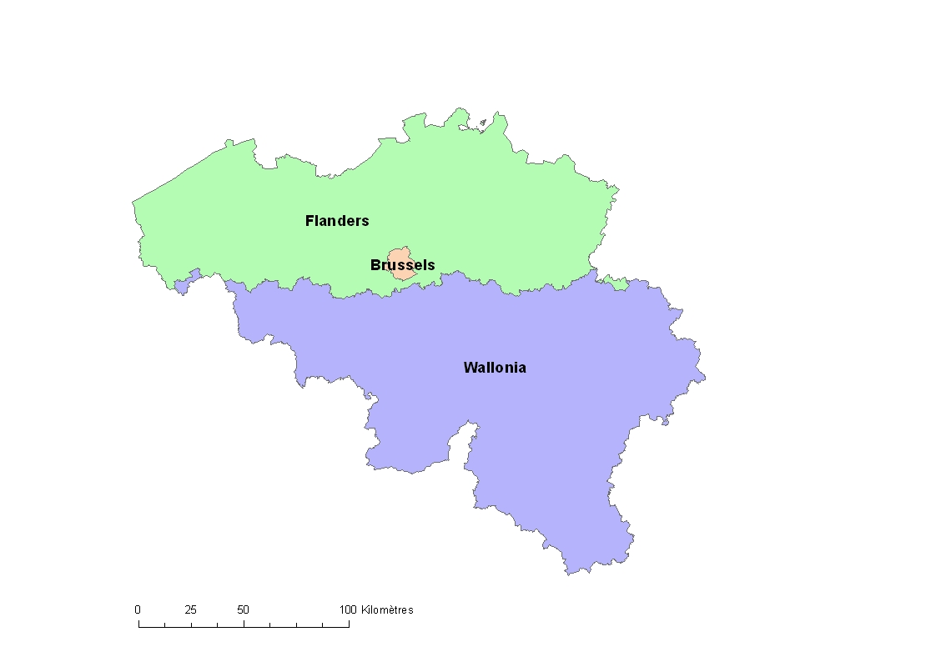
Belgium : 1 Federal State, 3 Regions
BE Context
Nature and biodiversity : regional compétences (WL, VL, BXL + FED)
BE pledge project team:
WL : Tomy Tchatchou, Stéphanie Zaros (DNF)
VL : Carl De Schepper, Thomas Defoort (ANB)
BXL : Mathias Engelbeen (Brussels environnement)
FED : Mieke Degloire, Mathilde Descombes (FPS)
Team assisted by scientists from INBO, DEMNA, RINSB.

Slide 3
WL Context : Walloon institutional framework
Public Service of Wallonia
General Secretary
Budget, Logistic & TIC
Mobility & Infrastructures
Territory, Housing, Heritage, Energy
Interior,
Social action
Economy
Employment
Research
Tax system
Agriculture
Natural Resources Environment

Slide 4
WL Context : Walloon institutional framework
European policy and International Agreements
(DPEAI)
Development, Rural Affairs, Watercourses, animal wellbeing
(DDRCB)
Natural and Agricultural Environment Studies
(DEMNA)
Environment and Water
(DEE)
Agriculture
Natural Resources
Environment
Agriculture
(DAgri)
Permits and Authorisations
(DPA)
Aids
(DA)
Police and Inspections
(DPC)
Soil and Waste
(DSD)
Wildlife and Forestry
(DNF)

Slide 5
Target 1 : PA (30%) – SPA (10%)
3.1. Steps towards the establishment of PA/SPA in Wallonia
Consultation & discussion with other BE entities
Information note →nature Minister on the ongoing process
Draft note from nature service i.e DNF (Wildlife and Forestry Department) & DEMNA (Natural and Agricultural Environmental Studies Department)
Contacts with other services of the PSW → draft proposal 1
Discussion/validation at higher level of administration incl. other services (COD) → draft proposal 2
Administration draft proposal 2 to the Minister of nature
Discussion with the Cabinet of the Minister of nature→1st minister decision : updated note 1
Stakeholders' consultation → updated note 2
Final decision of the Minister of nature on the PA incl. SPA→2nd minister decision : final note
Finalization of Walloon Pledge by our service
Submission of the PA pledge in the Reportnet3 (1st October 2024)
Notes:
I will only address here the target 1 on protected areas including 30% PA of which 10 are strictly protected. Target 2 on the conservation status of degraded habitats and species will be developped here.

Slide 6
3.2. Stakeholders involved
Target 1 : PA (30%) – SPA (10%)
The 18 following stakeholders were involved in the preparation of the pledge (on the updated note 2) & meeting on October 9, 2023) :
- Ardenne et Gaume
- Canopea
- Cercle des naturalistes de Belgique
- Confédération Belge du Bois
- Fédération des jeunes agriculteurs
- Fédération des parcs naturels
- Fediex
- Filière Bois Wallonie
- Fugéa (United Federation of Breeders and Farmers Groups)
- FWA
- LRBPO
- Natagora
- NTF (Rural owners of Wallonia)
- Union des villes et communes de Wallonie (Union of towns and municipalities of Wallonia),
- UNAB (National Union of Belgian Agrobiologists),
- Union wallonne des entreprises
- Société royale forestière de Belgique
- WWF
Notes:
The Minister of nature had decided the stakeholders to be consulted

Slide 7
3.3. 10 % SPA : some data categories
Target 1 : PA (30%) – SPA (10%)
Nature reserves under nature conservation law
Integral reserves under Forest Code walloon 2030 biodiversity strategy target (5%)
Rewilding areas in the 2 walloon national parks
Natura 2000 : the various open management units (MU 1, 2, 3, 4, Temp 1 & Temp 2) included in Natura 2000 network (except MU5) fall within the definition of "strictly protected" areas, mowing and grazing activities being essential for the restauration & management of these open areas. The forest MU 6 & 7 can also fall under this definition, tree felling being subject to authorization in most cases and enrichment with native species being prohibited. Similarly, the conservation/rewilding plots (3%) imposed by the Natura 2000 legislation in forest areas can also be included in the SPA.

Slide 8
3.4. 30 PA % : some data categories
Target 1 : PA (30%) – SPA (10%)
SPA categories &
Nature 2000 : In addition to the MU included in the SPA, the other MU in Natura 2000 network (5, 8, 9, 10, 11, Temp 2 (forest) & Temp 3) are included in the PA (30%)
Hedges : The CAP strategic plan indicates a significant increase in the eco-scheme "ecological mesh", which includes the planting of hedges. Based on this increase and the various incentives for planting that exist, a 20% increase in hedges can be envisaged. These are subject to various protections i.e. Territorial development Code) that also allow them to be considered as protected areas.
OECM : Even if the main objective is not the protection of biodiversity, natural sites classified as heritage and heritage protection zones (Heritage Code), 6m strips along 1st, 2nd and 3rd category watercourses (Water Code), green space zones and natural zones in the sector plan (sector plan legislation) can also be considered as protected areas, given the restrictions that apply in these areas.

Slide 9
3.5. 30-10% : still TBD
Target 1 : PA (30%) – SPA (10%)
Certain categories will be subject to consultation with stakeholders incl. subnatural ancient forests (eq. old-growth forests?) and sites of great biological interest (SGIB) which are not protected

Slide 10
3.6. Methodology : data analysis from cross mapping
Target 1 : PA (30%) – SPA (10%)
Start : extraction of area data from the nature reserves under the nature conservation law reported in the CDDA
Then :
adding the areas of the other sites, having subtracted what is already covered by the previous areas of the sites proposed to avoid duplication.
distribution in the categories 10% and 30% is proposed.
End : Filling in template and breaking down the data by ATL and CONT biogeographical regions

Slide 11
3.6. Methodology : data analysis from cross mapping
Target 1 : PA (30%) – SPA (10%)
Nature reserves until 31/12/2022 (RF, CSIS, RNA, RND, ZHIB) | Table 1.3 SPA
Rewildering areas in the 2 walloon national parks | Table 5 : OECM or future nature reserves by 2026
Integral biological reserves (RBI of the forest code) | Table 5 : OECM or future nature reserves
Natura 2000 conservation areas declared to SIGEC in the public and private domain | not counted because already included in Natura 2000
Natura 2000 management units 1,2,3,4,6,7 + Temp2 (meadow)+Temp1 | Table 4.2 SPA par sites
Other Natura 2000 management units (UG 5, 8, 9, 10, 11 + Temp2 (forêt) + Temp3) | Table 1.1 PA
Permanent grassland with AECM (MB1a) = Hedges | Table 5 OECM
Natural heritage sites | Table 5 OECM
Heritage protection zones | Table 5 OECM
6 meters strip along 1st, 2nd and 3rd category watercourse | Table 5 OECM
Green space zones and natural zones in the Sector Plan | Table 5 OECM

Slide 12
Target 1 : PA (30%) – SPA (10%)
3.7. Glossary
Nature reserves until 31/12/2022 (RF, CSIS, RNA, RND, ZHIB) | Groups approved and state-owned nature reserves, forest reserves and cavities of scientific interest under the nature conservation law
Rewildering areas in the 2 walloon national parks | Same meaning;
Integral biological reserves (RBI of the forest code) | Integral reserves under the forest code
Natura 2000 conservation areas declared to SIGEC in the public and private domain | Conservation/rewilding plots (3%) declared in the EC integrated management and control system (SIGEC) in the public domain, not counted because included in N2000
Natura 2000 management units (MU) 1,2,3,4,6,7 + Temp2 (meadow)+Temp1 | Groups together the Natura 2000 management units that have sufficient conservation measures to be classified as strictly protected areas (SPA): MU1 = Aquatic areas & wetlands MU2 = Priority open areas; MU3 = Species habitat meadows; MU4 = Extensive strips; MU6 = Priority forests; MU7 = Alluvial priority forests; MU Temp1 = Areas under protection status; MU TEMP2 = Areas under public management. Only the MU2 belonging to the UG TEMP2 are included here ;

Slide 13
Target 1 : PA (30%) – SPA (10%)
3.7. Glossary
Other Natura 2000 management units (MU) (UG 5, 8, 9, 10, 11 + Temp2 (forest) + Temp3) | Groups the other management units. They are included in PA. MU5 = Connecting meadows; MU8 = Native forests of great biological interest; MU9 = Species habitat forests MU TEMP2 = Areas under public management, outside MU2; MU TEMP3 = Beech forests with woodrush and other undifferentiated broadleaves; MU10 = Non-native connecting forests; MU11 = Cropland and anthropogenic elements.
Permanent grassland with AECM (MB1a) = Hedges | Estimated surface areas of the hedges, calculated on a 5m buffer on the linear hedges in MU1a “Hedges and tree lines”.
Natural heritage sites | Groups together the natural sites classified as heritage under the Walloon Heritage Code.
Heritage protection zones | Groups together heritage protection zones under the Walloon Heritage Code.
6 meters strip along 1st, 2nd and 3rd category watercourse | Groups together permanent plant cover areas, composed of woody or herbaceous vegetation over a width of 6m around watercourses of 1st, 2nd and 3rd category, under the Walloon Water Code.
Green space zones and natural zones in the Sector Plan | Groups together green and natural space areas in the sector plan

Slide 14
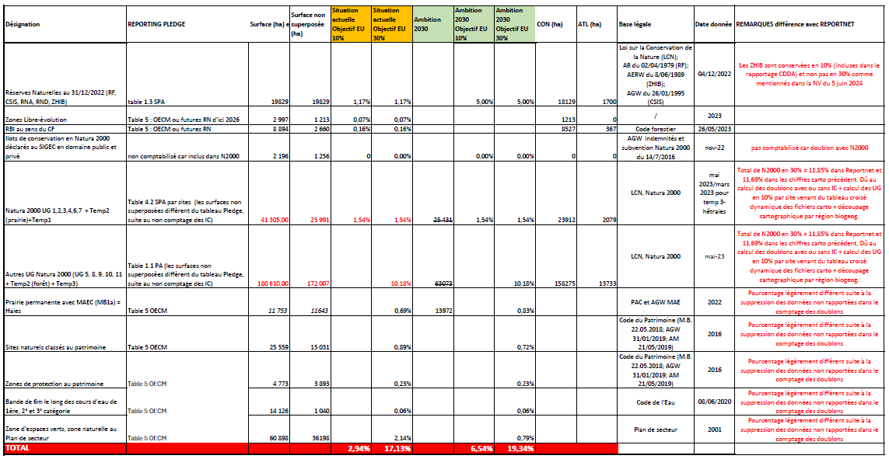
Target 1 : PA (30%) – SPA (10%)
3.8. First data submitted in Reportnet3

Slide 15
Management units (MU) under Natura 2000
A few words on the Natura 2000 management units
Regulatory approach
The backbone : Management units (MU)
MUs include habitats and species of CI
MUs determine management/conservation measures
MUs activate allowances for compensation

Slide 16
Management units (MU) under Natura 2000
A few words on the Natura 2000 management units
Regulatory approach
Measures
General prevention
Specific (MUs)
Legal Acts
(government decrees of march 11, 2011 & may 19, 2011)
3 levels : Banning
Authorisation
Notification

Slide 17
Management units (MU) under Natura 2000
A few words on the Natura 2000 management units
A management unit is a "perimeter, in one piece or not, located within a Natura 2000 site that requires generally homogeneous conservation measures, and which is delimited according to ecological, technical and/or socio-economic criteria“
11 types of management units (MU) have been determined, as well as 2 "overprinted" management units and 3 units with special status (temporary management units).
The decree gives an exhaustive list of the natural habitats and species concerned by each management unit.
In addition, each type of management unit is subject to specific prohibitions and preventive conservation measures to avoid deterioration of HCI and significant disruptions affecting SIC.

Slide 18
Management units (MU) under Natura 2000
A few words on the Natura 2000 management units (MU)
For example, MU 1 "Aquatic areas & wetlands " consists of aquatic areas with running or stagnant water and wetlands.
These include natural dystrophic lakes and ponds, rivers with muddy banks, or the breeding, wintering, resting and/or feeding habitats of pearl mussel, thick-shelled mussel, crested newt.
In MU 1,
the following acts are prohibited:
changes to the ground relief (except recharging);
the total or partial backfilling of ponds, bodies of water, dead arms, damp depressions (including with dredging or cleaning materials);
the following acts are subject to authorisation:
any transformation or enrichment with non-native species;
any introduction of fish into specific bodies of water;
the following acts are subject to prior notification:
the carrying out of ordinary cleaning, maintenance and repair work on watercourses and all surface waters of the site, except when this work is provided for in a management plan;
any planting or replanting of trees or shrubs. This measure does not apply to the replanting of poplars at least seven metres apart.

Slide 19
Management units (MU) under Natura 2000
A few words on the Natura 2000 management units (MU)
The MU 2 "Priority open areas" is made up of open natural habitats, wet or dry, of exceptional biological interest, of great biological interest or of biological interest.
These include in particular alkaline low peat bogs, wet pastures of biological interest, caves not exploited by tourism, or the breeding, wintering, resting and/or feeding habitats of the Short-eared Owl or the Bluethroat.
In MU 2,
the following acts are prohibited:
the storage and spreading of any amendment and any mineral or organic fertilizer, including manure, droppings, slurry, slurry, compost, sewage sludge, septic tank sludge;
overseeding in meadows except for one-off and localized work to restore wild boar damage;
any grazing and mowing between November 1 and June 15, except when these actions are provided for in a management plan;
changes to the relief of the soil (except refilling);
any mowing that does not maintain unmown refuge strips representing at least five percent of the total surface area of ​​the plot;
is subject to authorization;
livestock feeding
are subject to prior notification:
oversowing in meadows when it involves one-off and localized work to restore damage caused by wild boars;
any planting or replanting of trees or shrubs. This measure does not apply to the replanting of poplars at least seven meters apart.

Slide 20
Management units (MU) under Natura 2000
A few words on the Natura 2000 management units (MU)
In addition to the two MU presented above, the decree defines the following other MU :
MU 3 "Species habitat meadows";
MU 4 "Extensive strips";
MU 5 "Connection meadows";
MU 6 "Priority forests";
MU 7 "Priority alluvial forests";
MU 8 "Native forests of great biological interest";
MU 9 "Species habitat forests";
MU 10 "Non-native connection forests";
MU 11 "Cropland and anthropogenic elements".
Overprinted management units (MU S) for):
“Pearl mussel and thick mullet” (MU S1)
“Succise checkerboard” (MU S2),
“Temporary management units which are :
the “Zones under protection status” (MU temp 1),
the “Zones under public management” (MU temp 2)
the “Beech forests with woodrush and other undifferentiated broadleaves” (MU temp 3).

Slide 21
Management units (MU) under Natura 2000
A few words on the Natura 2000 management units
The Natura 2000 management units are built around the mapping of :
EUR 15 Habitats
Eunis Habitats
Habitats for species
MANAGEMENT UNITS

Slide 22
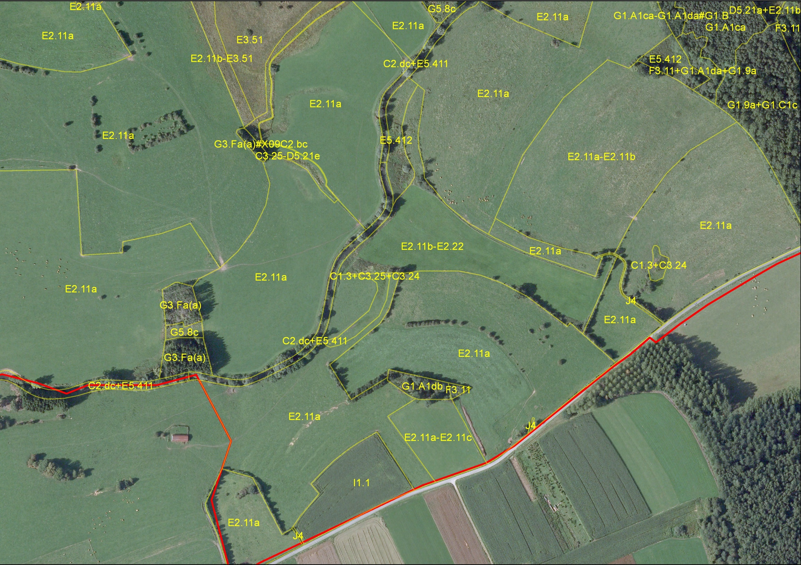
WALEUNIS HABITATS MAPPING

Slide 23
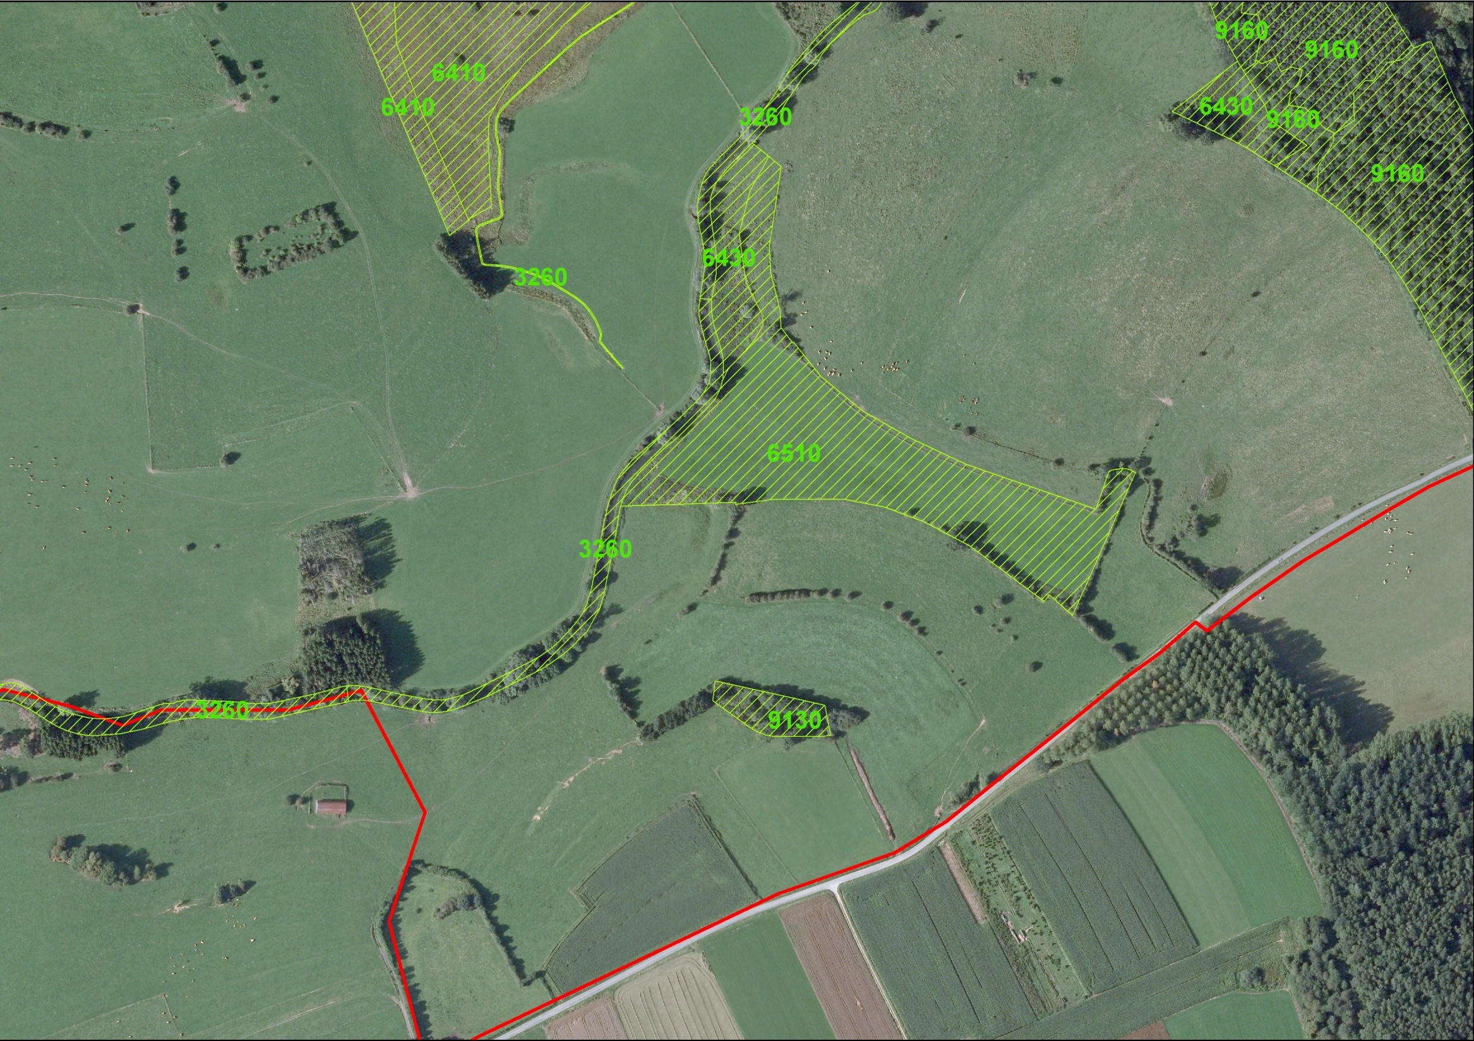
Eur15 HABITATS MAPPING

Slide 24
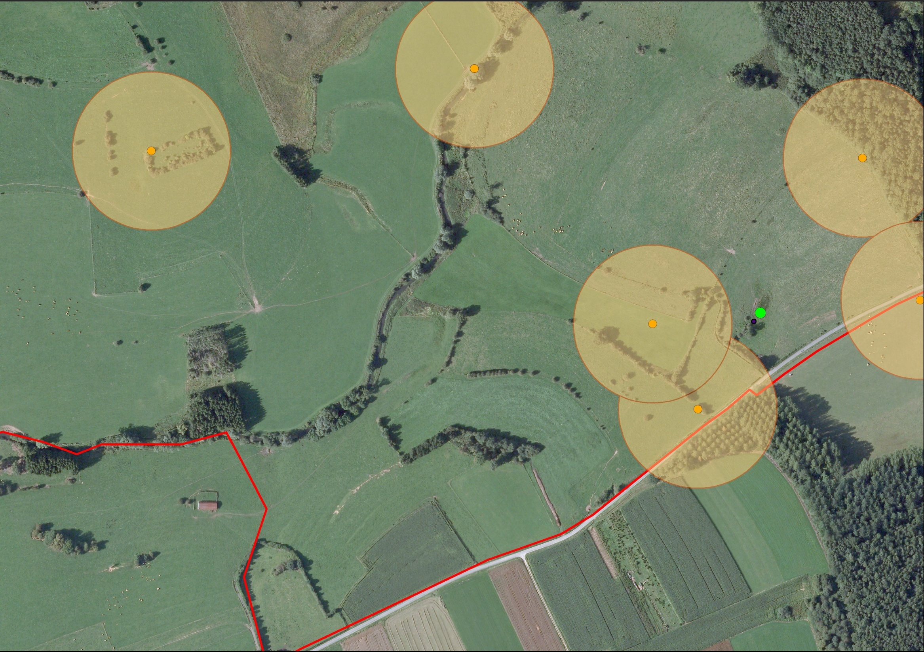
MAPPING of species of CI
Cantons de Pie-grièches écorcheurs
(Cantons of Red-backed Shrikes)
Mare à triton crêté
(Crested Newt Pond)

Slide 25
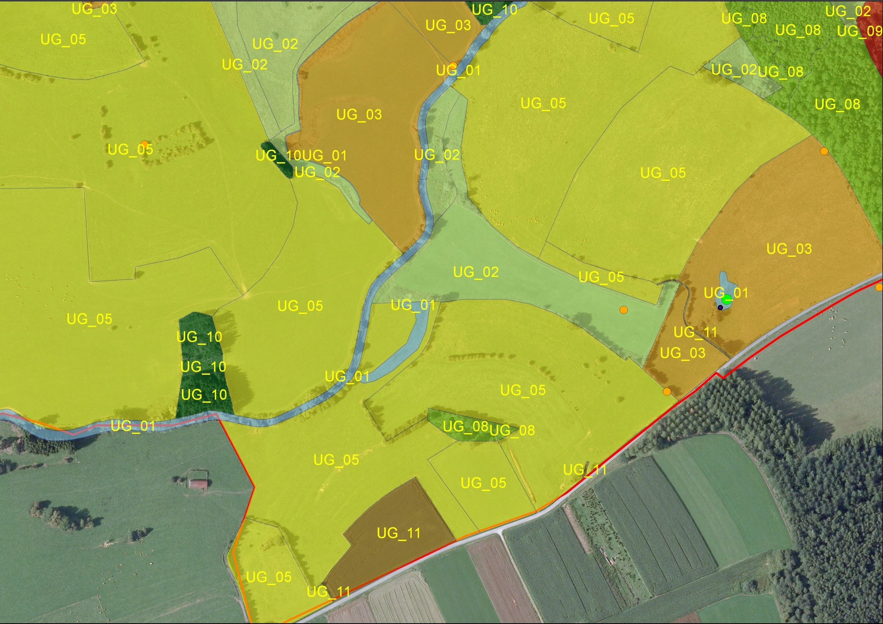
MAPPING of MANAGEMENT UNITS

Slide 26
Thanks
for your attention

